Slide 1
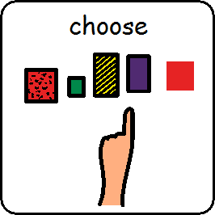
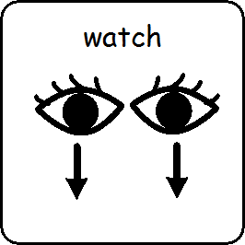
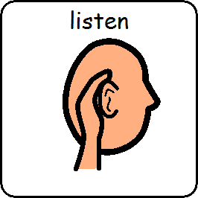
I am learning to choose, watch and listen to stories.

Slide 2
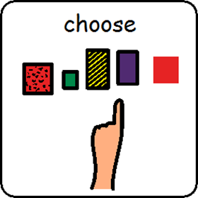
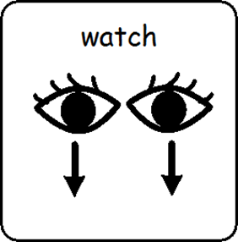
I am learning to choose, watch and listen to a story.
https://www.youtube.com/watch?v=Waoa3iG3bZ4

Slide 3
I am learning to choose, watch and listen to a story.
https://www.youtube.com/watch?v=UCYMMUYRQdc

Slide 4
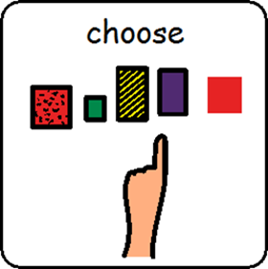
I am learning to choose, watch and listen to a story.
https://www.youtube.com/watch?v=9PBH7lFN_Yc

Slide 5
I am learning to choose, watch and listen to a story.
https://www.youtube.com/watch?v=pJL8AVBpHaA

Slide 6
I am learning to choose, watch and listen to a story
https://www.youtube.com/watch?v=Lz1oQedvO4M

Slide 7
I am learning to choose, watch and listen to a story is finished

