Slide 1
Croissants

Slide 2
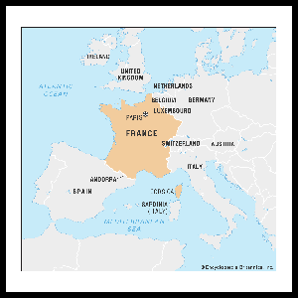
I am learning about France

Slide 3
Ingredients

Slide 4
I am learning to make croissants

Slide 5
I am learning to make croissants

Slide 6
I am learning to make croissants

Slide 7
I am learning to make croissants

Slide 8
Tidy up

