Slide 1
Sensory Science

Slide 3
Rainbow milk
https://www.youtube.com/watch?v=jUxOCPDP5rc&safe=active
I am learning to answer questions about what I have watched or listened to. (LIT 2-07a).
(SS/EM/JT).
Success criteria:
I can select appropriate visual from a choice of two to answer questions about a range of information sources.

Slide 5
Materials Needed
I am learning to share out items equally.(MNU 1-07b)
Full fat milk
A bowl
Food colouring
Kitchen roll
Washing up liquid.

Slide 6
How To
Pour milk into beaker
2. Pour milk into bowl.
3. Use pipette to drop food colouring into the milk.
4. Roll up kitchen roll.
5. Dip kitchen roll into dish soap.
6. Dip this into the milk.
.

Slide 7
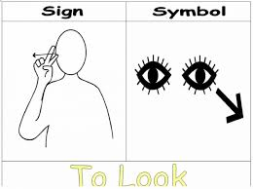
Look as the colours move
The washing up liquid bonds with the fat in the milk so strongly that the water and food colouring are pushed out.
The swirling effect is everything making way for the milk and washing up liquid.

Slide 8
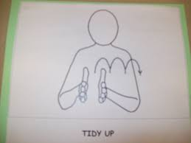
Tidy up
Wash equipment at sink.
Put items back in the box
Wipe the table

Slide 9
Sensory Science
is finished.

