Slide 1
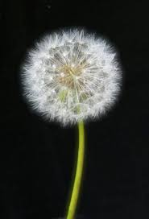
Dandelion Clock Math

Slide 2
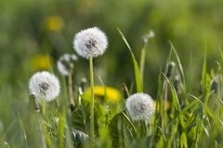
Dandelion Clock Maths

Slide 3
Dandelion Clock Maths

