Slide 1
Rebound Therapy

Slide 2
I am learning to work through grade 1 of my rebound therapy.

Slide 3
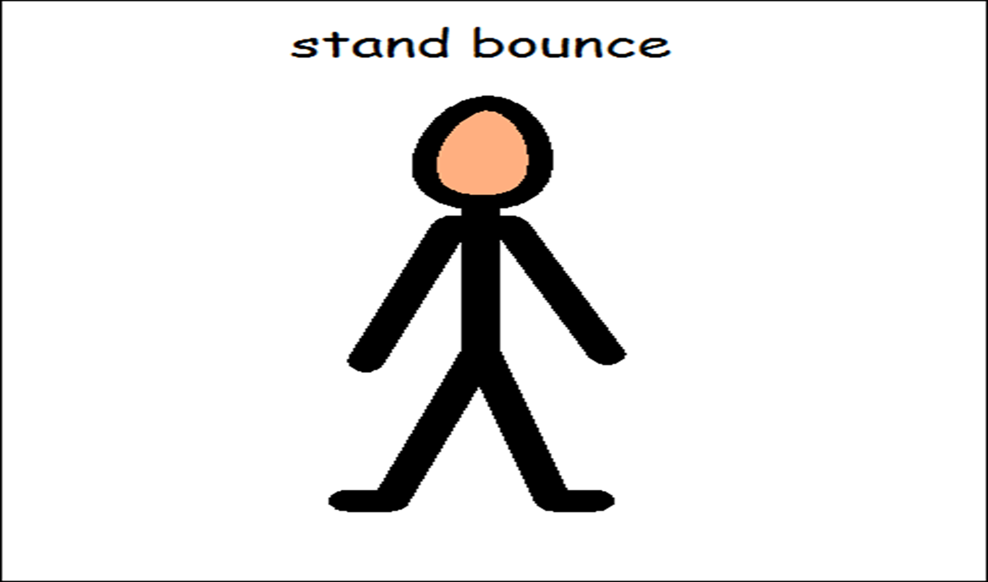
Warm Up Bounce

Slide 4
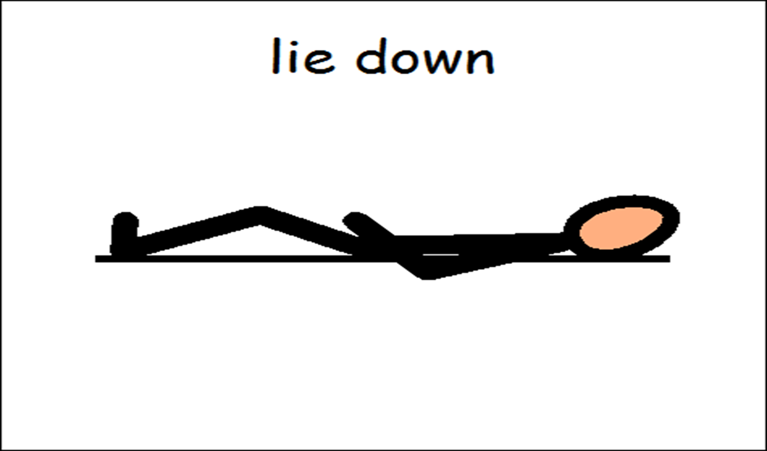
Instruct Daryl to lie still on the trampoline

Slide 5
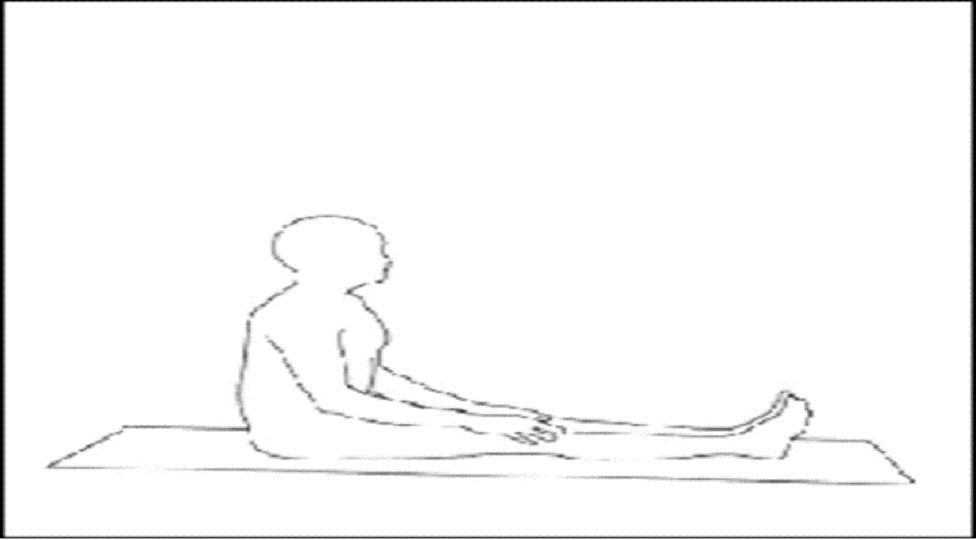
Instruct Daryl to sit still on the trampoline

Slide 6
Check for listening.
Bounce for the count of 5 then ask Daryl to stop.
Repeat 4 times to check that Daryl is listening.

Slide 7
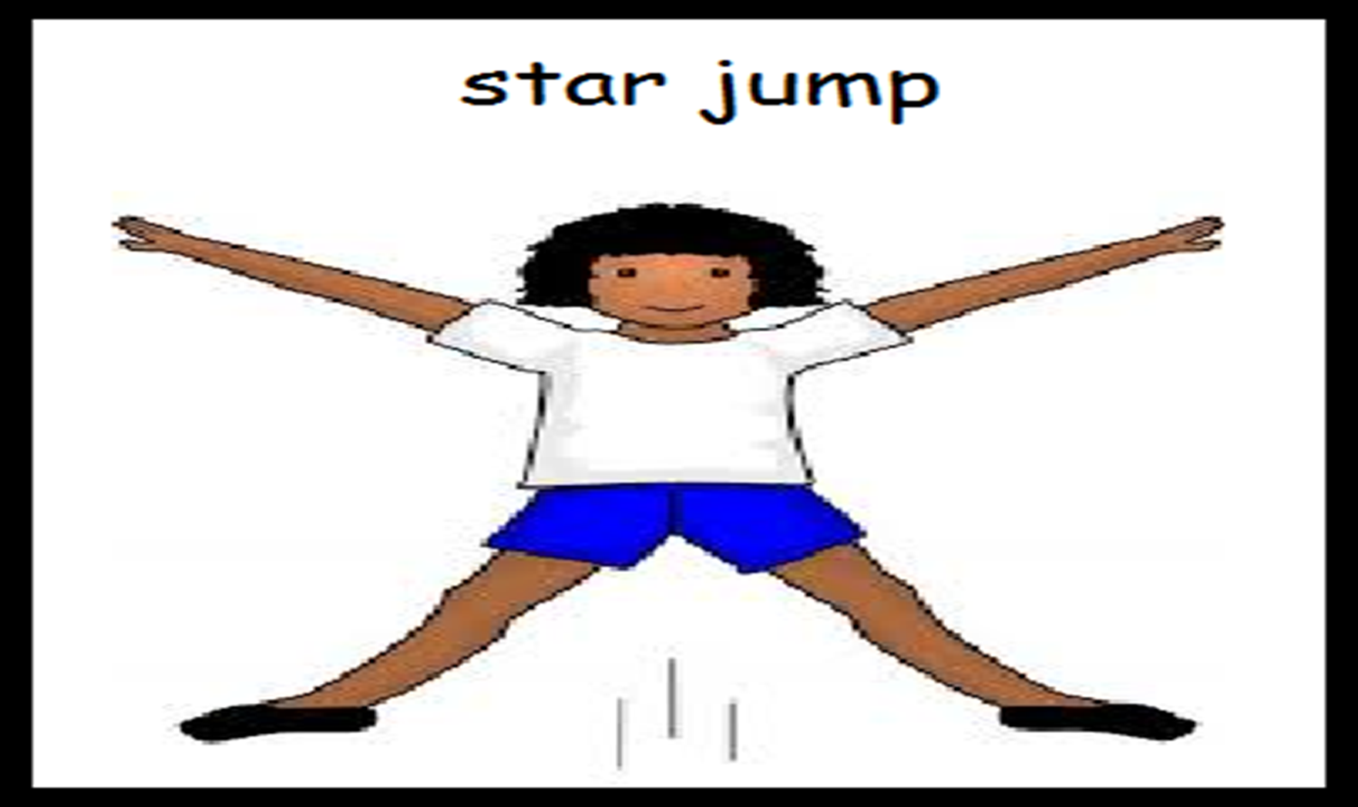
Show and hold a star position whilst standing up.
Ask Daryl- ” Daryl, show me star”. Use this language.

Slide 8
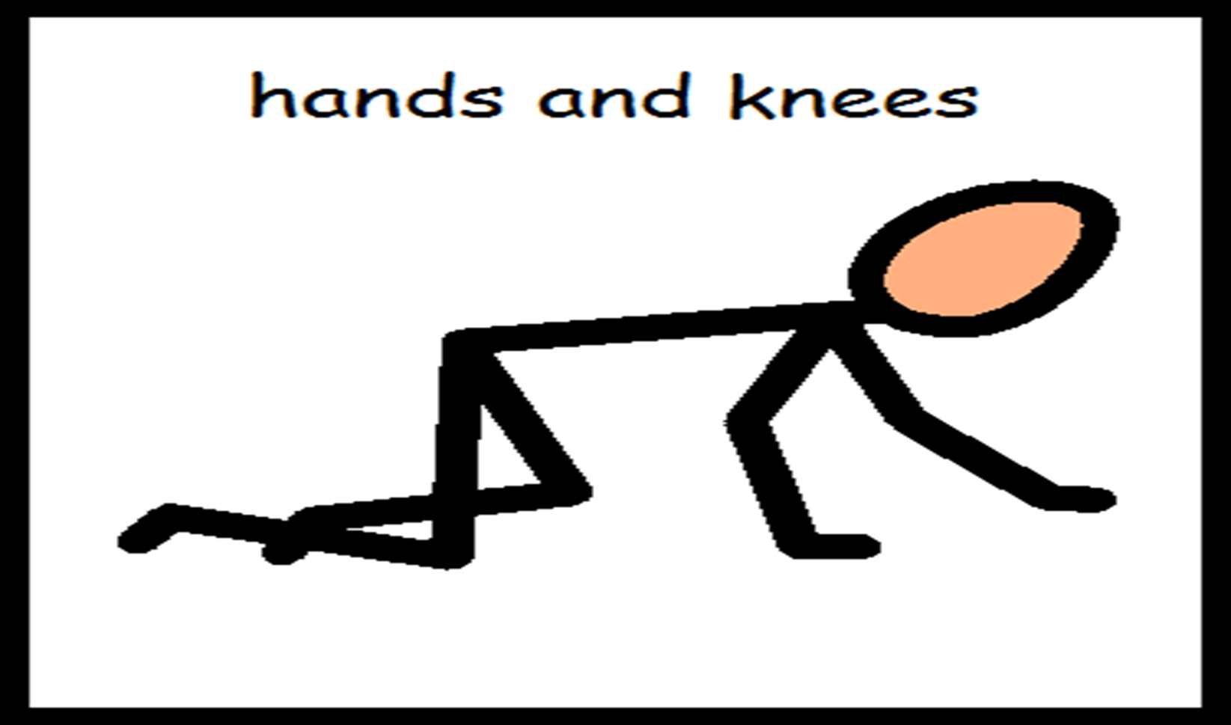
Get into hands and knees position. Assist Daryl if required to get into hands and knees position beside you on trampoline.

Slide 9
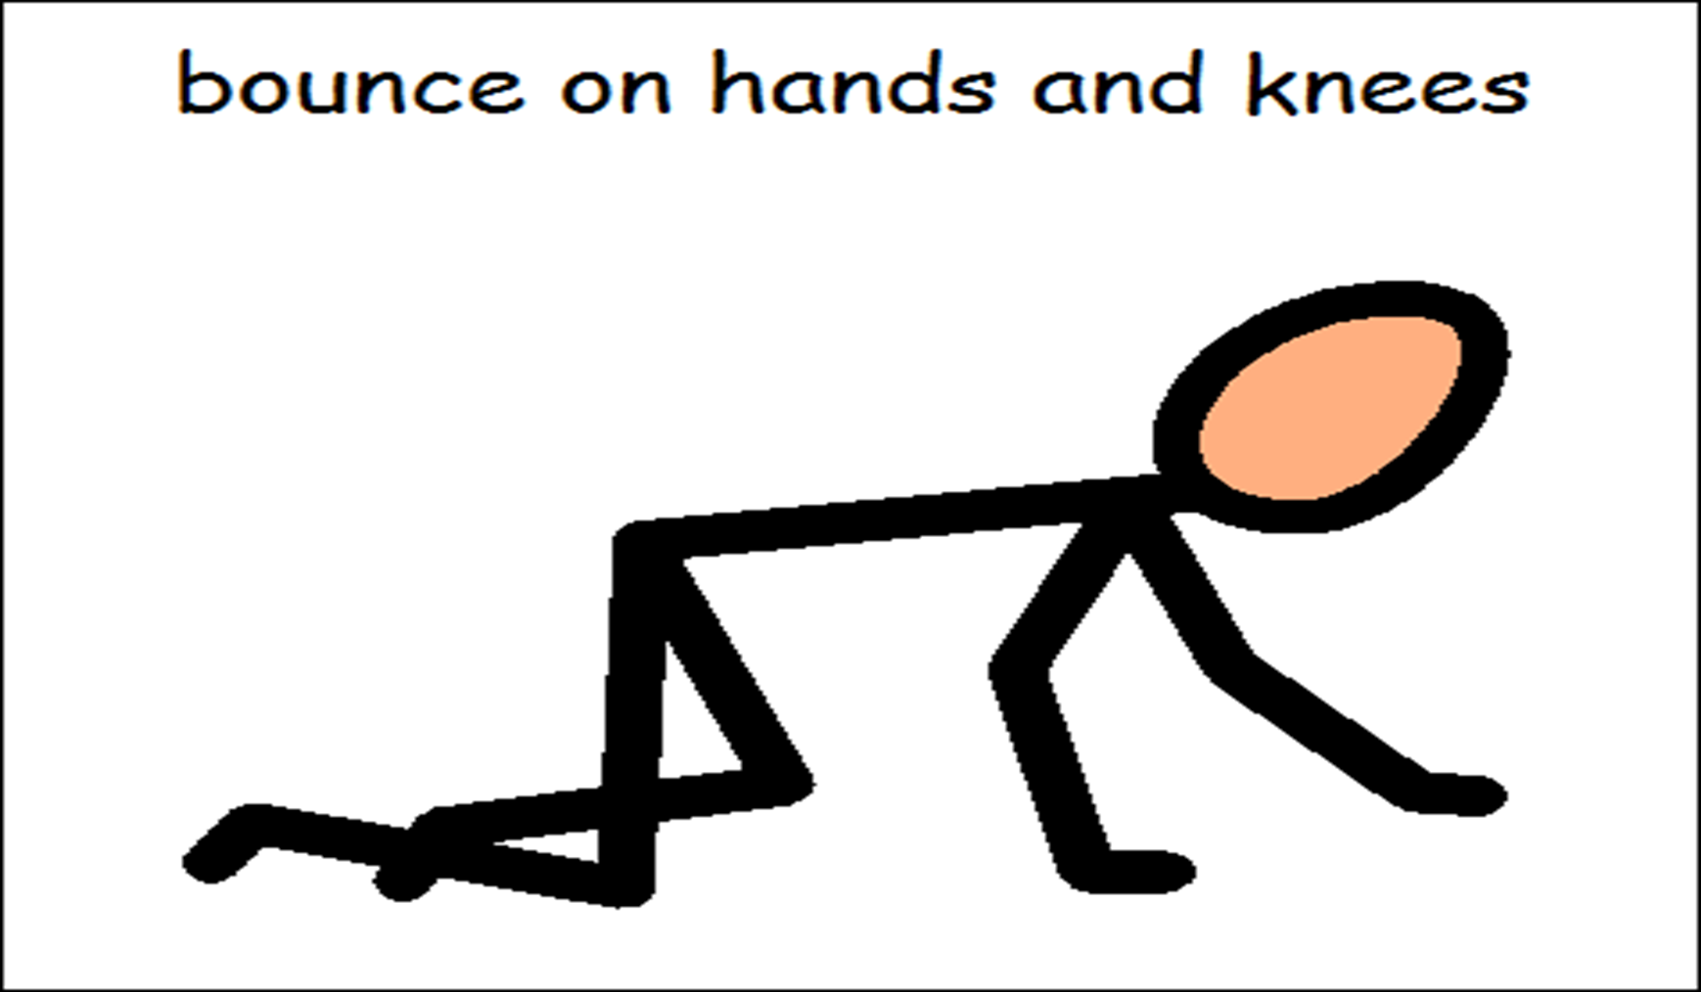
When in hands and knees position and sustaining it, instruct Daryl to bounce.
Language used “Daryl bounce”. Demonstrate if required.

Slide 10
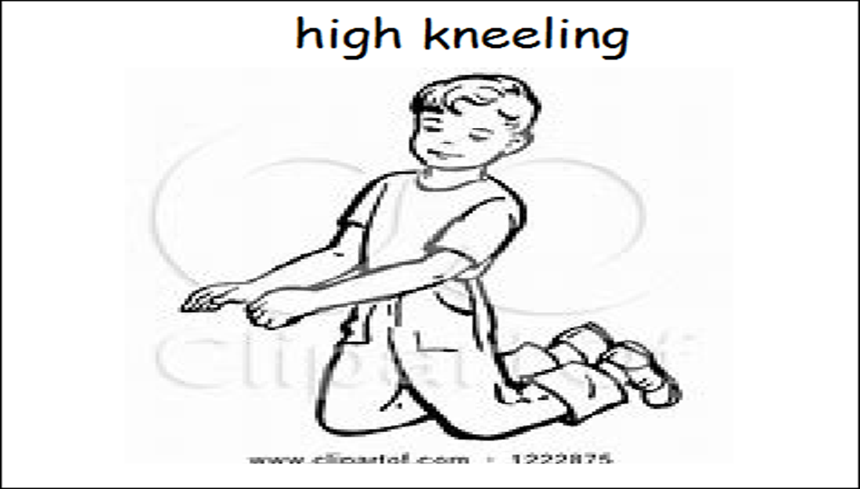
Get into high kneeling position. Language used “Daryl knees”
Help Daryl if he requires it.

Slide 11
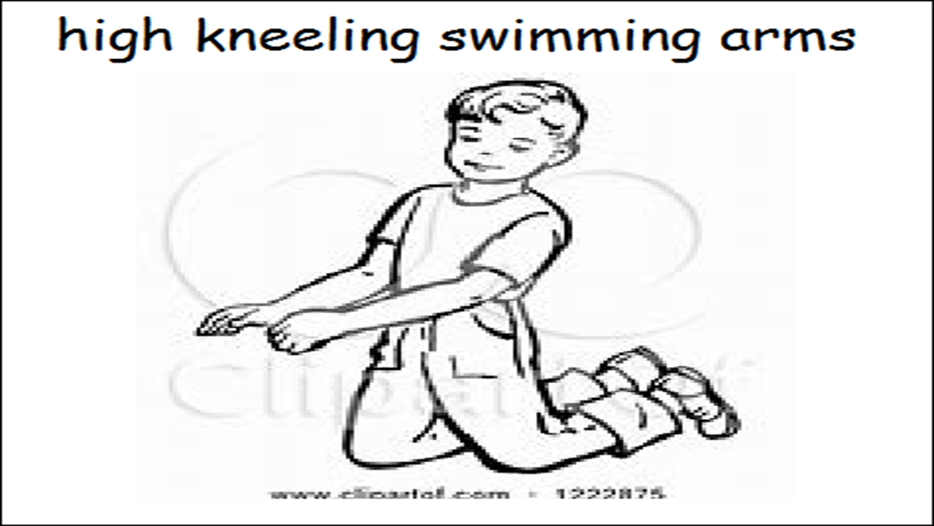
Once in position and sustaining it, instruct Daryl to circle arms. Language used ”Daryl, swimming arms” or “Daryl circles”

Slide 12
Cool down bounce

Slide 13
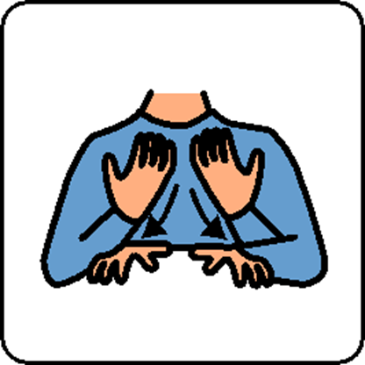
Rebound is finished

