Slide 1
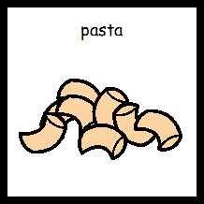
Cooked Pasta

Slide 2
Put on apron

Slide 3
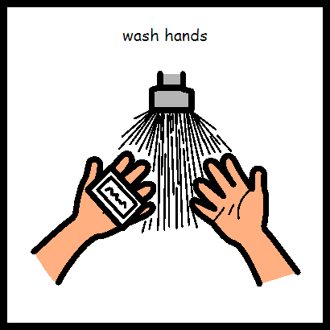
Wash hands

Slide 4
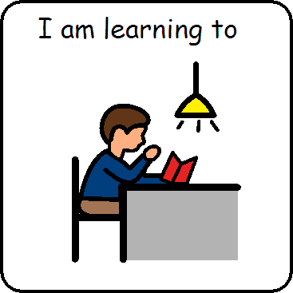
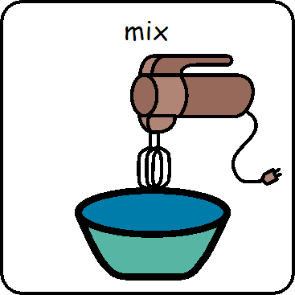
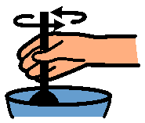
I am learning to mix

Slide 5
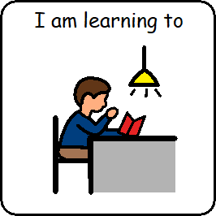
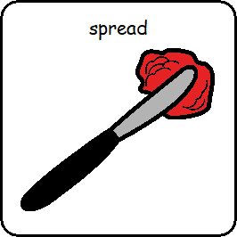
I am learning to chop

Slide 6
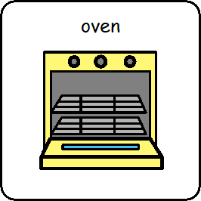
Chop the pepper

Slide 7
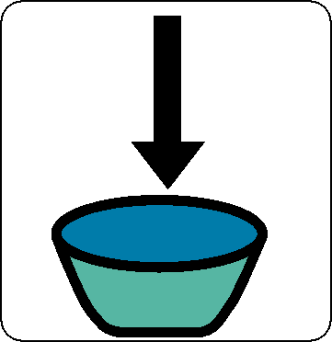
Put the chopped pepper into the bowl

Slide 8
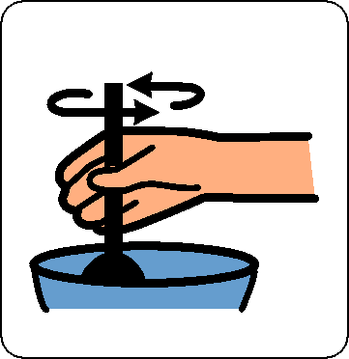
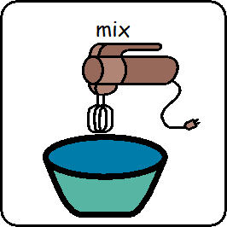
Mix

Slide 9
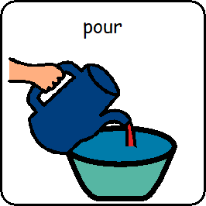
Chop the tomato

Slide 10
Put the chopped tomato into the bowl

Slide 11
Mix

Slide 12
Chop the chives

Slide 13
Put the chopped chives into the bowl

Slide 14
Mix

Slide 15
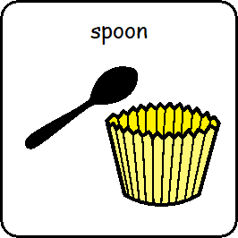
Pour ¼ of a cup of olive oil and ¼ of a cup of herbs (e.g. basil or mixed herbs) into the bowl

Slide 16
Mix

Slide 17
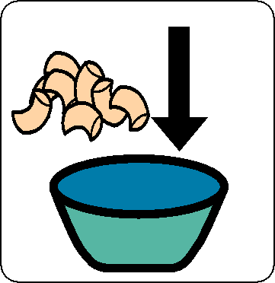
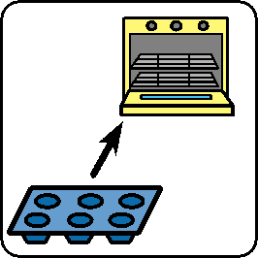
Pour cooked pasta into the bowl.

Slide 18
Mix

Slide 19
You have been learning to chop

Slide 20
You have been learning to mix

Slide 21
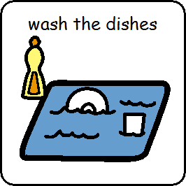
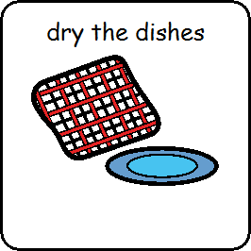
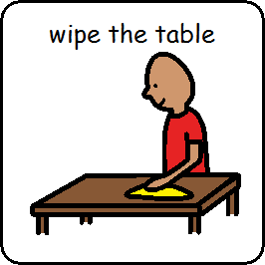
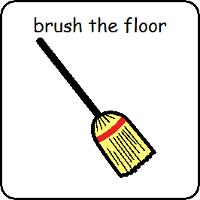
Tidy up

Slide 22
Home Economics is finished

