Slide 1
Rebound Therapy

Slide 2
I am learning to work through grade 1 of my rebound therapy.

Slide 3
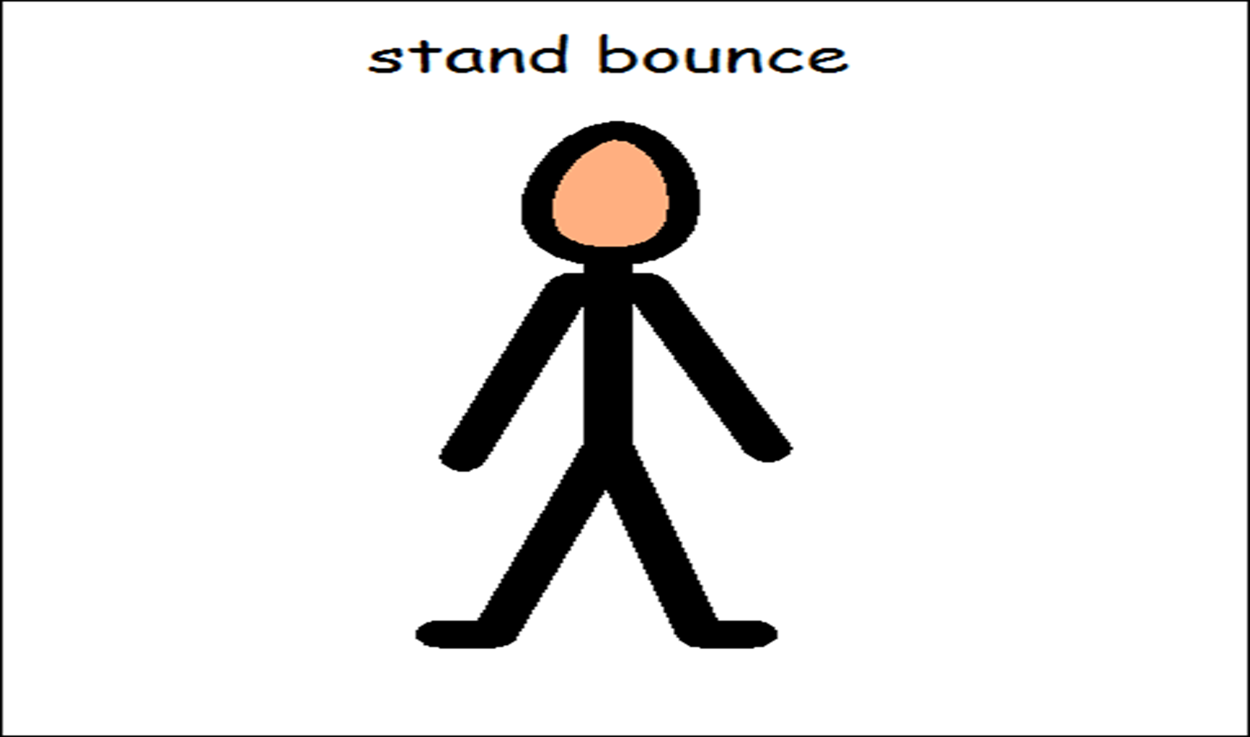
Warm Up Bounce

Slide 4
Check for listening.
Bounce for the count of 5 then ask Ciaran to stop.
Repeat 4 times to check that he is listening.

Slide 5
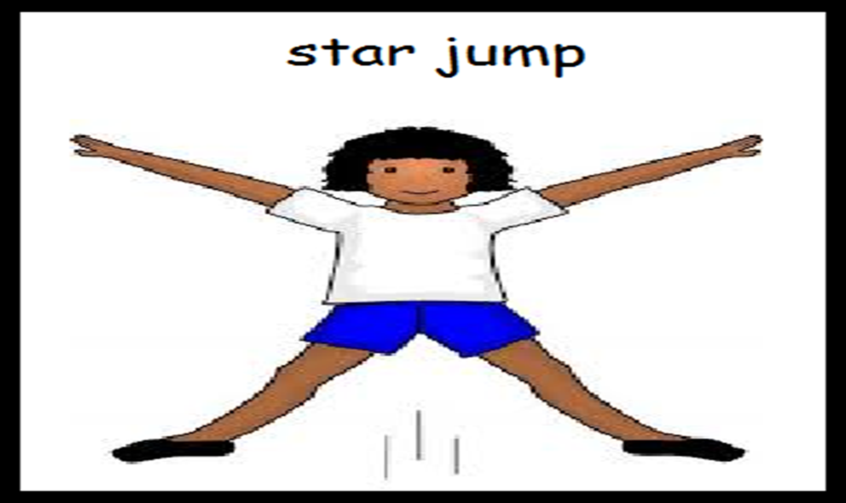
Show and hold a star position whilst standing up.
Ask Ciaran- ” Ciaran, show me star” Use this language.

Slide 6
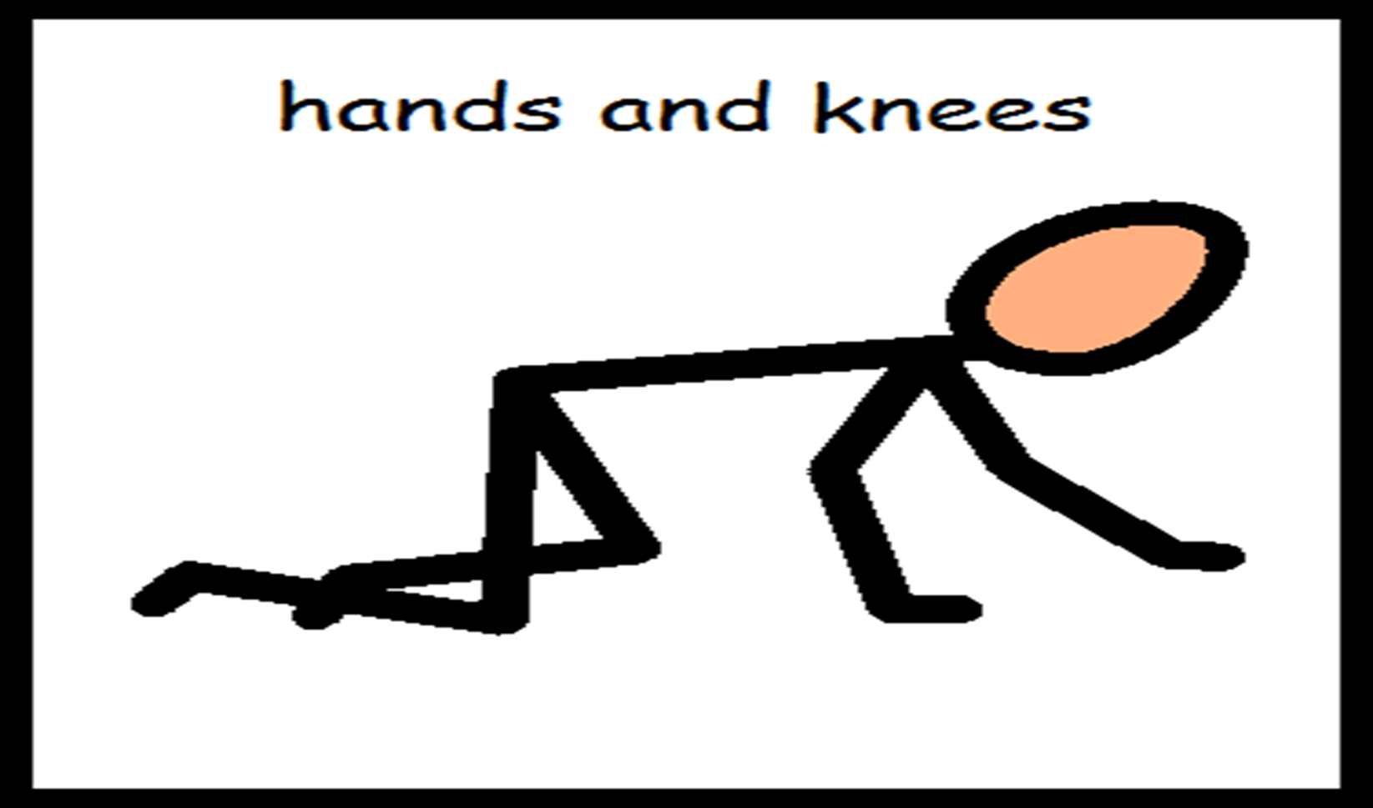
Get into hands and knees position. Assist Ciaran if required to get into hands and knees position beside you on trampoline.

Slide 7
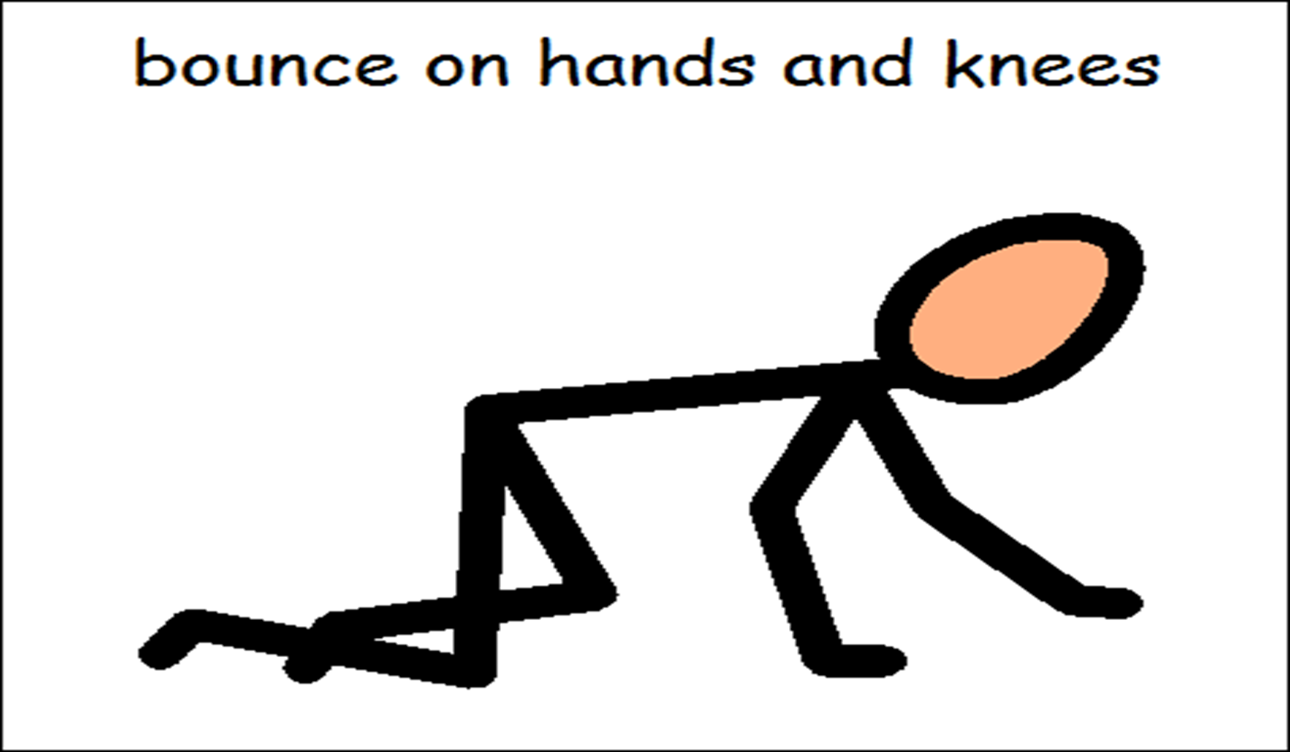
When in hands and knees position and sustaining it, instruct Ciaran to bounce.
Use language “Ciaran, bounce”. Demonstrate if required.

Slide 8
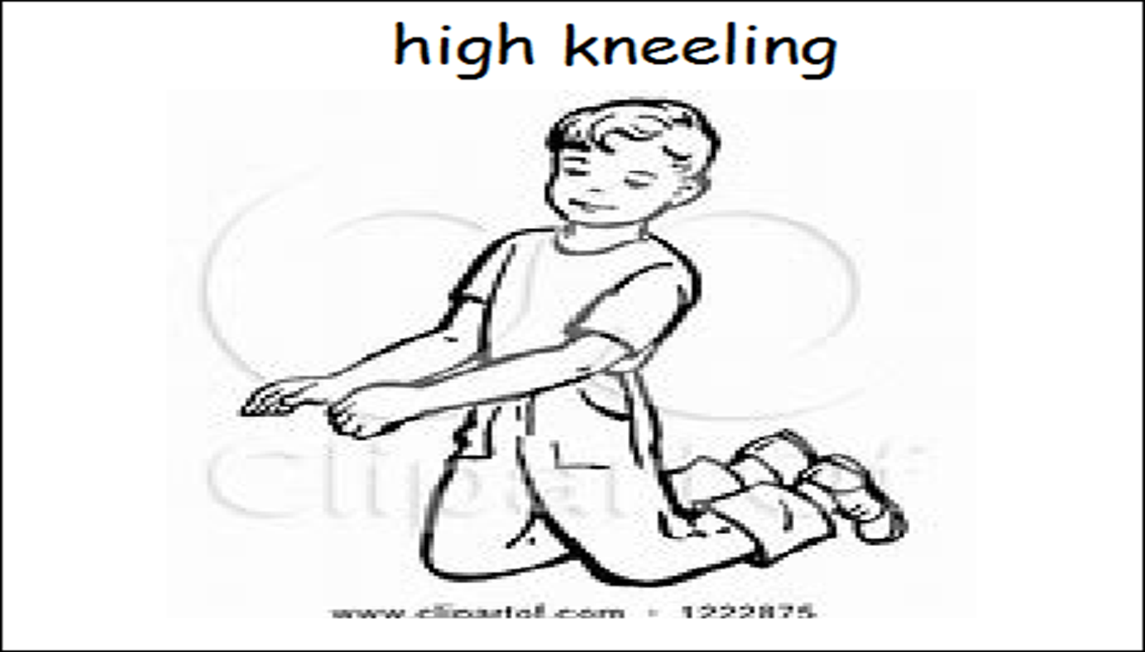
Get into high kneeling position. Language used “Ciaran, knees”
Help Ciaran if he requires it.

Slide 9
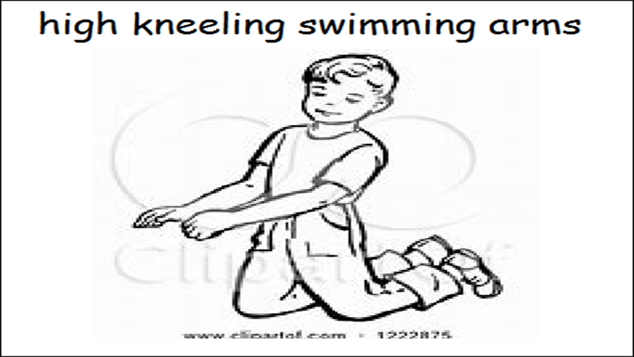
Once in position and sustaining it, instruct Ciaran to circle arms. Language used ”Ciaran, swimming arms” or “Ciaran, circles”

Slide 10
Cool down bounce

Slide 11
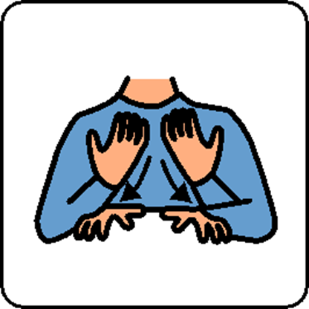
Rebound is finished

