Slide 1
Movie Club Maths

Slide 2
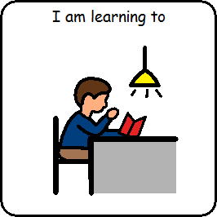
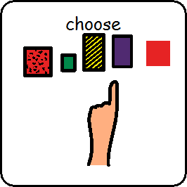
I am learning to choose a movie to watch

Slide 3
I am learning to make a poster

Slide 4
Make a poster to advertise the movie

Slide 5
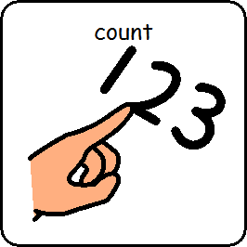
I am learning to count how many are coming to watch the movie

Slide 6
Movie Club Maths is Finished

