Slide 1
Biscuits

Slide 2
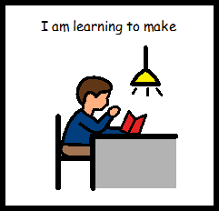
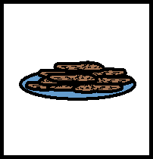
I am learning to make biscuits

Slide 3
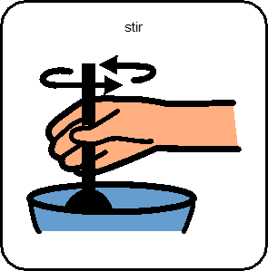
I am learning to stir

Slide 4
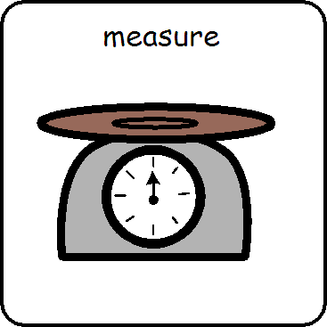
I am learning to measure

Slide 5
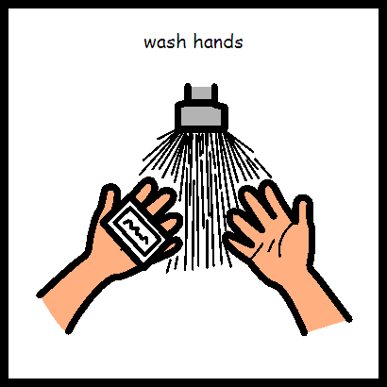
Wash hands

Slide 6
Put on apron

Slide 7
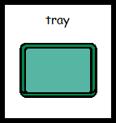
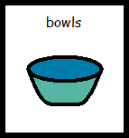
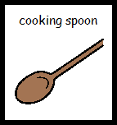
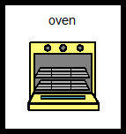
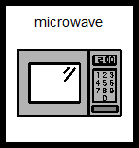
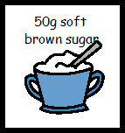
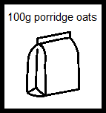
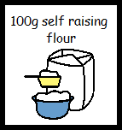
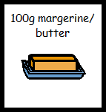
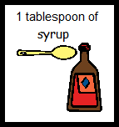
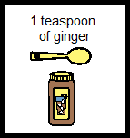
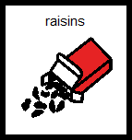
What do we need?

Slide 8
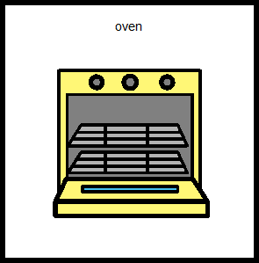
Set oven to 180 degrees celsius

Slide 9
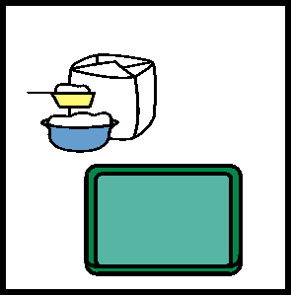
Flour or grease and line the baking trays

Slide 10
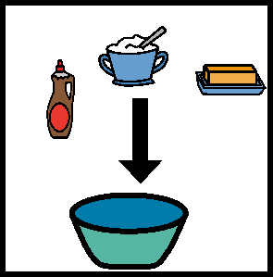
Put 100g of margarine, a table spoon of syrup and 50g of sugar into bowl

Slide 11
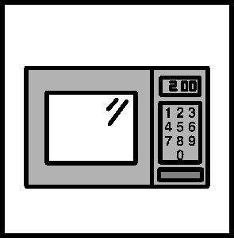
Melt the margarine, sugar and syrup in the microwave for a few seconds

Slide 12
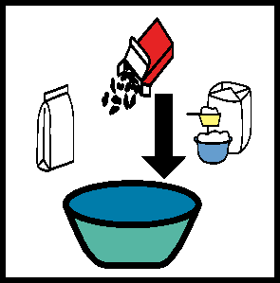
Add to the bowl the 100g of flour, raisins, 100g of porridge oats and 1 tea spoon of ginger

Slide 13
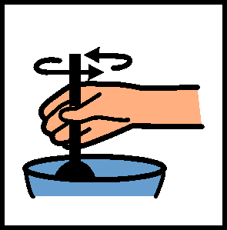
Mix all the ingredients

Slide 14
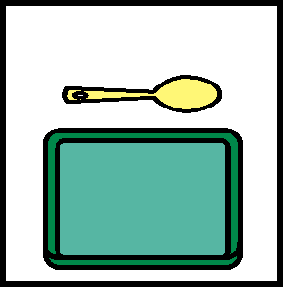
Put dessert spoons of mix onto baking tray, with space for the biscuits to spread and flatten a little

Slide 15
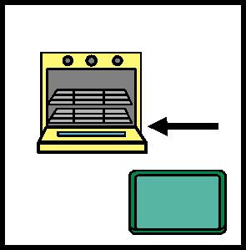
Put tray into oven for 15/20 minutes or when biscuits look golden

Slide 16
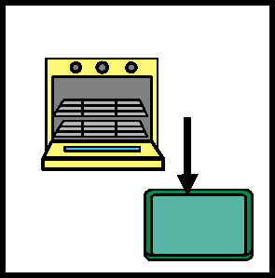
Remove tray from oven, when cool enough to touch. Place biscuits on a cooling rack.

Slide 17
You have made biscuits

Slide 18
Enjoy your biscuits

Slide 19
Making biscuits is finished

Slide 20
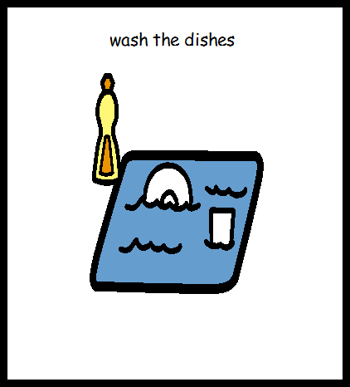
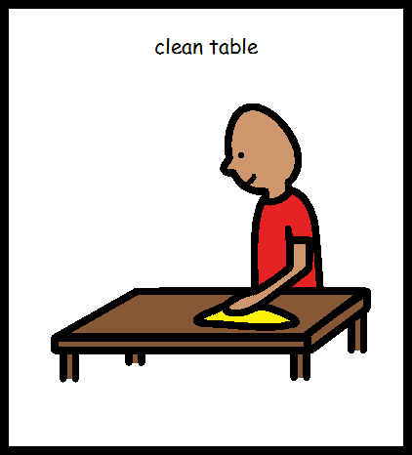
Tidy up

