Slide 1
I am learning about French Art

Slide 2
Take a virtual tour of the Louvre Museum in Paris
https://www.youtube.com/watch?v=hGtxqkbovjo

Slide 3
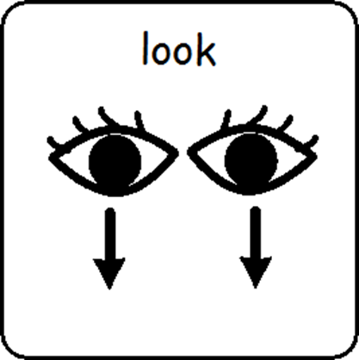
Look at the artwork

Slide 4
Looking at French Art is finished

