Slide 1
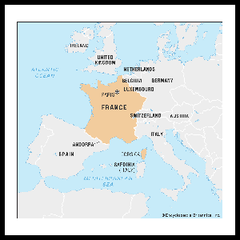
I am learning about France

Slide 2
France is a large country in Europe. It borders with Spain, Italy, Luxembourg, Belgium, Germany, Switzerland and Monaco

Slide 3
France is also bordered with the Mediterranean Sea and the Atlantic Ocean

Slide 4
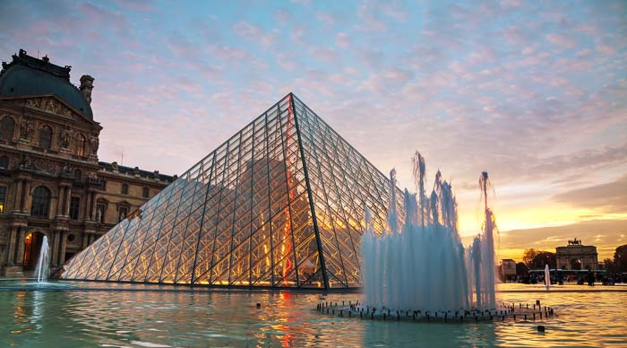
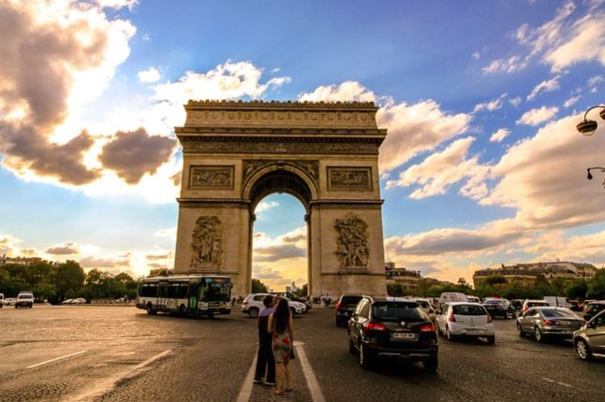
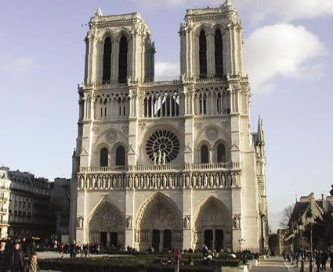
The capital of France is Paris In Paris you will find many famous landmarks: The Eifel Tower, The Louvre, The Arc de Triumph and Notre dam Cathedral.

Slide 5
In France the language is French
Hello – Bonjour
Goodbye – Au revoir
Please – S’il vous plait
Thank you – Merci
Yes – Oui
No - Non

Slide 6
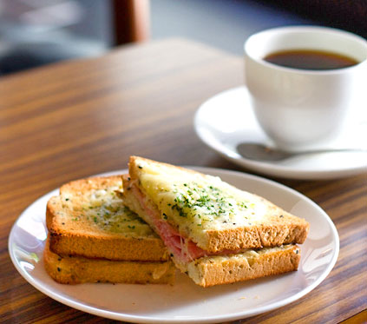
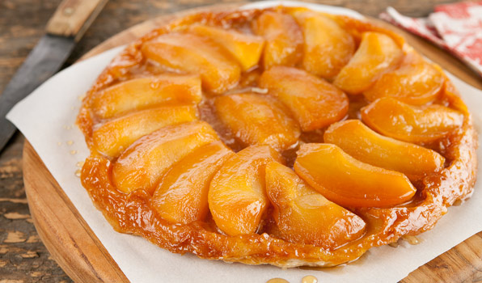
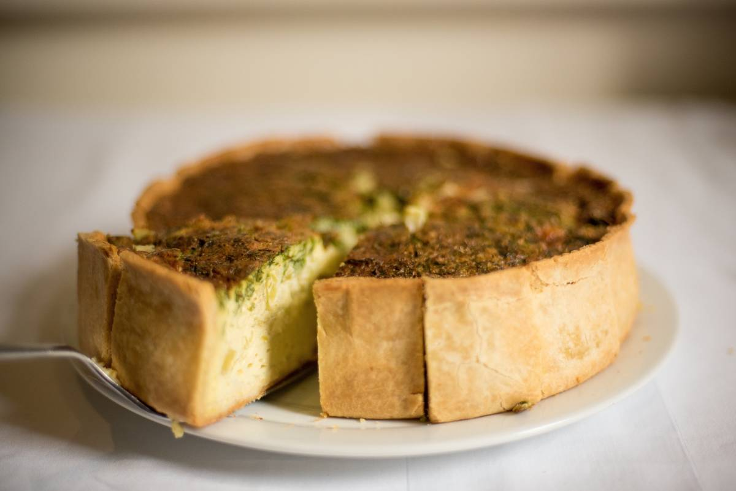
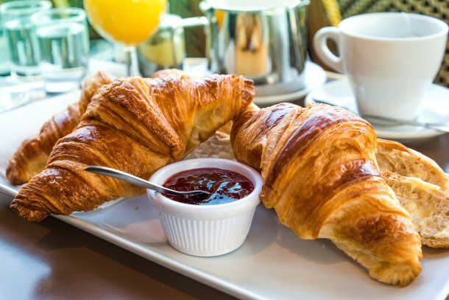
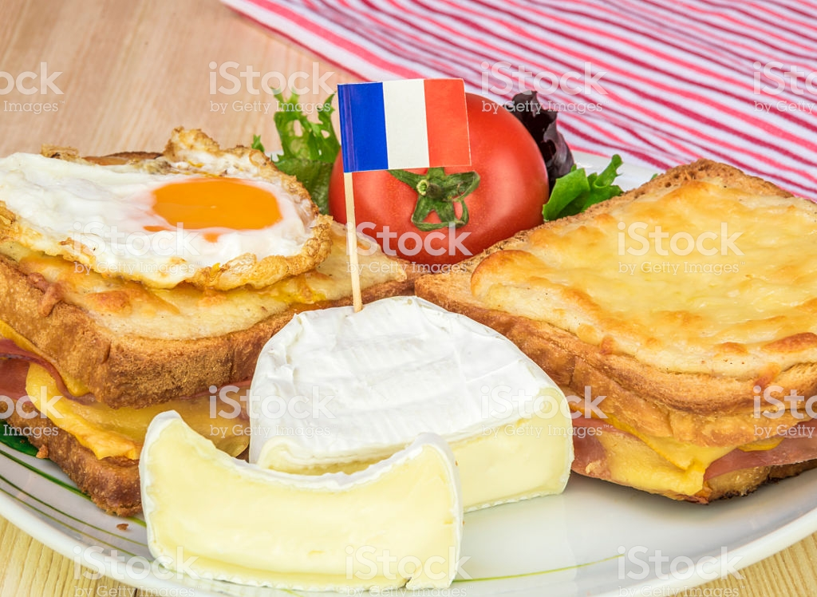
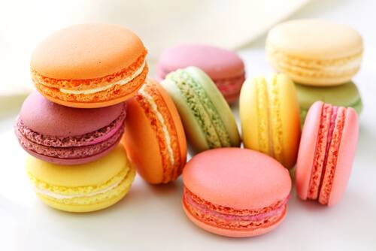
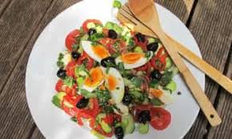
France is famous for its food

Slide 7
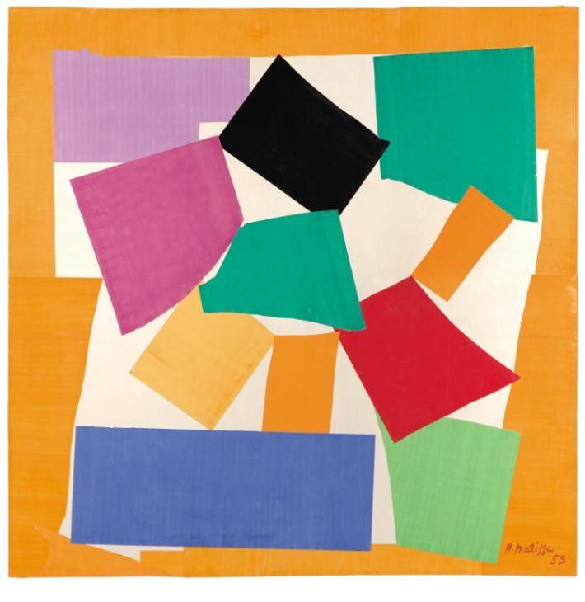
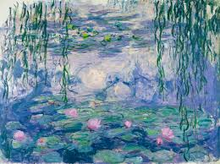
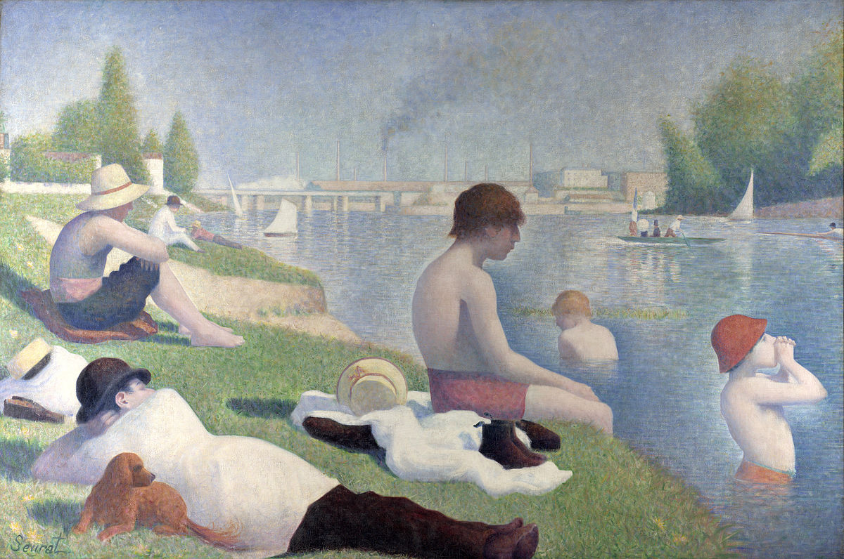
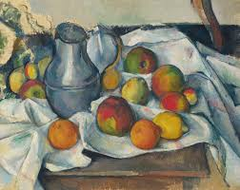
France is famous for its art and artists

Slide 8
France
BBC Bitesize France
https://www.bbc.co.uk/bitesize/topics/zyhp34j/articles/zhw7vk7
Office du Tourisme de Paris
https://www.youtube.com/watch?v=B-8fXb8tts0&safe=active

Slide 9
Learning about France is finished

