Slide 1
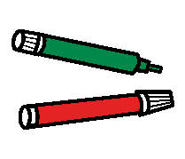
Writing Programme
Making marks

Slide 2
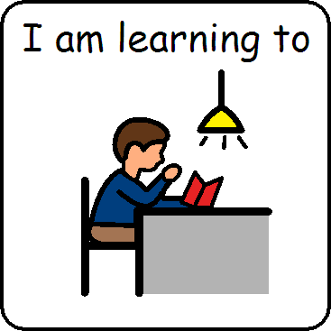
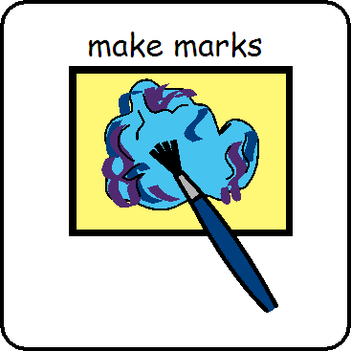
I am learning to make marks

Slide 3
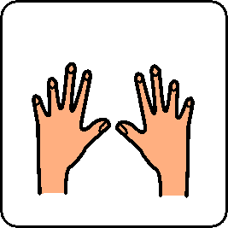
I am learning to use my fingers

Slide 4
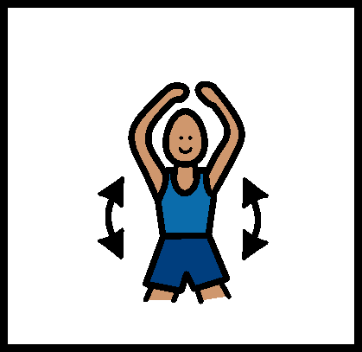
Warm up

Slide 5
Warm Up Music
https://m.youtube.com/watch?v=2w-_Vtttrfc

Slide 6
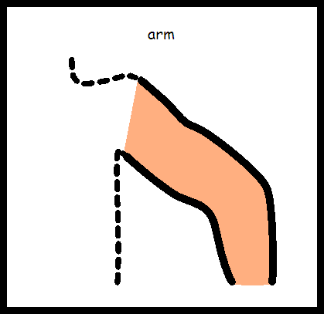
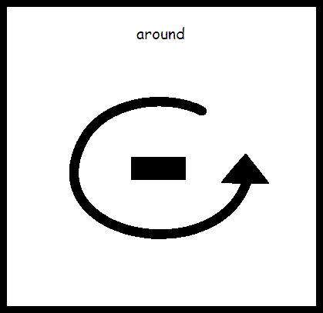
Circle your arms

Slide 7
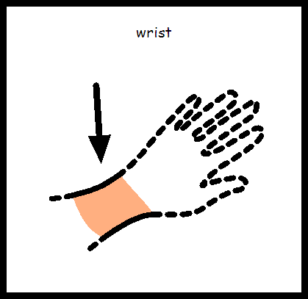
Circle your wrists

Slide 8
Wave arms in the air

Slide 9
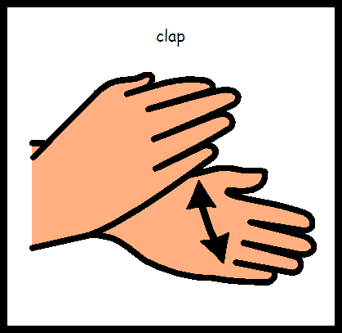
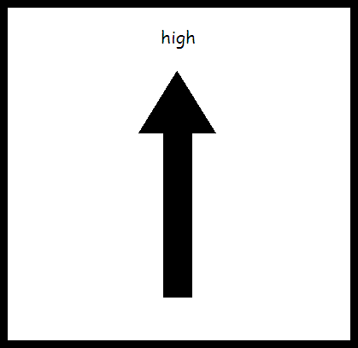
Clap hands up high

Slide 10
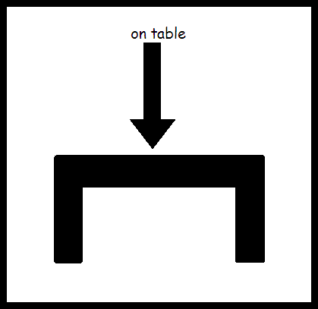
Clap hands on table

Slide 11
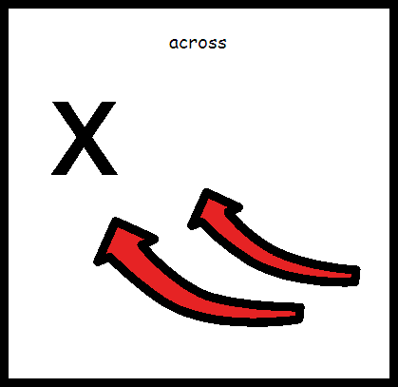
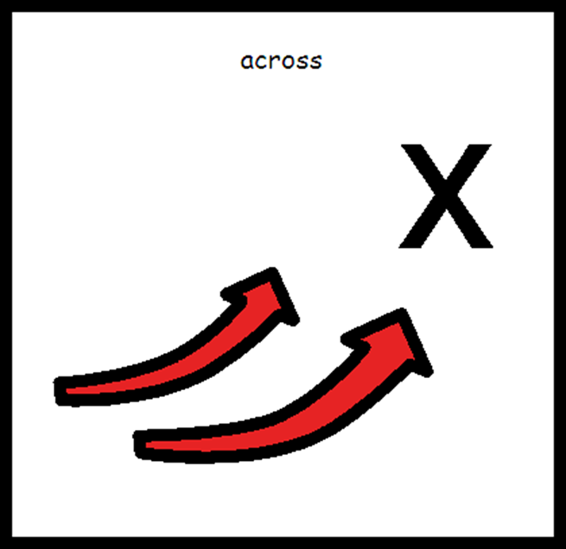
Reach across your body

Slide 12
Wave arms in the air

Slide 13
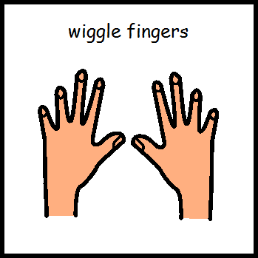
Wiggle your fingers

Slide 14
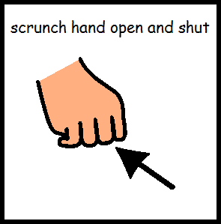
Scrunch hands open and shut

Slide 15
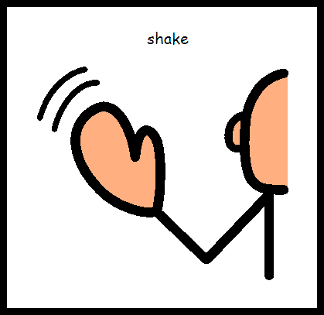
Shake hands out in front

Slide 16
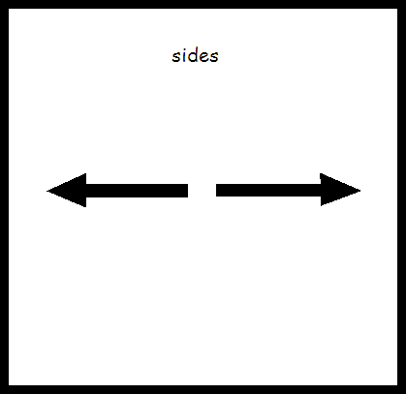
Shake hands out to the sides

Slide 17
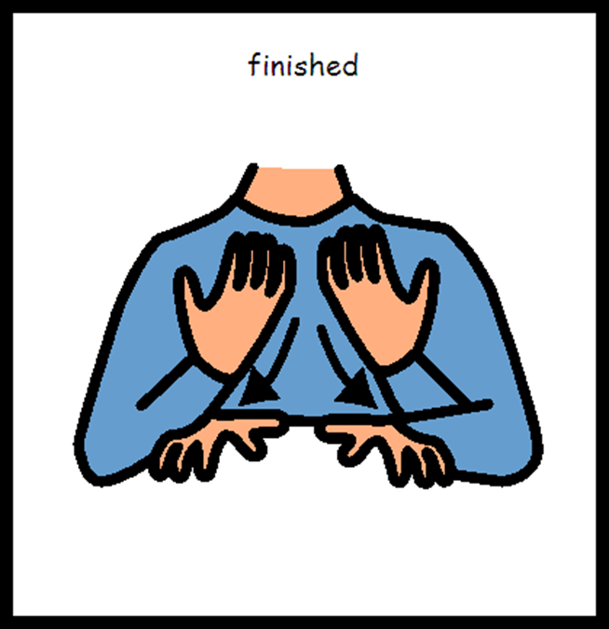
Warm up is finished

Slide 18
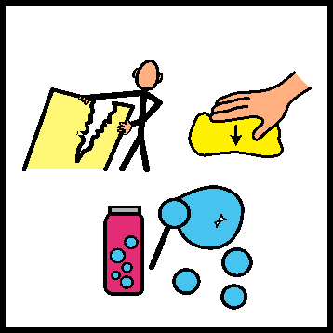
Hand and finger work

Slide 19
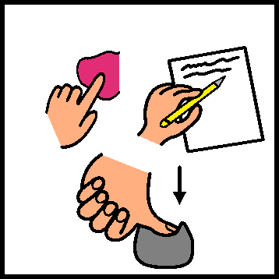
Make marks

Slide 20
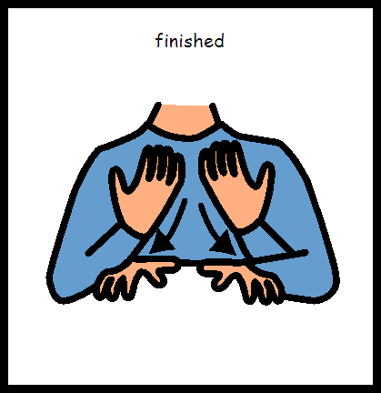
Mark making is finished

