Slide 1
P.E.
Throwing, catching, rolling and playing

Slide 2
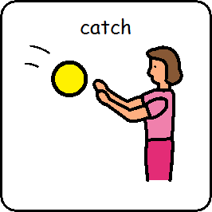
I am learning to catch
Bubbles
Scarf
Balloons
Large ball

Slide 3
Bubbles I am learning to catch bubbles
https://www.youtube.com/watch?v=DBYjZTdrJlA&safe=active

Slide 4
Scarves I am learning to catch a scarf
https://www.youtube.com/watch?v=_VJlHWESyLI&safe=active

Slide 5
Balloons I am learning to catch a balloon
https://www.youtube.com/watch?v=3jec0lKmyYU&safe=active

Slide 6
Ball I am learning to catch a ball

Slide 7
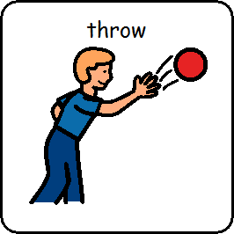
I am learning to throw
Scarf
Balloon
Ball

Slide 8
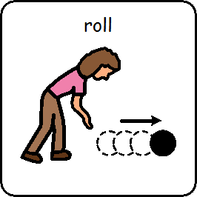
I am learning to roll https://www.youtube.com/watch?v=brdqJ29PQac&safe=active
Roll the ball
Roll up and down a ramp

Slide 9
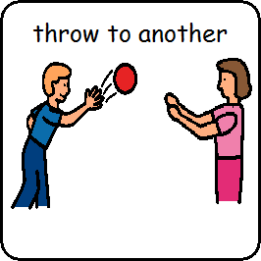
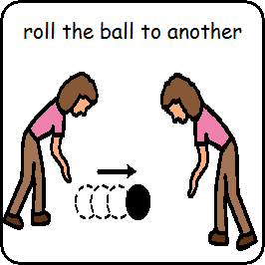
Ball Games
Throwing and catching with another
Rolling the ball back and forth to another

Slide 10
P.E is finished

