Slide 1
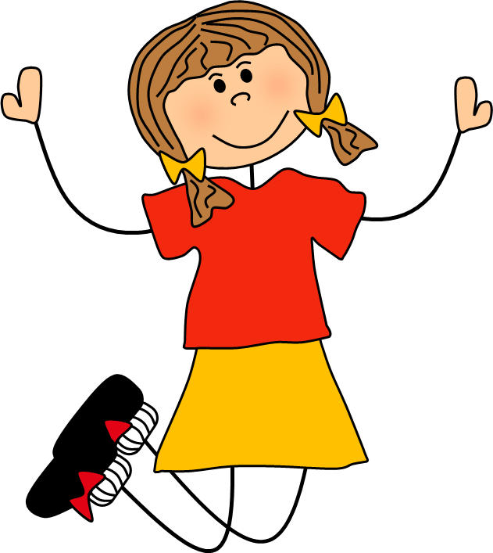
Action Words
jump

Slide 2
What are we learning?
Today we are going to learn about action words called verbs. We will practise recognising them in our reading and look at how to use interesting verbs to improve our writing.

Slide 3
What is a verb?

Slide 4
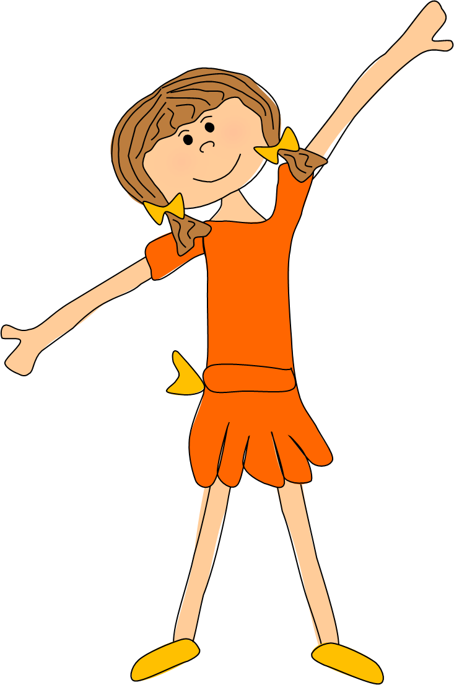
A verb is an action word. It tells us what someone or something is doing…
Alex dances well.

Slide 5
The fish swim in the sea.

Slide 6
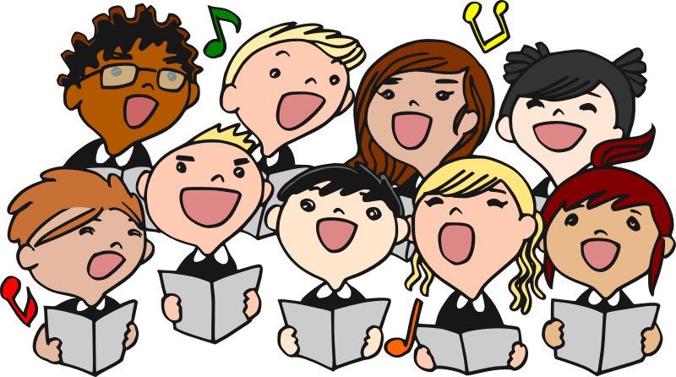
The choir sing beautifully.

Slide 7
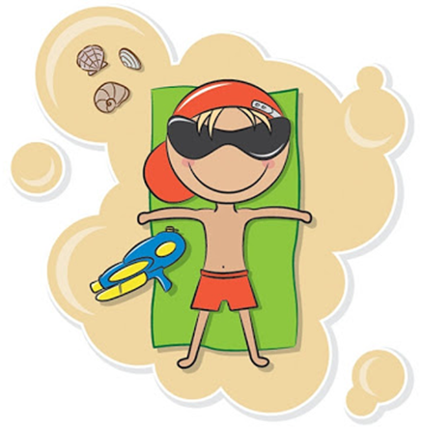
I relaxed on the beach.

Slide 8
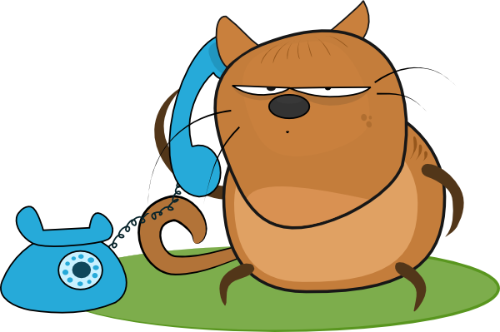
Cyril is chatting on the phone.

Slide 9
Can you think of any other verbs? Go around your family and see how long you can make a ‘verb chain’ before you run out of words.

Slide 10
Below are some of the things I can do. They are all verbs.
sleep
jump
think
argue
play
smile
skip
shout
swim
worry

Slide 11
The verb is the most important word in a sentence. It tell us what is being done in the sentence…
Alex is dancing.
The verb ‘dancing’ tells the reader what the subject of the sentence (Alex) is doing.

Slide 12
Read the sentence on each slide and identify the verb.

Slide 13
Fred is reading his book slowly.
reading

Slide 14
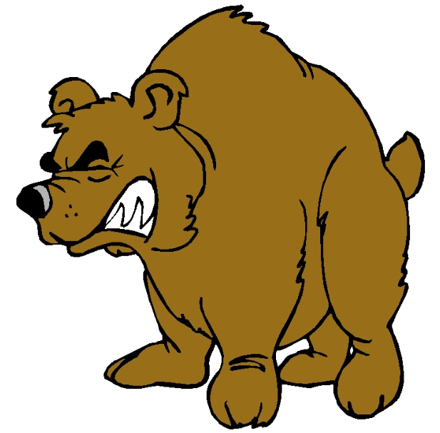
The vicious bear growled.
growled

Slide 15
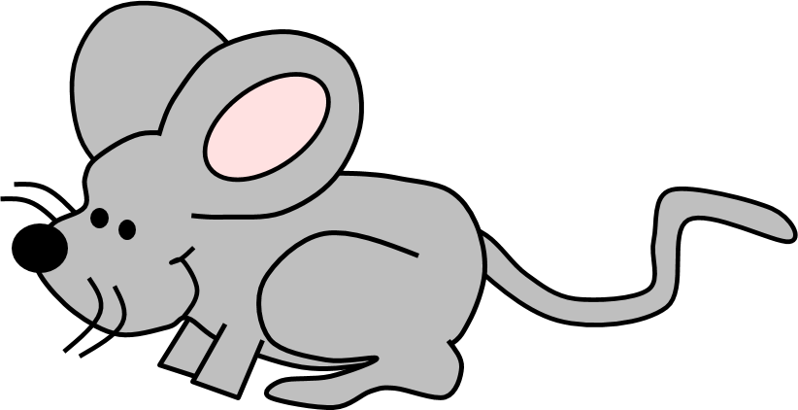
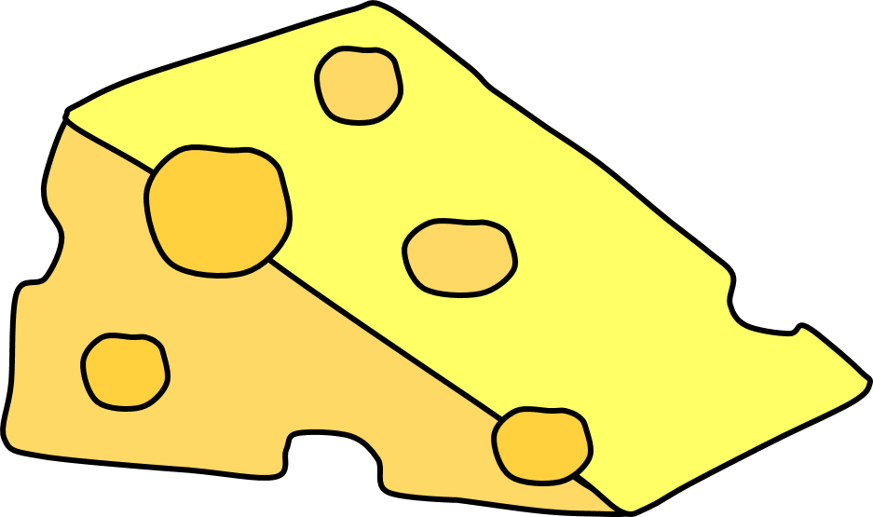
The mouse nibbled the cheese.
nibbled

Slide 16
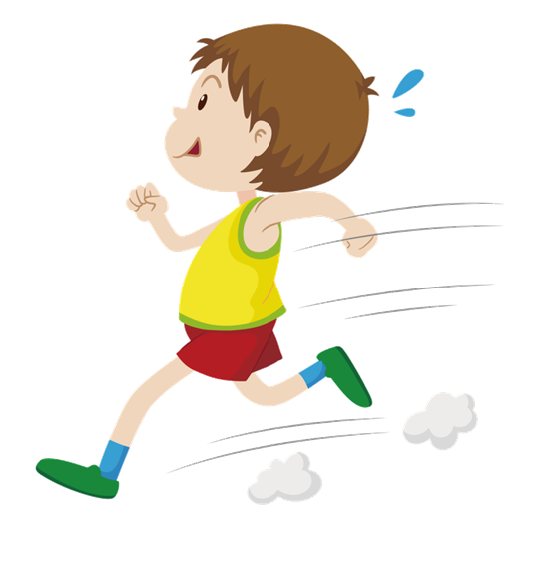
Charlie ran as fast as lightning.
ran

Slide 17
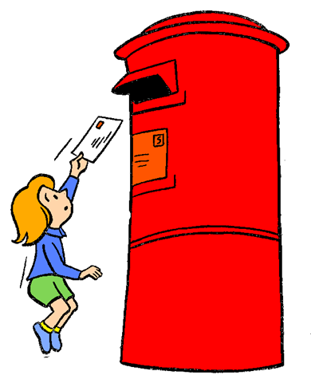
Lucy posted a letter to her friend.
posted

