Slide 1
Parent Council Meeting
6th of Feb 2024

Slide 2
School Improvement
1 year since our HMIe inspection

Slide 3
NAC Quality Improvement Framework
Engagement visits from key staff – Sharon McDowell, Senior Manager
Quality Indicator 3.2
Quality Indicator 2.1 and 3.1 - Thursday
Quality Indicator 2.3

Slide 4
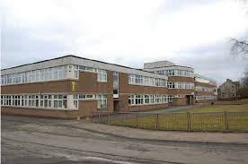
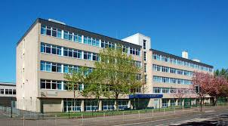
Trio Work
Quality Indicator 2.3 – Learning, teaching and assessment
Irvine Royal Academy Kilwinning Academy

Slide 5
School Improvement Plan
All schools have an improvement plan to help identify and plan what they want to focus on and continue to improve.
Greenwood Academy has five priorities in the plan.
One of the priorities is to ‘Improve attainment and achievement for all, including literacy and numeracy’.

Slide 6
Learning and Teaching
One of the ways that we can raise attainment is to focus on high quality lessons. Over the course of the week you should take part in different activities –
Discuss with your teacher the types of lessons that you engage in…
Individual Work
Group Work
Practical Work

Slide 7
Learning and Teaching
Are you able to identify any lessons where you have engaged in these activities –
Video clip used to promote discussion or used to explain something
Think, pair, share activity
ICT used to enhance the lesson
Presenting your finding to the class or a group of pupils
Opportunity to make something
The teacher has asked for your opinion/feedback to shape future lessons

Slide 8
How do you receive feedback about next steps?
Verbal Feedback
Written Feedback
Peer Feedback
Discuss some lessons where you have received effective feedback.
What did you do next? Did you have to improve the work and show your improvement to the teacher?

Slide 9
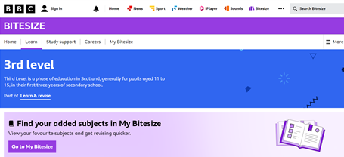
S1-3 Support
Go to BBC Bitesize. You can then select the level and the subject that you are looking for. Ask your teacher which CfE Level you are working within if you are unsure.

Slide 10
National 5 and Higher Support
Achieve is a great resource to help young people improve. It can be accessed from within GLOW. Go to the GLOW Launchpad and download the Achieve App.

Slide 11
There are many, many National 5 and Higher courses that have mini tests, further information and self-assessments.

Slide 12
Dates for the Diary
S4-6 Study Skills Evening - 19th of February 6pm – 7pm
S1-3 Literacy and Numeracy Evening – 26th February 6pm – 7pm

Slide 13
Pupil Councils
Toilets
Hand sanitiser
Prelim timetable/Easter school
S4-6 coursework
Bring your own device
Merits/demerits
Litter – Atrium, bins, outdoor
Montgomery Park Bus

Slide 14
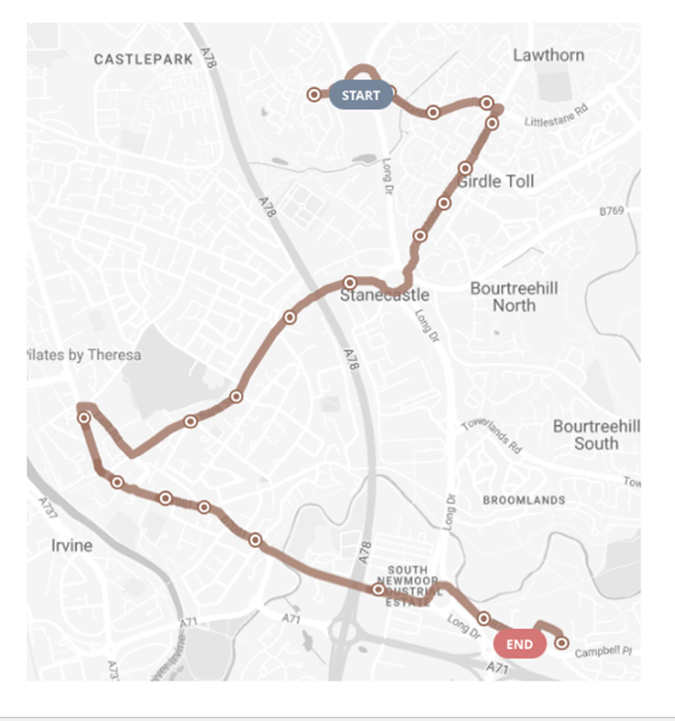

Slide 15
Supporting Health and Wellbeing
Greenwood Academy has a large team of people to support your health and wellbeing -
School Nurse
School Counsellor
Campus Police Officer
Area Inclusion Worker
Guidance Teachers
All school staff

Slide 16
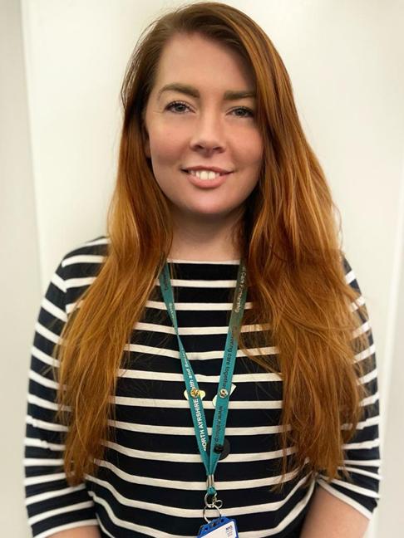
School Nurse
We have a new School Nurse – Kimi Kerr
Kimi has kindly contributed to the slides.

Slide 17
Greenwood cluster
I am currently the school nurse for the following schools:
Greenwood Academy
Springside Primary School
Dreghorn Primary School
Elderbank Primary School
Lawthorn Primary School
Glebe Primary School
I work between my office in Greenwood Academy (ground floor next to the office) and Ballot Road Clinic in Irvine.

Slide 18
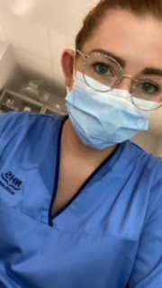
Background
I started my nursing career when I was in my mid 20s and have never had any regrets about this decision.
I decided to pursue a career in nursing when my son took unwell and feel lucky to be in the role I am today.
I have worked in acute hospital settings including Ayr Accident & Emergency department.
I became a school nurse in June 2022 because I enjoy working with children, young people and their families.

Slide 19
School Nurse Service
School nurse support is guided by the school nursing pathways and the areas that we focus on are:
Emotional/mental health and wellbeing
Substance misuse: drugs, alcohol and tobacco
Child protection
Domestic abuse
Looked-after children
Homelessness
Sexual health and wellbeing
Youth justice
Young carers
Transitions (Nursery to Primary School, Primary School to Secondary School. Secondary School to Adult Services)

Slide 20
Confidentiality
Please be reassured that I am employed by NHS Ayrshire & Arran, therefore discussions are confidential unless I have significant concerns about your wellbeing.

Slide 21
How to get School Nurse support?
Pupils can self refer to school nurse support by scanning the QR code outside her office and completing the form.
If my door is open, drop in to see me.
Referrals can also come from your Guidance Teacher if you wish them to ask for school nurse input on your behalf.
I can signpost/refer young people to wider services with their permission if it would be beneficial.

Slide 22
Thank you
Thank you for welcoming me into the school.
Please drop by my office if you have any
health related questions or just to say ‘hi’.

Slide 23
Parent Council
Bids
Increasing parental engagement in the Parent Council
Fundraising ideas – Summer term

