Slide 1
Parent Council Meeting
School Update
4th Dec 2023

Slide 2
School Improvement
Faculty Engagement Visits
Trio Work
Senior Manager Engagement Visits

Slide 3
Working Groups
Meeting Needs Review – Staged Intervention Working Group
Moderation – School Leads
Learner Participation Working Group
Attendance Working Group
Network Meetings
SQA
Leaders of Learning - Pupils

Slide 4






Notes:
The four arenas of participation which are drawn from the initial children’s commissioner research are outlined in this guidance for this first time. These arenas outline all the places that participation can take place and extend it beyond the scope of decision making groups. For example, children might participate in giving their opinions on aspects of lessons including the content and delivery. Some aspects of assessment is for learning would be helpful in this arena.
Opportunities for personal achievement include ch/yp being included in all those wider areas in school such as volunteering, award schemes, visits, etc. It can be helpful to get the children involved in

Slide 5
HWB/Registration
On the 23rd of February 2022, we consulted with staff, pupils and parents/carers via a GLOW Forms.
956 people took part in the survey - 110 staff, 332 parents/cares and 514 pupils.
80% of those who completed the survey supported the re-introduction of wellbeing/registration.

Slide 6
Looking Back…Introducing Our New Curriculum
Following consultation we have introduced a new curriculum.
Every morning you will attend a HWB Check-in/Registration.
During this time you will get the daily bulletin, receive key messages and link with your HWB/Registration Teacher.
Your Guidance Teacher will be in the corridor every morning to support.

Slide 7

Under Review

Slide 8
Pupil Consultation
1. Does your teacher show the HWB/Reg slides?
2. Do the slides contain useful information?
3. Do you feel as if there is a consistent message?
4. Do you feel more informed?

Slide 9

Pupil Consultation
9. Slides - what would you like more information about?

Slide 10

HWB/Reg - Any Other Comments?

Slide 11
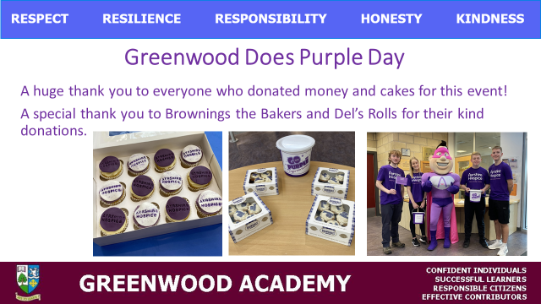
Purple Day
Greenwood Academy community raised £1150 for the Ayrshire Hospice during Purple Day.

Slide 12
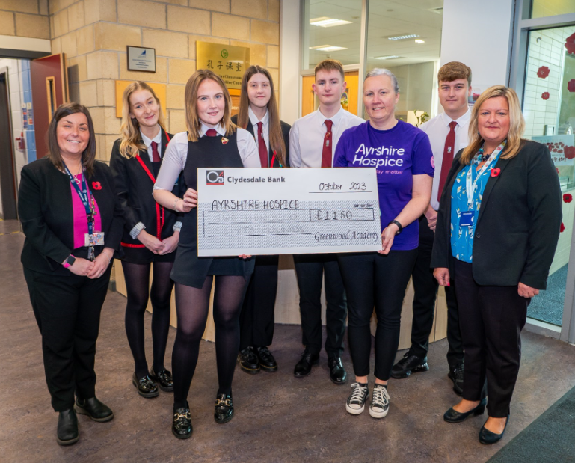
Purple Day
This week we were proud to hand over the cheque to the Ayrshire Hospice.

Slide 13
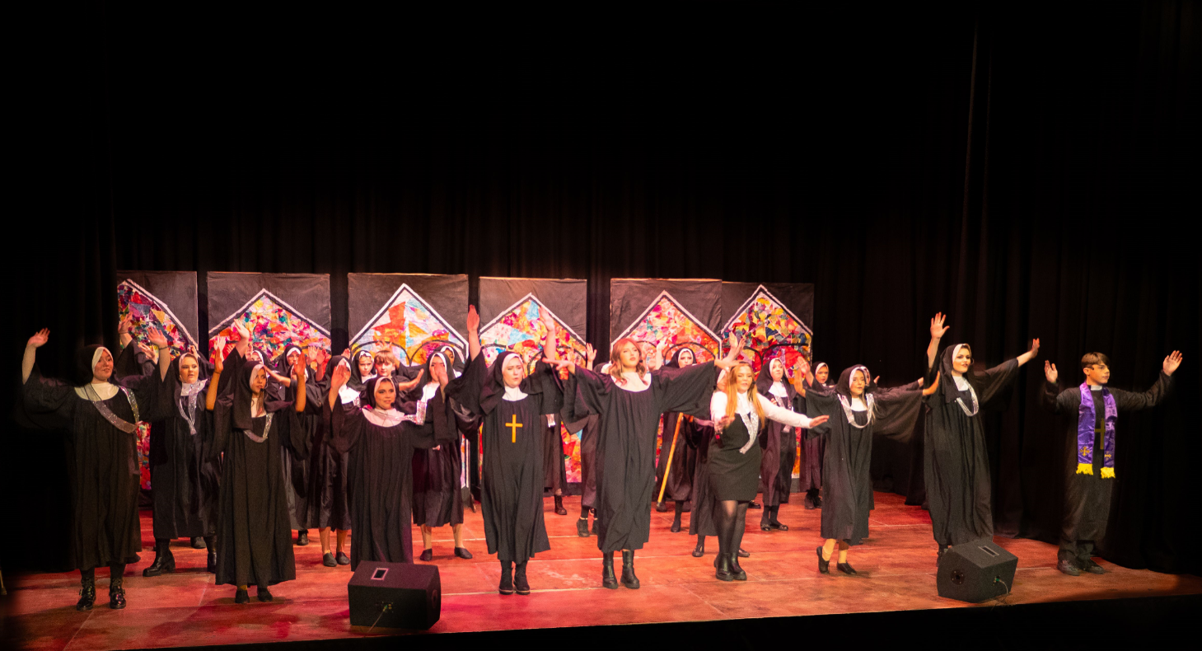
Sister Act Jnr

Slide 14
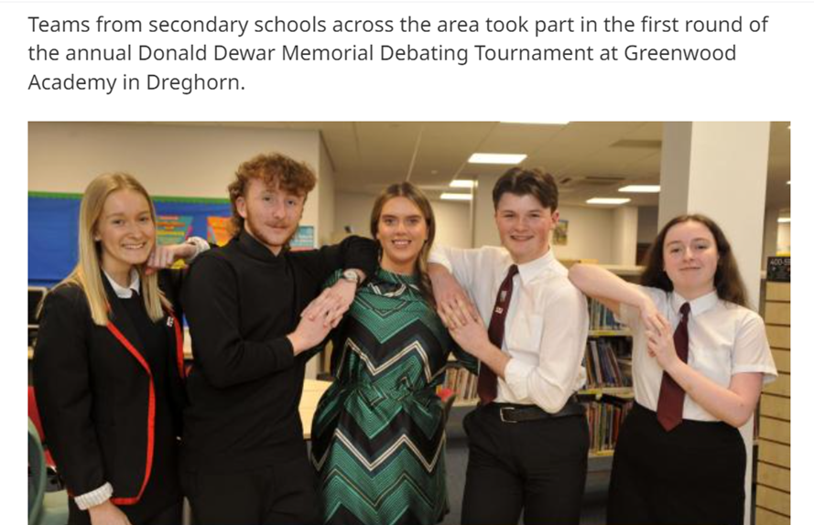

Slide 15
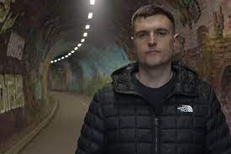

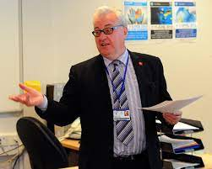
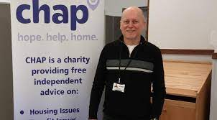
Speakers
Thank you to the staff who have invited guests into share their experiences and to speak to pupils.
Some of our recent guests…

Slide 16
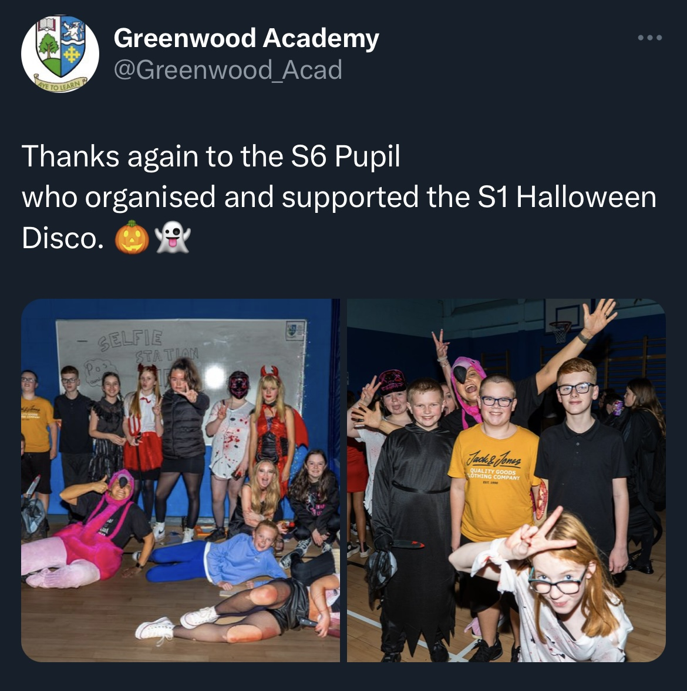
Halloween Fun
A huge thank you to our S6 pupils and key staff for organising the S1 Halloween disco on Friday!

Slide 17
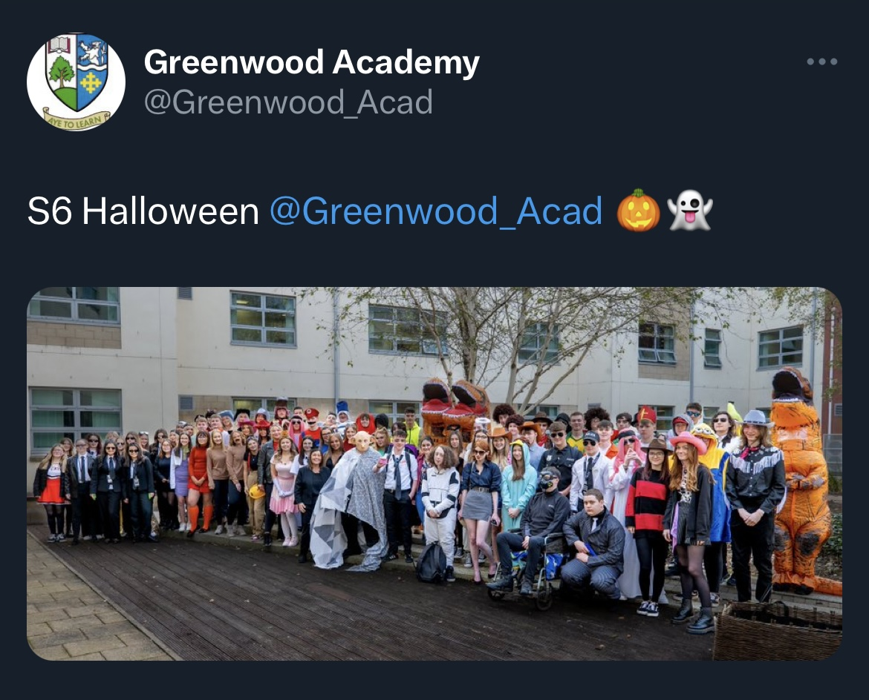

Slide 18

What’s going on in Greenwood Academy?
Our fantastic Journalism Club put together our Newsletter, sharing all of the great things going on across the school.
Look out for the 2nd Newsletter of the year!

Slide 19
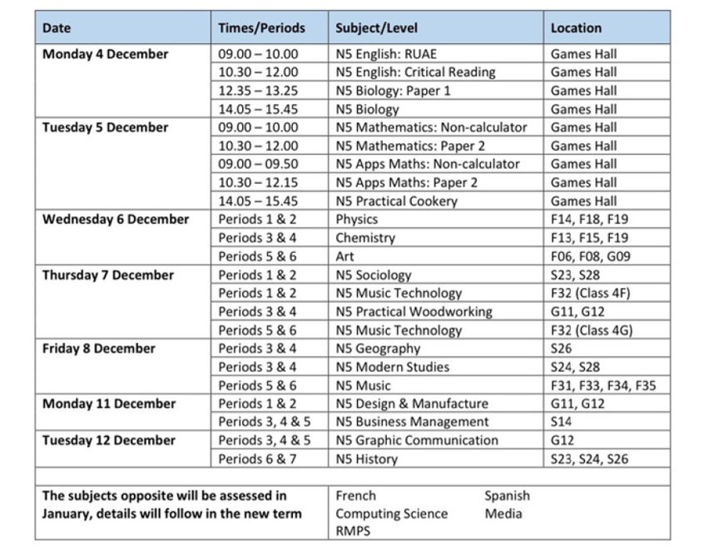

Slide 20

This is available in the Atrium from 8.00am

