Slide 1
Beat the Street is turning North Ayrshire (Active Nation) into a giant game! 14th February – 27th March

Slide 2
Get points and win prizes by walking, rolling, running and
cycling around your town. You can also play when travelling by bus or train.

Slide 4
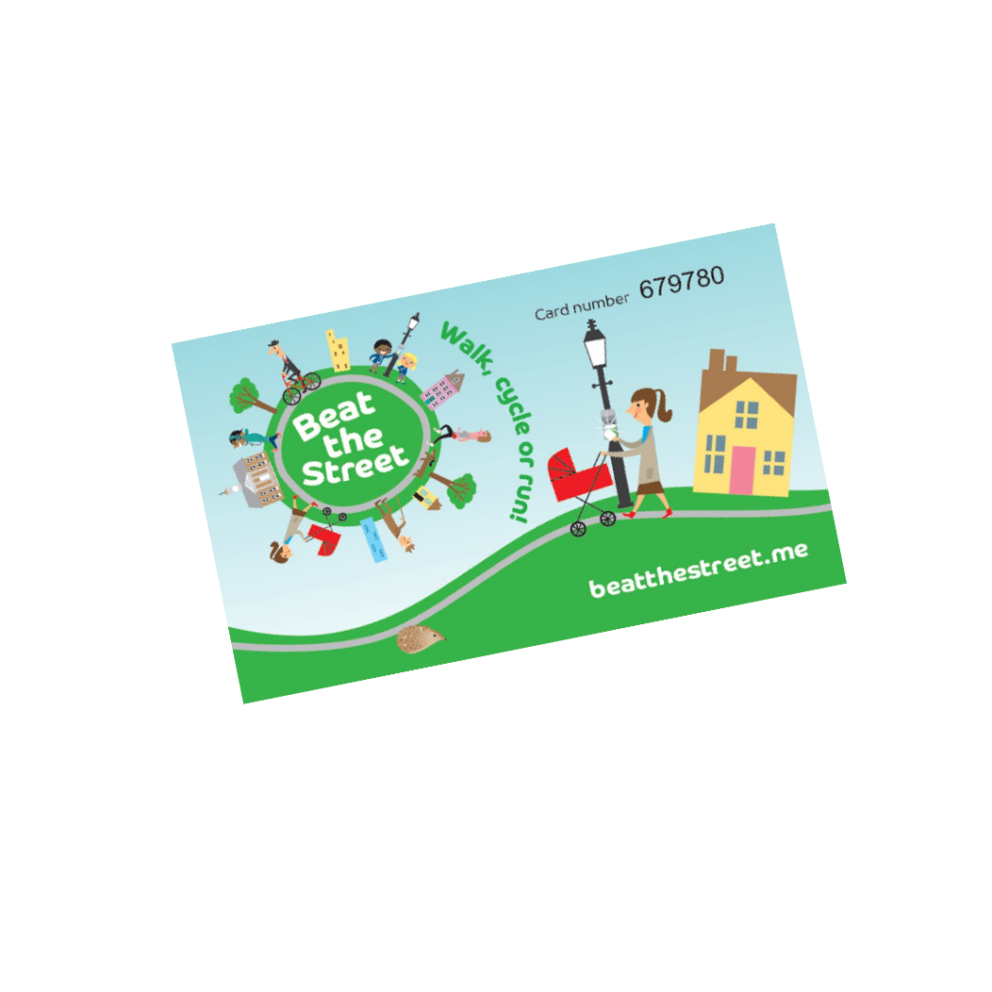
Here’s how you play….
Your school will give you a Beat the Street CARD

Slide 5
And a Beat the Street Map

Slide 6
Hover your card over Beat Boxes on lampposts in your area

Slide 7
The Beat Box will beep and flash

Slide 8
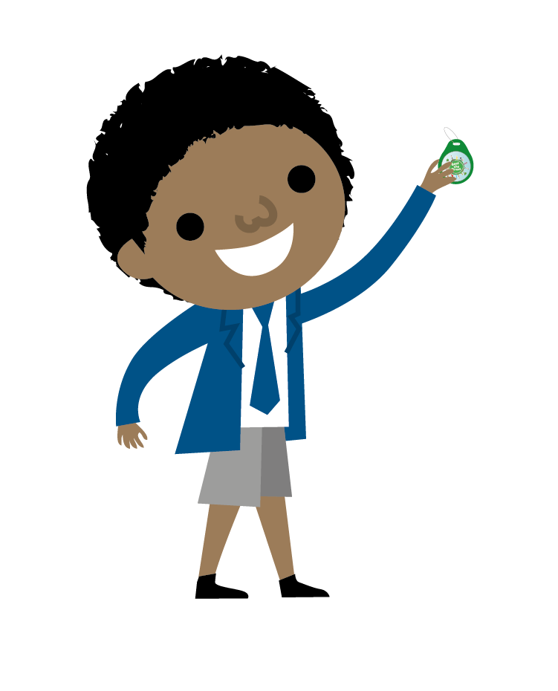
+10!
Visit at least 2 Boxes within an hour to earn points

Slide 9
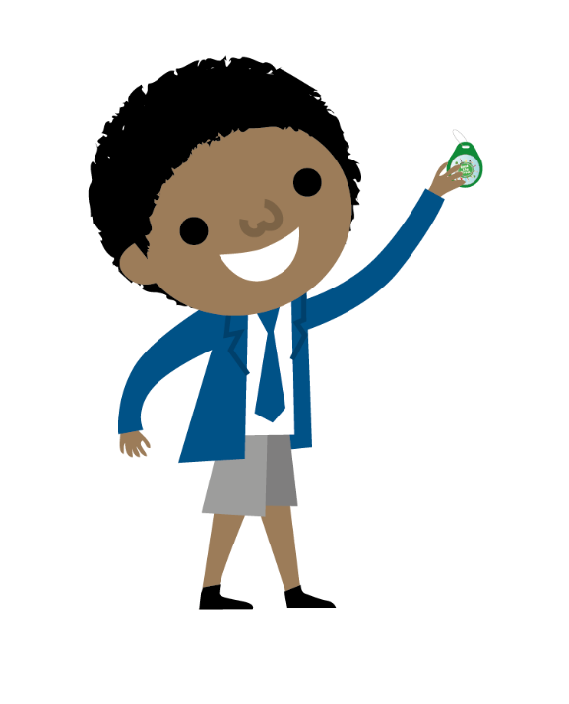
+10!
The more times you travel between Boxes the more points you will earn

Slide 10
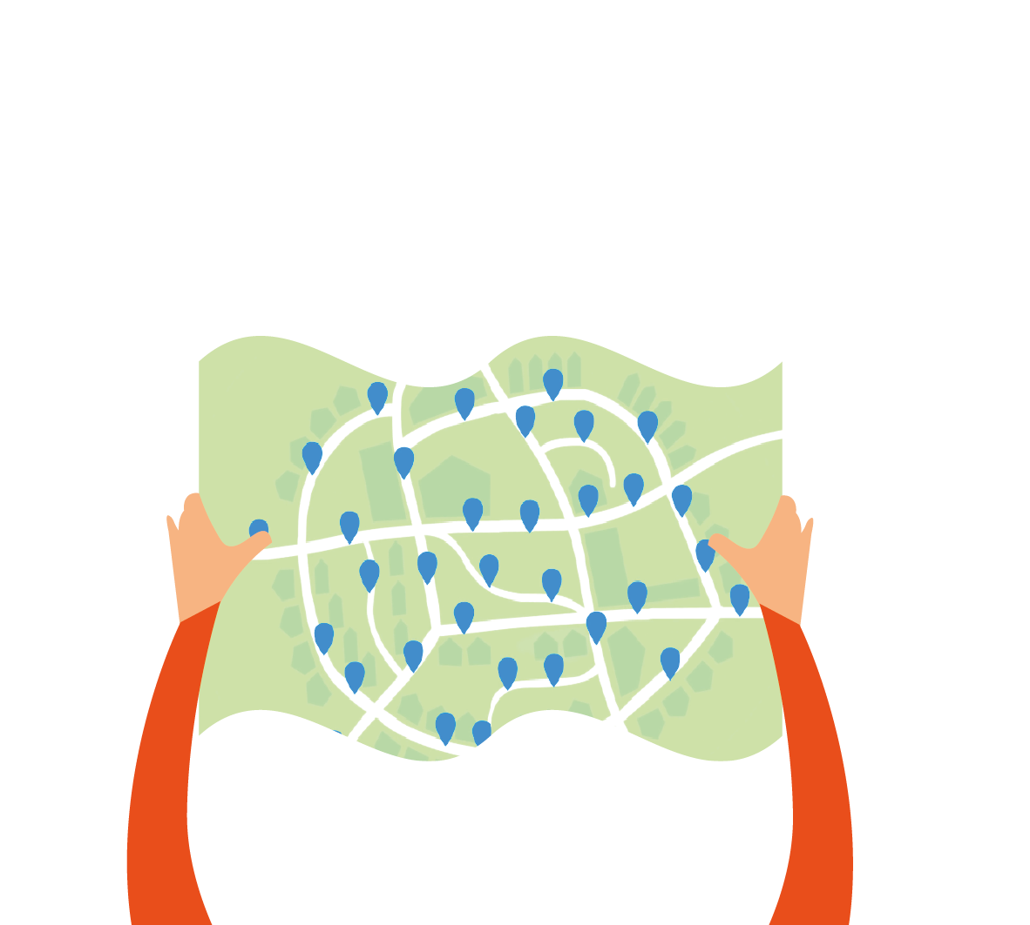
Use your map to find Beat Boxes

Slide 11
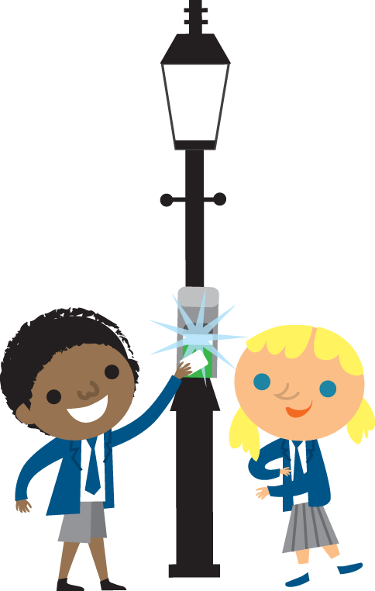
There’ll be one near your school

Slide 12
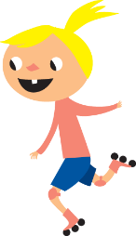
And lots more throughout North Ayrshire

Slide 13
Areas in the game
Ardrossan
Saltcoats
Stevenston
Beith
Gateside
Dalry
Kilbirnie
Glengarnock
Isle of Arran

Slide 14
Every point you score goes towards your school total

Slide 15
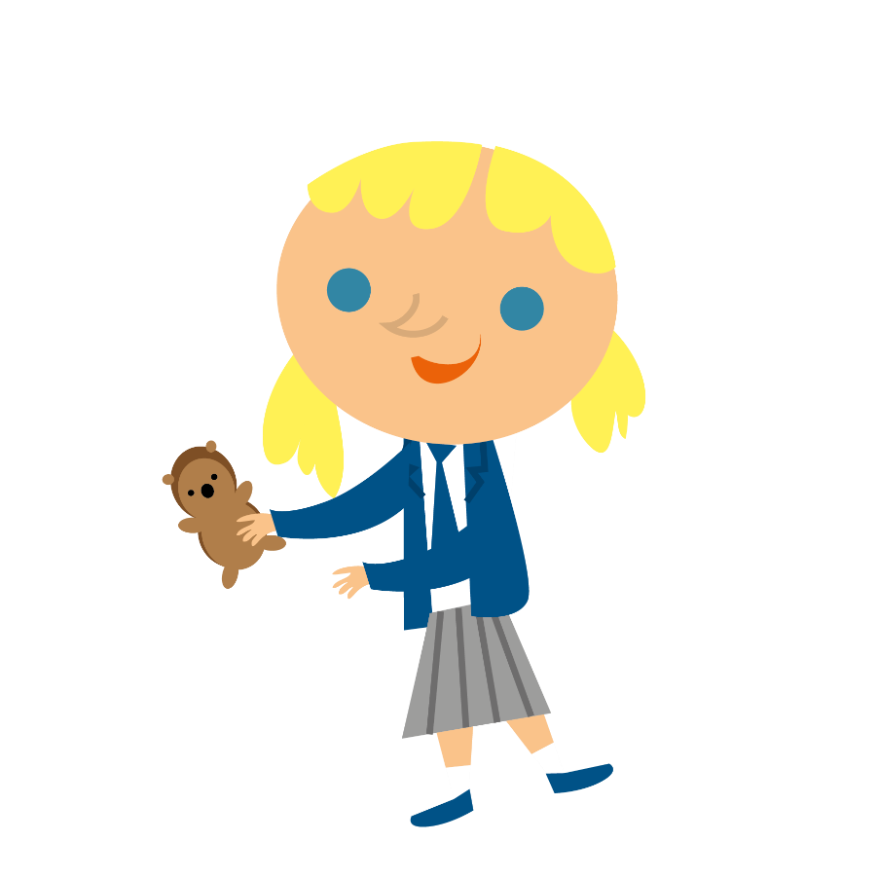
Register your CARD online to be in for a chance to win a prize

Slide 16
+10!
Collect Extra Cards for all your family from –
Tesco (High Road) Saltcoats
Morrisons, Stevenston
Auchenharvie Leisure Centre
Beith Library
Dalry Library
Kilbirnie Library
Arran Library
Arran Eco Hub

Slide 17
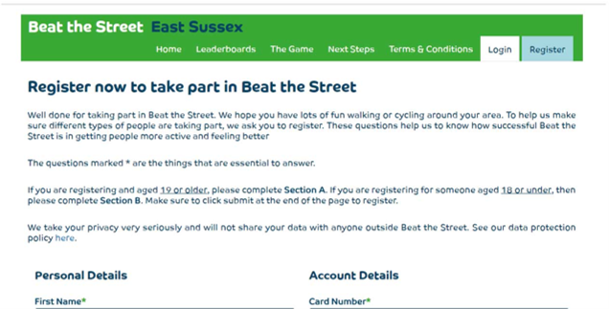
Make sure any extra cards picked up are registered online to join your team

Slide 18
Remember……
Hover your card at the first Beat Box to begin your journey.
The next Beat Box records your journey – you begin to collect points
Look for more Beat Boxes and keep earning points.

Slide 19
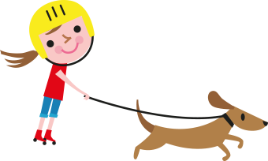
Remember!
Staying active is not only good for your body but for your brain as well!

Slide 20
Staying Safe!
Watch out for cars and buses
Use crossings
Stop, look, listen
Be bright, be seen

Slide 21
Staying Safe!
Boxes are contactless, you don’t need to touch the Box with your card
Wash your hands before and after playing
Keep hold of your own card, don’t share it with others

Slide 22
Most importantly have fun and play fairly!

Slide 23
Will your school come top of the leaderboard and win prizes ?
There are prizes for top 4 schools on each leaderboard.

Slide 24
www.beatthestreet.me/activenation

