Slide 1



Attendance Matters
Every day in school counts - right from the start!
No poverty of expectation, opportunity and aspiration for our young people and families.

Slide 2

The Challenge
School attendance across Scotland is falling. Our data tells us this is negatively impacting the academic performance and wellbeing of our learners.
🧠 Regular attendance supports mental health and belonging.
🎓 Pupils with attendance below 90% are less likely to achieve learning outcomes and qualifications.
💼 Poor attendance is linked to lower earnings and more unemployment by age 23.
⚠️ <90% = Persistent Absence | <80% = Serious Concern.
📚 Even 95% = 10 full school days missed per year.
No poverty of expectation, opportunity and aspiration for our young people and families.

Slide 3
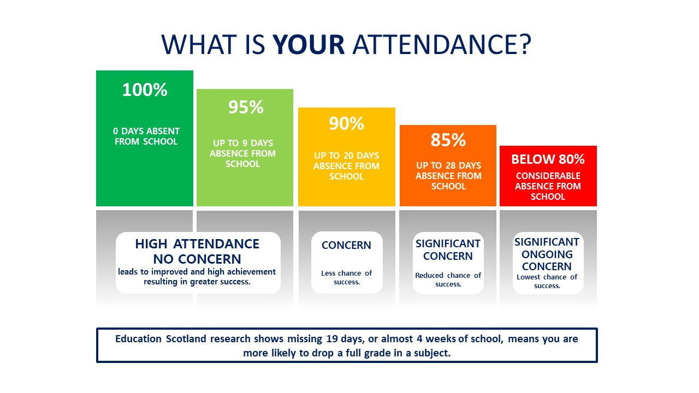

Slide 4


Coming to school every day builds important habits for life.
Building blocks of learning
Boosts attainment and achievement
Increased Engagement
Enhances participation in classroom activities
Social Skills
Fosters positive relationships with others
Future Readiness
(And we are here to help you every step of the way)
Prepares learners for learning, life and work

Slide 5

What happens when children miss school?
📚 Learning gaps grow quickly
😔 Friendships and routines are disrupted
💼 Poorer learning, job and life outcomes

Slide 6

Spot the early
warning signs
😟 Frequent vague illnesses such as headaches or stomach aches
⏰ Struggles to get out of bed or constant lateness
🗓 Anxiety on Sunday nights or before school days
🙁 Loss of interest in activities they once enjoyed
🤐 Withdrawal from friends or family conversations
🧳 Regularly forgetting things or appearing unprepared
📉 Drop in engagement, energy, or school performance
🛑 Expressing statements like 'No one will notice if I’m not there'
No poverty of expectation, opportunity and aspiration for our young people and families.

Slide 7


How can we support
your child?
We know that when children feel included and involved, they are more likely to want to come to school.
When learners know and enjoy what they’re learning, they are more likely to come to school.
There’s a place for everyone—and we help children find it.
If your child is struggling to come to school, please talk to us—we’re here to help.
“You’re not alone. Support goes beyond the school gate.”
Inclusive School Culture
Our schools are nurturing places where every child is known, valued and celebrated.
We aim to:
  Build strong relationships between staff and learners;
  Celebrate progress and achievement;
  Promote mental wellbeing;
  Create calm, structured environments where children feel safe
Flexible & Engaging Curriculum
Learner needs are met through:
engaging experiential learning opportunities, encompassing all areas of the curriculum.
Play and skills based learning are core to our service.
Personalised support is tailored to help children to succeed.
Extracurricular Opportunities
Our schools offer clubs, sports, arts, after school and lunchtime activities.
These help learners to:
  Build friendships;
  Develop confidence and life skills;
  Feel connected and motivated.
Targeted Support
We recognise that some children need specific support
to come to school.
Our schools offer:
  Alternative pathways;
  Key adult check-ins;
  Soft starts/phased returns;
  Tailored wellbeing support.
Partnership Working
We work with a wide network of professionals to support families. This includes:
  Area Inclusion Workers;
  Educational Psychologist;
  School Nursing Service;
  Youth Workers and Third-Sector partners;
  Family-centred Wellbeing Support Service.
We understand every family is different—and we’ll work with you!

Slide 8





What can you do at home?
Bedtime and morning routines.
Prepare for school the night before
Limit Screen Time
Talk positively about school
Predictable routines get the best for every one.
Small routines make a
big difference.
Blue light from screens, mobile phones and gaming disrupts sleep and affects mental wellbeing through poor sleep.
Ask questions such as, “What were you learning today?”, “What was your favourite part of the day?” to keep conversations positive.
You know your child best and we are a team. So, let us know early if there is a concern.

Slide 9

Attendance Matters
Your Child Matters
Our Partnership Matters
TOGETHER, LET’S GIVE OUR CHILDREN THE BEST START IN LIFE!
No poverty of expectation, opportunity and aspiration for our young people and families.

