Slide 1



S2 Curriculum
Options
Information Briefing for 2026 Session
Respect Equality Determination

Slide 2
Our Vision:
To provide an equitable and excellent learning environment for ALL pupils which enables them to maximise their full potential and supports them into appropriate, positive and sustainable destinations.
Our Values:
Respect Equality Determination

Slide 3
Pupil Entitlement in S1 to S2
Pupils make progress within a BGE (Broad General Education)
Follow subjects that give them opportunities to develop:
skills for life and work, literacy, numeracy, health and their well-being
The best personal support to allow high levels of achievement
Opportunity to move into positive and sustained destination post-school

Slide 4
S2
S2 is the final year of the Broad General Education and should provide a transition from the S1/2 courses, experiences and outcomes into National Qualifications which are followed over S3 and S4, with exams being sat at the end of S4.

Slide 5
BGE - 8 Curriculum Areas
Languages
Mathematics
Health & Well Being
Sciences
Social Subjects
Technologies
Expressive Arts
Religious & Moral Education
Pupils in S1 to S2 are able to make progress across 8 main curriculum areas as part of their school week.

Slide 6
Curriculum for Excellence Principles of Curriculum Design
Challenge and Enjoyment
Breadth
Progression
Depth
Personalisation and Choice
Coherence
Relevance
We will be going through the S2 options process in the next 2 weeks to allow pupils a choice to pick subjects they enjoy, do well in and that meet future career aspirations. They will study these subjects over S3 and S4.

Slide 7
The Qualifications What are they in ‘old money’!
At the end of S4 your child will achieve awardS at N3, N4 /L4 or N5/L5 level dependant on progress.
Higher and Adv. Higher are sat in S5 and S6 respectively.
New National Qualifications | Preceding Qualifications
National 3 | Access 3 Foundation
National 4/ (Level 4 SCQF) | General level (Grade 4) Intermediate 1 (Grade C)
National 5 (Level 5 SCQF) | Credit Intermediate 2
National 6 (Higher) (Level 6 SCQF) | Higher
National 7 (Advanced Higher) | Advanced Higher

Slide 8

The Options Choice Process

Slide 9
S2 options process
S2 Pathways event
(September)
S2 Tracking reports
(November)
S2 Parents Progress Evening
(December)
S2 Subject Talks
(December)

Slide 10
Parents/Carers Briefing
Options Discussed in PSE/Subjects
Choice Interviews
Online PowerPoint Provided – School Website
December
12.1.26 – 26.1.26
New Timetable – May 2026

Slide 11
Options Form Discussions
S2 Pupils
These discussions will take place 12.1.26 – 26.1.26
Pupils will complete their options form during PSE lessons and have the opportunity to discuss this with their pastoral care teacher or Year Head.
Pupils will also bring a copy of their options form home to be discussed with their parent or carer. This should then be signed and returned to school.
If parents/carers have any further questions with regards to their young persons options they can request a call back from the young persons S2 pastoral care teacher or Year Head.

Slide 12
The S3 and S4 Curriculum

Slide 13
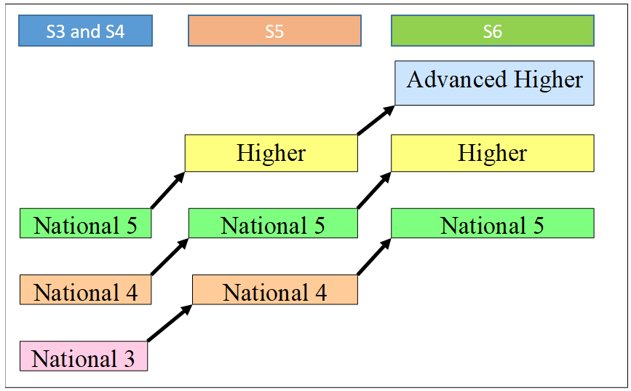
Level of Award – Progression from BGE (S1 & S2)

Slide 14
The S3 and S4 Curriculum
During the S2 options process pupils will make subject choices to study seven subjects for two years in S3 and S4
Students study seven National Qualifications – please note that English & Maths are compulsory
Subjects are more demanding than in S1/S2
Pupils study fewer subjects than in S2 - 4 periods per week each subject
They sit National Qualifications at the end of S4 - Study at 3 different levels, dependant on progress
National 3 National 4/L4 SCQF National 5/L5 SCQF
Pupils can access other qualifications
e.g. Personal Development, Wellbeing Awards, National Progression Awards,
Developing Young Workforce Certifications

Slide 15
S3 and S4 Curriculum
Assessment : Final exam carried out by the SQA at the end of S4
Most subjects - mixture of internal and external assessments

Slide 16
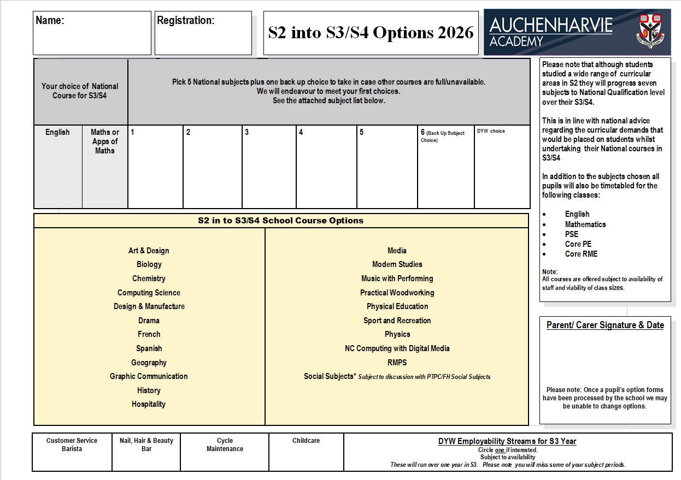
What your son/daughter’s curriculum will look like in S3

Slide 17
Developing Our Young Workforce Employability Streams
DYW courses run in the school and some are linked to the Ayrshire College
These are programmes that take place over the whole school year
These allow for a range of vocational qualifications to be banked in S3
Nail, Hair & Beauty Bar
Childcare & Early Years
Customer Service –
Barista
Cycle
Maintenance

Slide 18
Considerations For Subject Choice
Attainment - good results
Enjoy subject
Interests/abilities
Career pathways

Slide 19
Career Pathways
If career is known:
Have I investigated the employer/college/university?
Do I have a specified goal to aim for?
Which subjects are required?
If unsure of career:
Which subjects would keep options open?
Where do your strengths lie?

Slide 20
Avoid Subject Choice Based On…
Friend(s) choosing subject
Teacher liked/disliked
Guesswork

Slide 21
Supports
Decision made after discussion with
Parents/Carers
Pastoral Care Staff
Subject Teachers & Faculty Heads/PTs
Careers Adviser
Senior Management

Slide 22

Careers Guidance
Lesley Niven (Careers Adviser)
Contact lesley.niven@sds.co.uk or 07917200965
Appointments can be organised via your pastoral teacher or by contacting Lesley directly

Slide 23
Your Role
Please discuss options programme with your child
Parents/carers are invited to contact the school to arrange a telephone call or a meeting for options choices if they wish.

