Slide 1












Auchenharvie Academy
Assembly areas covered S1-S6
W/b 1 September 2025

Slide 2
School Captains and Vice Captains 2025-2026
Captains
Skye Robson and Struan Campbell
Vice Captains
Andrew O’Hare, Hollie Leckie, Jamie Helley and Taylor Morgan

Slide 3
SEPTEMBER 2025 NATIONAL/WORLD WIDE EVENTS
10 September 2025 | World Suicide Prevention Day
19 September 2025 | Youth Mental Health Day
24 September 2025 | National Fitness Day
26 September 2025 | European Languages Day
26 September 2025 | McMillan Cancer Coffee Morning

Slide 4








Year Heads
Mrs Shaw – S1
Miss Davis – S2
Mrs MacDonald – S3/S5
Mr Gilmour S4/S6
If you require support please speak to your Year Head or Pastoral Teacher
Pastoral Care Teachers
Miss Rattray – S1/S5
Mrs Scott – S2/S5
Miss Lynch – S3/S5
Ms Shaw – S4/S6
The house system will still remain in place as part of our school ethos and you will be given opportunities to participate in House challenges

Slide 5







S1-S6 Expectations
Registration Bulletins – start this week – update of what is happening in school
Uniform
Work Hard
Phones and Ear Pods
Do Your Best
Attendance
Be Kind
Time keeping
Toilets
Earning Merits and Merit Plus
Energy Drink
Ban
Take Part
Respect Equality Determination

Slide 6







Merits and
Merit Plus
If you work hard and follow expectations you will receive a merit.
If you go over and above you will receive a merit plus.
These will count towards reward events

Slide 7
S1-S6 Expectations
Around the school be calm, sensible and respectful
Technical Stairwell
Out of bounds at interval and lunch
Concerns reported about mess being left
This area has cameras and these will be checked every day
Canteen – no food and drink to be taken of this area
Bottles/rubbish – must be put in bag or bin.
Respect Equality Determination

Slide 8
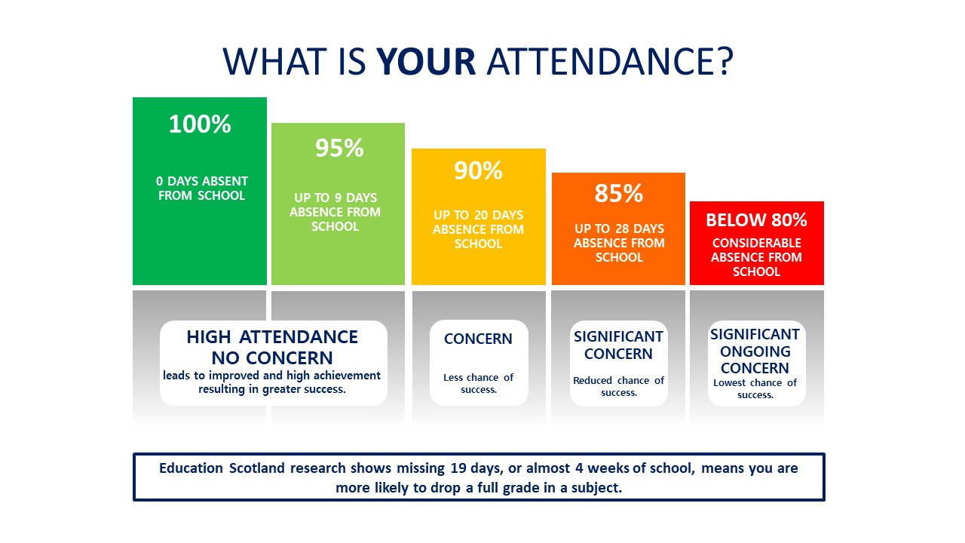

Slide 9

Sam Baker
Caitlin McCorgray
Luke McKee
Daniel Barnes
Aimee Aitchison
Eva McNeil
David Walker
Traci Masson
Jamie Helley
Taylor Moran
Evie Loughray
Adelaide Fisk
Steven Grant
William Fulton
Kallum Gilmour
Alfie Maclachlan
Alexander Meredith
James Lindsay
Lloyd Ryan
Reserve List
Robert McCrumb
Jessica Ewing
Lee McManus
James Gibson
Jack McKinlay
S5/S6 ONLY
List shows who CURRENTLY is coming to Alton Towers.
3 reserve list pupils have already been moved up into the list! Current reserve list also is shown.
Reminder that this can change due to attendance. Attendance will be monitored 2 weeks before trip and pupils under the 92.5% mark will be fully refunded and place offered to reserve list pupils.
FULL PAYMENT DUE MONDAY 29TH SEPTEMBER ON IPAY IMPACT
Any issues or questions please come see Miss McCourt in D48
Domanic Coyle
Ava Monaghan
Nathan Ros
Scarlett Woods
Aaiva Muir
Mya Johnston
Alanna Clark
Sophie Agnew
Hollie Leckie
Skye Robson
Lennon McManus
Lee Fitzpatrick
Kerr Hill
Nathan Welsh
Ciara Harvey
Peyton Jamieson
Mark Marriott
Finlay James Fisher
Andrew O'Hare
David McNeil
Stella Morrison
Emily Duff
Darcy Webster
Sophie McKerrell
Emma MacDonald
Eva Kelly
Fiona Brown
Hayley Molloy
Sophie McCall
Tami Latta
Lexi Muirhead
Amber Grimley
Logan Riddell
Elise Wilson
Kinzie Breen
Lucie Gemmell
Jack McIlreavy
William Lewis
Alex Murdoch
Saihajleen Kaur
Erin Julia Ryan
Rhiannon Elizabeth Mima McMillan
Georgia Ann Patterson
Tafadzwa Mhiko
Nathan McCracken

Slide 10
Pupil Council
Lee Fitzpatrick – S6 senior leader
Pupil Council gives pupils a very important voice and the opportunity to shape what happens in school.
If interested go give your name at end of assembly. This will be passed to Miss Davis

Slide 11
S3-S4 pupils
Great opportunity to represent North Ayrshire’s Young people
Please speak to Miss Davis and she can put your name forward.

Slide 12
S4-S6 Supported Study
There will be supported study sessions running after school for most subjects in the run up to your prelims.
Supported Study Will Start From Monday 15th September
Prelims Will Start from Wednesday 26th November

Slide 13
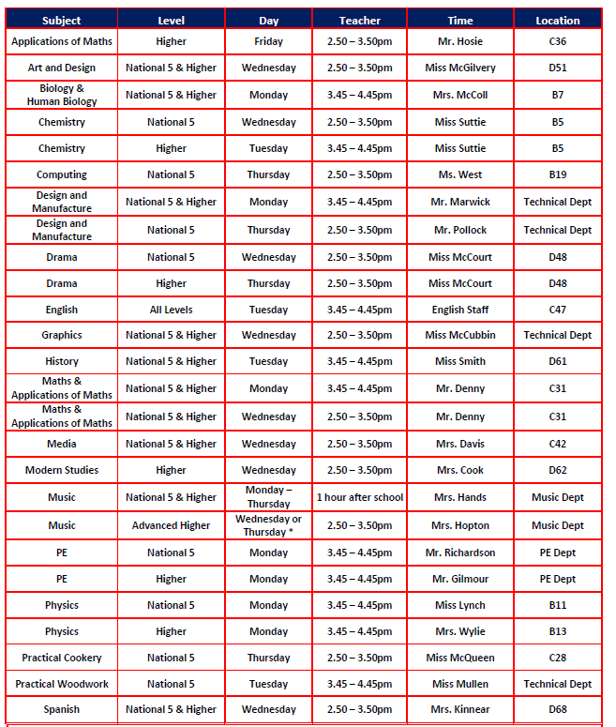
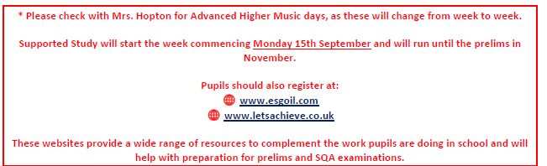
S4-S6 Supported Study
Supported study timetables will be emailed to all pupils
Paper copies are available from the back of the hall or from the office
The timetable will also be on twitter
Pupils who attend supported study do better in their prelims and exams
The library homework club will also run as well as the supported study sessions

Slide 14
S4-S6 Supported Study
To encourage people to go to supported study, you will receive a stamp each time you attend.
For every 8 stamps you will get a free drink from our Barista team
There will also be a £50 voucher for one lucky pupil
Mrs. McDade will let you know next week how this programme works

Slide 15
S6 Information
Prom
Yearbooks
Hoodies
Leavers Event

Slide 16

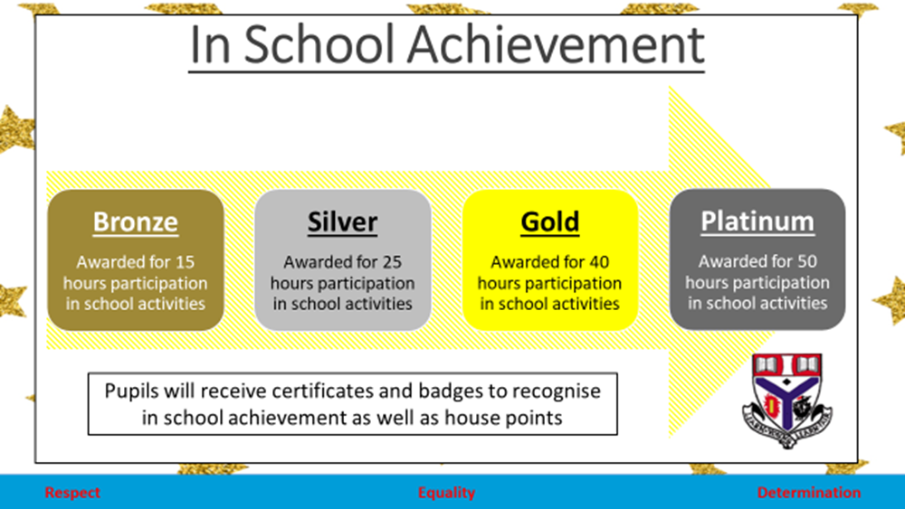

Slide 17
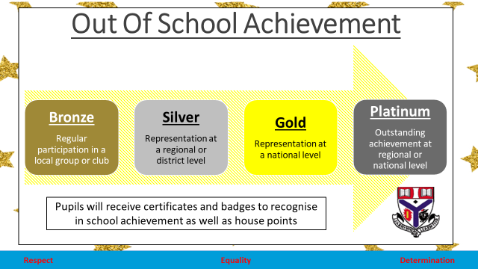

Slide 18
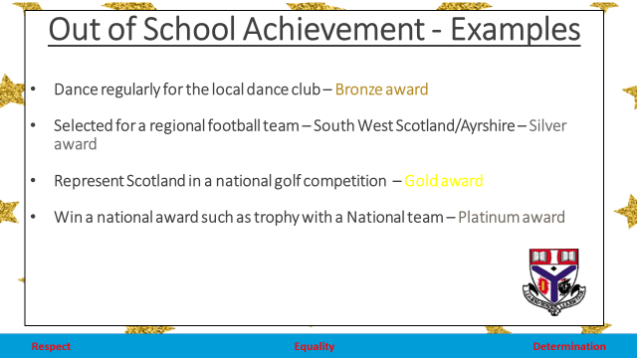

Slide 19
Extra-curricular Fayre
Ta
Taking place in the Assembly Hall,
Friday 5 September 2025.
Opportunity to sign up to many extra-curricular clubs for lunch times and after school

Slide 20
Careers Advisor – Lesley Niven
Ta
Lesley will now be based in an office next to HTs room and not the library
Regular updates at assembly

Slide 21
Health and Safety
Ta
The corridors and stairs can be very busy at certain times during the day. Calm and sensible behaviour is a must at all times
C floor corridor can become very busy eg at the end of period 1 on Wednesday. S3 leaving the dept and S1 arriving and Maths have S2 leaving.
S2 to be advised to use the middle stairs rather than coming to the stairs at the end of the corridor.

Slide 22
Fire Evacuation
Expectations
Ta
Priority is evacuating the building calmly and safely. Do not gather your belongings
Listen to instruction from your teacher.
Leave the area in a sensible and orderly fashion and when out of building go directly to your assembly point – S1-S3 in the playground and S4-S6 the astroturf
Area is marked for both areas
Stay in your register class – do not wander. Must listen for your name so that register can be taken.
Only go back in the building when given instruction to do so.

Slide 23
Any questions?

