Slide 1
Trauma Informed Contact & Care Initiative (TICC) Briefing to Schools February 2022

Slide 2
Overview
Background to Trauma Informed Contact & Care (TICC)
Overview of domestic abuse and its prevalence in Scotland
The impact that domestic abuse can have on children
Why TICC is important
Process should follow should you get a TICC disclosure from Police
**Self Care is Important**

Slide 3
Trauma Informed Contact & Care (TICC)
2018 - Ayrshire Division & Partners introduction to ACE’s and impact of trauma
Test of Change 2019 across Ayrshire - Operation Encompass
Set up in 2011 in England and related to incidents where a child had been exposed to an incident of domestic abuse
Efficient, confidential communication process between police and Named Person / CP Co-ordinator
Immediate recognition of the child's situation that enables staff to provide appropriate, proportionate and timely support
Adopted a similar framework to Operation Encompass but recognised processes already in place across Scotland including GIRFEC
Implementation in schools across East, North and South Ayrshire commenced from September 2021.

Slide 4
Domestic Abuse Definition
Any form of physical, verbal, sexual, psychological or financial abuse which might amount to criminal conduct and which takes place within the context of a relationship. The relationship will be between partners (married, cohabiting, civil partnership or otherwise) or ex-partners. The abuse may be committed in the home or elsewhere including online.

Slide 5
Domestic Abuse in Scotland 2020/21
Police Scotland recorded 65,251 incidents of domestic abuse in 2020/21, an increase of 4% compared to the previous year. This is the fifth year in a row this figure has shown an increase. (2019/20 62,907 recorded incidents.)
In 2020/21, 40% of incidents of domestic abuse recorded by the police in Scotland included the recording of at least one crime or offence
The crime or offence that was most frequently recorded as part of a domestic abuse incident was Common assault (accounting for 32% of all crimes and offences recorded). This was followed by Breach of the peace etc. which accounted for 23% of crimes and offences. This includes stalking and abusive behaviour
Where gender information was recorded, more than four in five incidents of domestic abuse had a female victim and a male accused.(80%) This decreased slightly from 82% in 2019/20

Slide 6
Domestic Abuse 2020/21
In 2020/21, the 31 to 35 years old age group had the highest incident rate for both victims and accused.
50% of incidents were between current partners, 49% between ex partners and 1% was classed as other.
Three-in-ten incidents (31%) occurred at the weekend in 2020-21. This is a slight decrease from 34% in 2019-20.
In 2020-21, Just over nine-in-ten (91%) of all domestic abuse incidents occurred in a home or dwelling.

Slide 7
Location of Incident
Joint Home – 15%
Victims Home - 39%
Accused's Home – 6%
Other dwelling – 31%
Street – 5%
Licensed premises – 0.2%
Other – 4%

Slide 8
Known Frequency
No Previous Incidents – 23%
Previous Incidents – 64%
Mix of Previous Incidents – 14%
Total – 65,251

Slide 9
What children may experience when living with domestic abuse
The tension of waiting for it to happen
Overhearing violent incidents
Being degraded and belittled
Drug/alcohol misuse
Destruction of property or belongings
Abuse of siblings and/or family pets
Forced participation/being made to watch abuse & aftermath of injuries and distress
Being deprived of family and social contacts (limiting disclosure)
Day to day control of family life
Arrests / attempted suicides / death

Slide 10
The Reality
https://www.youtube.com/watch?v=mrtNAsnXJgk

Slide 11
Effects of Domestic Abuse on Children
They may become anxious or depressed
They may have difficulty sleeping
They may have nightmares or flashbacks
They may complain of physical symptoms such as tummy aches
They may start to wet their bed
They may have temper tantrums
They may behave as though they are much younger than they are
They may have problems at school, or may start truanting
They may become aggressive
They may internalise their distress and withdraw from other people
They may have a lowered sense of self-worth
Older children may start to use alcohol or drugs
They may begin to self-harm by taking overdoses or cutting themselves
They may develop an eating disorder

Slide 12
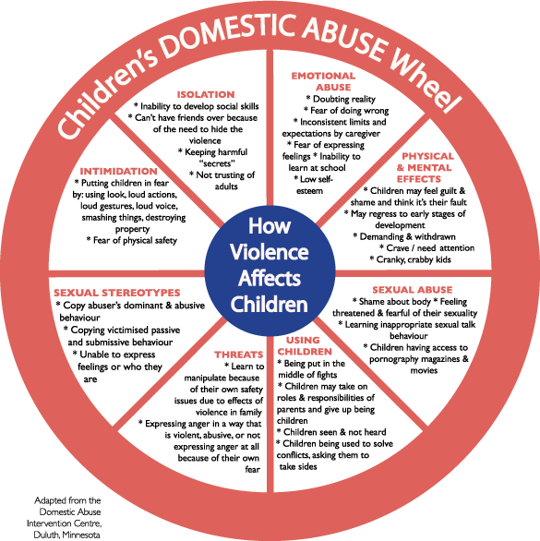

Slide 13
Children In School
Children who are experiencing domestic abuse at home will possibly arrive at school the following morning in a high state of anxiety about what they may have been exposed to (seen or heard) the night before.
They may be exhausted through lack of sleep with heightened stress.
A child who is anxious and dysregulated is a child who cannot learn.

Slide 14
Adverse Childhood Experiences (ACE’s)
ACE’s are stressful events occurring in childhood and include domestic abuse, parental abandonment (through separation or divorce), a parent with a mental health condition, victim of abuse, victim of neglect, a member of the household being in prison, growing up in a home where there is substance misuse.
When children are exposed to adverse and stressful experiences, it can have a long lasting impact on their ability to think, interact with others and on their learning.
https://www.youtube.com/watch?v=omPdemwaNzQ

Slide 15
Adverse Childhood Experiences (ACE’s)
The single most critical factor in how children cope to exposure of domestic abuse and other Adverse Childhood Experiences is the presence of at least one loving and supportive adult in their life.
Children without any support, who are isolated or lack nurturing adults in their lives are more negatively affected by their exposure to domestic abuse.

Slide 16
Children want:
Someone to talk to
Someone to listen to them
Someone who will treat them as an independent person
The Information from TICC enables you to change…
What’s wrong with you?
To
What’s happened to you?

Slide 17
Our Gift
https://www.youtube.com/watch?v=omPdemwaNzQ

Slide 18
Trauma Informed Contact & Care (TICC)
A police and education early intervention partnership which supports children and young people exposed to domestic abuse.

Slide 19
TICC
Process to ensure that prior to the start of the next school day, a Named Person / Child Protection Co-ordinator will be informed that a child/young person has been exposed to a domestic incident in the last 24 hours.
The information given to schools allows the provision of immediate early support depending on the wellbeing needs and wishes of the child.

Slide 20
TICC Contact
The following information will be passed via e-mail to the Named Person Service in Education. This email will be issued prior to the start of the school day. The information given by Police will be:-
Name and Date of Birth of child
Police Reference Number
Time and Date of Incident
Brief circumstances where the child was present, exposed to or involved in the incident (ie Violence and/or weapons)
Wishes of the Child

Slide 21
TICC Care
What happens after this email is received?
Named Person / Child Protection Co-ordinator should:
Follow the GIRFEC Child’s Pathway
Consider your knowledge of the family and any additional information you have
Take account of the child's views, and if appropriate talk to the child and/or parent/carer and offer support
Record information in Pastoral Notes and in the AYRshare chronology if appropriate
If required carry out a wellbeing assessment and follow Team Around the Child Processes
Information regarding the incident will continue to be shared with Social Work by the Police.
If significant concerns arise then follow Child Protection Procedures.

Slide 22
Information Sharing
Notes:
Follow Information Sharing Guidance within the GIRFEC Practitioner Guide.

Slide 23
Next Steps
Following this briefing the Child Protection Co-ordinator will disseminate the appropriate information to all staff in the school
Parents will be informed that their child’s school is part of the Trauma Informed Contact & Care Initiative (TICC) and it will be included in the school handbook and on their website
The GIRFEC Child’s Pathway will be followed when a TICC disclosure is received by the school. These will include the views of the child where appropriate
Monitoring commenced from implementation in September 2021 and will continue until June 2022 when a further evaluation will take place.

Slide 24
Questions?
get it right for me
TICC

