Slide 1
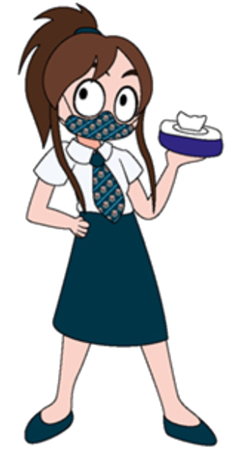
Auchenharvie Academy
Senior Phase Information
University Applicants
School Leavers
Option Choices
College Link Courses
S4 REACH
Senior Career Information - Google Classroom
Who can help me?

Slide 2
Our Vision:
To provide an equitable and excellent learning environment for ALL pupils which enables them to maximise their full potential and supports them into appropriate, positive and sustainable destinations.
Our Values:
Respect Equality Determination

Slide 3
University Applicants - S5/6
How can we help?
All pupils who have applied to UCAS - check your email and UCAS track regularly
https://www.ucas.com/undergraduate/after-you-apply
When you receive an offer from a university
Types of offers:
https://www.ucas.com/undergraduate/after-you-apply/types-offer/replying-your-ucas-undergraduate-offers
Making the right decision/responding to universities:
https://www.ucas.com/undergraduate/after-you-apply/making-right-decision

Slide 4
University Applicants - S5/6
How can we help?
Check on funding for your course:
https://www.saas.gov.uk/
Webinars - https://www.eventbrite.co.uk/o/student-awards-agency-scotland-460580653
Let Mr Herd and/or Miss Morton know about your offers and what one you are thinking of accepting
We can help with a back up plan for other applications
You will be able to attend a leavers support session via MS Teams:
Each Monday P4 – 11.40 – 12.30
We will email a link to invite you and there is a link on the Senior Career Information Google Classroom

Slide 5
School Leavers - S4, S5, S6
How can we help?
Email Mr Herd or Miss Morton to confirm you are thinking of leaving
(if you have not already)
We can help with college, employment, modern apprenticeships and training…
You will be able to attend a leavers support session via MS Teams:
Each Monday P4 – 11.40 – 12.30
We will email a link to invite you and there is a link on the Senior Career Information Google Classroom
SDS Advisors will be able to offer one to one support via email, telephone or MS Teams
Online resources such as: PlanIT Plus, My WOW, college websites available
Senior Career Information Google Classroom – pupils can fill out a Ayrshire College
application form to help with college applications & personal statements:
https://www.youtube.com/watch?v=7vQw0sq8Od0&safe=active

Slide 6
Option Choices - S4 & S5 (March)
How can we help?
Given the present circumstances of remote learning, S4/5 pupils will not have the opportunity to meet with their pastoral care teacher and/or depute head to discuss option choices for next session on a face to face basis
Your pastoral teacher will make contact/telephone to discuss your options, the timeframe for this will be in March and the school will be in touch to confirm the roll out of option interviews via the Head teacher update
If there is a specific time that parents/carers would like to schedule a telephone call to discuss option choices this can be done by emailing your Pastoral Teacher (contact details on later slide)
Please note that there is a copy of the Senior option form available on the school website at: https://blogs.glowscotland.org.uk/na/auchenharvieacademy/options/
SDS Advisors will be able to offer one to one support to give you career advice
before your option interview via email, telephone or MS Teams (contact details on later slide)
Online resources such as: PlanIT Plus, My WOW, college & university websites available

Slide 7
School Link College Courses- S4, S5, S6
Staying on at school but doing a college course as part of your timetable
How can we help?
Email Mr Herd or Miss Morton to confirm you are wanting to do a college course (if you have not already)
You will be able to attend an application support session via MS Teams:
Each Tuesday P4 – 11.40 – 12.30
We will email a link to invite you and there is a link on the Senior Career Information Google Classroom
SDS Advisors will be able to offer one to one support via email, telephone or MS Teams
Online resources: Ayrshire college website
https://www1.ayrshire.ac.uk/schools/
Senior Career Information Google Classroom – pupils
to fill out a Ayrshire College school application form and there is also an
application support video to help you:
https://www.youtube.com/watch?v=7vQw0sq8Od0&safe=active

Slide 8
School College Link Courses

Slide 9
School College Link Courses

Slide 10
School College Link Courses

Slide 11
School College Link Courses

Slide 12
REACH for S4
Pupils who are considering going to university
If any S4 are interested in studying any of the following courses at university can you please email Miss Morton by no later than Thursday 26th February
We have an opportunity to work with Glasgow University on the REACH qualification which can help gain entry to university courses below
Teaching
Engineering
Vet Medicine
Medicine
Dentistry
Law
Accounting & Finance

Slide 13
Senior Career Information - Google Classroom
Leavers, college link courses, career opportunities, careers guidance, webinars & work experience
Access this resource through logging on to Glow
Click on the Google Classroom tile on the Glow main screen

Slide 14
Who can help me?
School Supports
Mr Herd (DHT) gw09herdjohn@ea.n-ayrshire.sch.uk
Miss Morton (PT DYW) gw17mortonkayleigh1@ea.n-ayrshire.sch.uk
Miss Walker (School Librarian) gw16walkersuzanne@ea.n-ayrshire.sch.uk
Miss Shaw (PTPC Parkend) gw09shawhelen@ea.n-ayrshire.sch.uk
Mrs Scott (PTPC Warner) gw09scottclaire4@ea.n-ayrshire.sch.uk
Miss Lynch (PTPC Ashgrove) gw16lynchamanda@ea.n-ayrshire.sch.uk
SDS Careers Guidance
Lesley Niven (Careers Adviser) lesley.niven@sds.co.uk or 07917200965
Christine Strain (Work Coach) christine.strain@sds.co.uk or 07766087074

