Slide 1
Family Learning
‘A strategic approach to improving outcomes for pupils through targeted family learning and working in partnership with parents.’

Slide 2
Meet the team
Allison Hopton
Principal Teacher of Family Learning
Angie Pirie
Area Inclusion Officer
Stephen Scholes
Depute Head Teacher (Acting)
Respect Equality Determination

Slide 3
Our School
Our school is a six year non-denominational school.
Our catchment covers Stevenston and Saltcoats in North Ayrshire.
Our current school roll is 648.
Respect Equality Determination

Slide 4
Why Family Learning?
Many of our families face challenges to supporting their young people to attend, attain and achieve.
The Pupil Equity Fund allowed us an opportunity to focus on Family Learning as an intervention.
Respect Equality Determination

Slide 5
1. ‘Targeted’ Parents in Partnership Programme
2. ‘Universal’ Programme of Events
Respect Equality Determination

Slide 6
CELCIS
6 week programme for parents/carers
Experience of school in the eyes of their young person
Parents in Partnership
Respect Equality Determination

Slide 7
How we targeted parents/carers
Made aware of targeted families
Telephone contact -Summer holidays
Home visit
Contact 1 week prior to programme
Respect Equality Determination

Slide 8
P.I.P in Auchenharvie – 2017/18
Date | 10-10.35 | 10.35-11.25 | Interval | 11.40-12.30 | 12.30-13.20
Week 1 | Tea/Coffee & hot roll | Welcome from HT | Tea/Coffee Conference Room | Art | CLD
Week 2 | Tea/Coffee & hot roll | Science | Tea/Coffee Conf. Room | PSE | Maths
Week 3 | Tea/Coffee & hot roll | English | Tea/Coffee Conf. Room | Music | Parental Empowerment
Week 4 | Tea/Coffee & hot roll | Mod. Languages | Tea/Coffee Conf. Room | Soc. Subjects | Credit Union
Week 5 | Tea/Coffee & hot roll | Digital Literacy | Tea/Coffee Conf. Room | Technical | Barnardo’s
Week 6 | Tea/Coffee & hot roll | Drama | Tea/Coffee Conf. Room | Technical | Graduation Ceremony
Respect Equality Determination

Slide 9
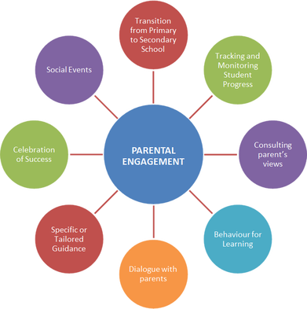
PIP Moving forward
Parents fully engaged – didn’t want to stop coming to school!
Second block
Parental empowerment course
Whole school events including school show and open evenings
100% attendance at parents’ evenings
Respect Equality Determination

Slide 10
PIP Moving forward…
SQA accredited courses in Literacy, Numeracy and Volunteering
Barista training from senior pupils
6/10 initial group full time employment or full/part time education
New group joined after initial 6 week block
Targeted the same way – measure impact
Respect Equality Determination

Slide 11
Impact on staff…
“I have realised that there is benefit to having a programme like this run in the school. The parents were brilliant to work with and have shared with me stories of how it has impacted their relationship with their child and how this has had a positive impact on their child’s attendance at school.”
“I had a positive experience teaching the PIP group, so much so that I’m continuing to teach them Spanish a period a week over a 4 week block. I thought the parents and carers were really keen to learn and enjoyed taking part.”
Respect Equality Determination

Slide 12
Impact on parents…
“I cannot thank the staff enough. This programme has allowed me to gain more confidence when engaging with the school. From doing my National 5 Numeracy, I have been able to help with Maths homework at home which has helped with having more conversations with my son at home.”
“I am so glad I decided to come along to this programme. I am now at college part time and have applied for a summer job to gain more experience to help me with my course. I would never have done this if I hadn’t started the programme.”
Respect Equality Determination

Slide 13
Impact on pupils . . .
‘My Gran now knows what I have on at school and who to speak to if I don’t understanding things. I think it’s a good thing . . . most of the time!’
‘I am a young carer and have helped looked after my Mum for a long time. She’s never mentioned going to university and now she has been accepted into a course.’
Respect Equality Determination

Slide 14
Universal programme of events
Events for all Parents/Carers
Respect Equality Determination

Slide 15
So far…
Internet Awareness
Show My Homework
Materials for parents to help at home
Mindfulness workshops
Zumba
Parents leading parents
Respect Equality Determination

Slide 16
What next?
Continuing to build links with agencies to best support our parents.
Add to our programme of events based on the needs and requirements of our families.
Looking at learning tutorials on school website from each Faculty.
Respect Equality Determination

Slide 17
Aim for a community in which parents/carers feel included and involved in their young person’s learning and, most importantly, knowing how they can best support their young person at home.
Respect Equality Determination

