Slide 1
Supporting Attendance
North Ayrshire Council
Notes:
Supporting attendance is one of the key priorities in North Ayrshire’s service improvement plan – we need to focus on both the preventative – promoting attendance where we can through working with parents and partners, making school a welcoming and inclusive place to be and ensuring we have a range of approaches to support attendance. Then when issues do occur we want to tackle these early and ensure we have targeted supports and interventions

Slide 2
Agenda for the session
National context
Local context
What impacts on attendance
What supports attendance
School Role
Family role
Supporting attendance in North Ayrshire – what is available
North Ayrshire Council
Notes:
This session is intended to be used flexibly to support groups of school staff, parents and partners – it may be helpful to take out the slides you don’t wish to use with certain groups – e.g.may not want to have national context for all or may not want all of the data for certain groups. This is intended to be adapted to meet local/community needs. So please feel free to also add some slides about your own school and community and the supports that you can offer.

Slide 3
Attendance in the News!! Its not just us
Guardian Headline Nov 2023 - School leaders in England feel lockdown ‘broke spell’ of bond with parents
SkyNews Sep 2023 - Parents don't believe children must be in school every day anymore –
Sydney Morning Herald Mar 2023 - School attendance has plummeted. And it’s not just because of COVID
Northen Ireland Oct 23 - Summit to address serious pupil attendance issues at school
North Ayrshire Council
Notes:
Attendance has been in the news a lot in recent years as you can see from these headlines – not just in Scotland but across the UK and beyond. This has no doubt been significantly affected by COVID and the pandemic but some of the trends around attendance started before that – impacted upon by mental health and anxiety issues, also people seeing school differently – not as compulsory in some instances.

Slide 4
National Guidance….
‘Whilst both the causes and the impact of poor attendance are known to be complex and multifaceted, research demonstrates the potential impact that poor attendance can have. Poor attendance has been linked to lower levels of attainment; peer relationships; emotional and behavioural difficulties and poorer employment opportunities.
- Included, Engaged and Involved Part 1, A positive approach to the promotion and management of attendance in Scottish Schools
Notes:
This is the last national guidance around attendance issued by the Scottish govt and although out of date to some extent still has some important messages, particularly around the importance of attendance for later outcomes. Often schools are where children and young people learn life skills etc as well as learning about the curriculum and attainment. Often when school fails for young people they can become isolated and mental health issues can increase.

Slide 5
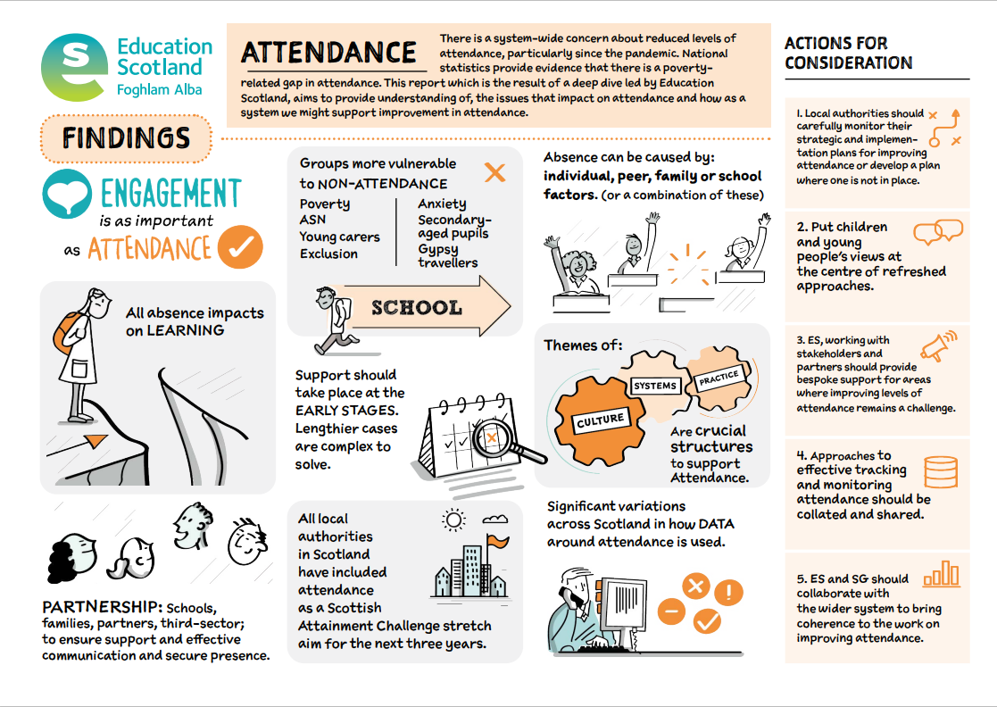
Improving Attendance: Understanding the issues
All absence can affect progress
The causes of absence are multifaceted and need to be understood
Need to look at school culture, systems, and practice to consider approaches to improving attendance and engagement
Schools should work in partnership with families and others
Early warning systems should initiate intervention
North Ayrshire Council
Notes:
This is taken from a report that was completed by Education Scotland in November 2023 – it again emphasised how any absence can affect overallprogress. That the reasons behind it are complicated and it is important to understand the different underling reasons. School culture and how they support attendance is important – lots of different things they can do to improve attendance but need to work in partnership with families as it can feel sometimes like they are working against one another. Need to look for early signs as if wait until non-attendance is significant can be too late to do anything. Analysign our data is also a key part in supporting attendance.

Slide 6
Absent Minds Report
The research shows:
Nearly one in three children are missing an average of one day per fortnight
One in eight are missing a day a week
Nearly 20 per cent of high school pupils miss a day every week
And 2-in-5 miss a day every fortnight, including during the examination years
There is significant variation at local authority level, with some particularly concerning levels of absence in secondary schools:
Half of secondary pupils are missing a day every fortnight in Dundee, East Ayrshire, North Ayrshire, North Lanarkshire and West Dunbartonshire
This compares to one-quarter or less in East Dunbartonshire, Highland, South Lanarkshire and Stirling
North Ayrshire Council
Notes:
This report was pulled together by a group called School reform who did an FOI on attendance from every local authority and pulled together the data – this was at a time when Scottish Govt were not collecting the data.
Some of questions posed by this group
Did school closures in 2020 and 2021 weaken parent’s view about the necessity of compulsion in schooling?
As a society, do we no longer think attendance is as important?
“The social contract between parents and schools has been fractured by lockdowns and closures.” And she warned: “That social contract took years to build and consolidate and it will take time to restore.”
Hopes for the new curriculum – Hayward Review
“The unquestionable belief that school must be attended was exploded. It’s predictable and expected to see that for some families, those have been hard habits to rebuild. And inevitably it’s the families who already struggle, who have struggled the hardest to build them,

Slide 7
Key messages
Attendance less than 90%
Missing one day of school every two weeks
Attendance less than 80%
Missing one day of school every week
An average attendance of 90% from P1 to S3
Missing around a whole school year
Notes:
Its important to understand what the data means in context – in NA we start to track attendance more carefully when it drops below 90% as that figure means that a child will over time miss at least one day of school every two weeks which is a significant amount.
When it drops below 80% they are then missing a day of school every week. Often it is difficult to catch up on learning when that happens.
If this pattern was repeated throughout school they would miss nearly a whole year.

Slide 8
What are the risk factors for low attendance?
Research demonstrates that a range of child, family, peer, community and within school factors impact on low attendance
If we understand the causes, we can tackle the symptoms
In order to tackle the causes, we need to look at all aspects of school absenteeism
Notes:
When we look at attendance it is easy to think that children don’t attend because they are anxious/lacking in resilience, etc or to blame parents and say it is down to them having a negative or permissive attitude. Sometimes children do have anxiety that goes beyond school or parents are very negative and lacking in motivation regarding school – but often there can be a combination of reasons which come from school, community, children and parents. When a child is ill they may struggle to get back and become anxious, if parents fail to notice this or tackle it and if schools don’t put in special arrangements to welcome them back and support them – all of these factors can combine to make non-attendance a greater issue. Schools need to both set high expectations for attendance alongside ensuring that they are being empathetic and supportive when required.

Slide 9
Factors impacting on attendance - School
Behavioural issues
School expectations of pupils
Relationships with teachers, including potential conflict
Levels of support for pupils, including feeling stigmatised
Appropriateness of curriculum/learning and teaching approaches
Understanding and response to needs of diverse cultures and learning needs/styles of pupils
Effective monitoring of attendance
Appropriate early intervention
Environmental factors within the school – noise, too busy, etc.
Anxiety around school
Bullying/peer conflict
North Ayrshire Council
Notes:
There are many aspects of school life that can exacerbate attendance issues. When children experience behavioural issues at school this can make them more likely to stop attending – we need to find ways to help them feel settled and welcome in school – school connectedness is a significant protective factor for attendance and having a relational and positive approach to pupils can help prevent future issues.
Again expectations are important – we need to set them high and consistent but also know that if pupils are in difficulty we may have to be flexible in our approach.
While lots of initiatives like cost of the school day, breakfast clubs, support for period poverty etc can help prevent stigmatising pupils – there are sometimes things we can do inadvertently that can stigmatise – e.g. making a fuss of latecoming if the yp is a young carer who needs to get younger siblings ready.
Teachign and learning is key to tackling non-attendance – need to listen to pupils to help them with this.
Pupils may have sensory issues and may require areas of the school that are calmer and less overwhelming.

Slide 10
Factors impacting on attendance – Family/community
Parental support or influence
Competing family priorities: for example conflicts family holidays; caring for/supporting families;
Domestic violence; child abuse or neglect;
Drug or alcohol abuse
Cultural obligations
Involvement in gang or territorial activity
Consequence of exceptional circumstances eg Care Experienced, Kinship Care, Fostering, Young Carer
Coping with adversity and trauma
Peer group influence can be an important factor in attitudes to school.
Parental mental/physical health difficulties
North Ayrshire Council
Notes:
There are many factors that can impact on attendance relating to family and community – parents may have had a negative experience of schools themselves and this may then influence how they support their child or yp; families may have different priorities to school also such as caring for others or taking holidays – communication around this can be key. Domestic violence can have a significant impact on children’s ability to attend school. There may be cultural obligations that can impact on attendance such as attending certain events, etc – dependent on the community of the school – it could be helpful to meet with community reps to discuss what is expected in this area – some things will be important and others less so.
Some children can be involved in gangs or territorial issues in the community that affect their attendance as they may be afraid or be threatened.

Slide 11
Factors impacting on attendance – Child/personal
Previous negative experiences of school
Lack of engagement and motivation for areas such as future positive destinations, course choices.
Pupil's own health and wellbeing - for example difficulties with mental or physical health
Social and emotional needs
Loss or bereavement
Poor academic progress
Low confidence, self-belief or self esteem
Fear of returning to school following absence
Bullying or conflict with others
Issued relating to Social Media
Difficulties with authority
Substance or alcohol use
Difficulties managing lots of transitions
North Ayrshire Council
Notes:
Children may have had a negative experience of school and this impacts on their future engagement, they may not have much motivation or engagement with how education can support them and this makes it difficult for them

Slide 12
Comparing stakeholder views
Most common | Parents/ carers – Higher attendance | Parents/ carers – Lower attendance | Children - Primary | Children - Secondary | School SLT | Partners
1st | Children’s physical health/illness | Children’s mental health | Children’s physical health/ illness | Children’s mental health | Parental mental health | Children’s mental health
2nd | Children’s peer relationships | Children’s peer relationships | Children’s mental health | Bullying | Children’s mental health | Children’s emotions and behaviour
3rd | Children’s mental health | Children’s emotions and behaviour | Someone being ill at home | Children’s physical health/illness | Family attitude to school | Peer relationship issues
Children’s mental health was a common factor across all stakeholders
Schools thought that parental mental health and family attitude to school were common reasons, whereas parents/carers, children and partners thought physical/mental health and peer factors were more common
Notes:
NA carried out a survey with different groups of stakeholders including parents, children in primary and secondary, school Senior leaders and partners –n this is what they felt the most common factors were in non-attendance.
we looked at the commonalities across the different stakeholder groups that participated in this survey
Children’s mental health – common factor across all stakeholders (particularly felt by parents/carers of children with lower attendance, Secondary pupils, and Partners)
Some differences - schools thought parental mental health and family attitudes were more common reasons behind non-attendance, whereas parents/carers, children and partners thought physical/ mental health or peer factors were more common

Slide 13
What is the extent of the problem in NA?
Year | Pupil Numbers | Attendance Rate | Under 90% | National under 90%
2018/19 | 18516 | 92.13% | 4667 (25%) | 141,502 (21%)
2021/22 | 18278 | 89.44% | 7078 (39%) | 218,787 (34%)
2022/23 | 18169 | 88.78% | 7171 (39%) | 210,672 (32%)
North Ayrshire Council
Notes:
Commission of school reform include education academics, Keir Bloomer (Chair): Education Consultant and former Director of Education • Cllr Sarah Atkin: Independent Councillor at The Highland Council and member of the Education Committee. Former Parent Council Chairwoman and School. Worked in ASN for 12 years. • John Barnett: University Court Member, retired finance professional and former Parent Council Chairman. • John Edward: Scottish Council on Global Affairs, Former Director SCIS; Trustee of Scottish European Educational Trust and Board Member of AGBIS. • Carole Ford: Former head teacher of Kilmarnock Academy and former president of School Leaders Scotland • Jim Goodall: Former Head of Education and Community Services at Clackmannanshire Council and former Lib Dem councillor at East Dunbartonshire Council • Anna Hazel-Dunn: Headteacher, Royal High Primary, Edinburgh • Johann Lamont: Former teacher (1979-99) and retired Member of Scottish Parliament (1999-2022) • Frank Lennon: Former Head of Dunblane High School and St Modan’s, Stirling • Ross Martin: Economic agitator with experience in a variety of roles in education – including school teacher, voluntary tutor, chair of local education authority, member of college board and university court, Chair of a charity, and, most importantly, a parent and former student. • Lindsay Paterson: Professor emeritus of education policy in the School of Social and Political Science at Edinburgh University
Felt SG data and statistics on attendance were inadequate at identifying the scale of the problem. Did an FOI to look at both overall attendance rates, absence rates and persistent absence rates…..
Under 90% equates to missing one day every two weeks as we saw earlier – our figures have actually been shown to be worse than this with over 40% under 90%. We also have the highest figures for holidays taken in term time and our primary figures are in the lowest 3 for LAs.

Slide 14
Attendance Statistics
NAC 2018/19, 2021/22 and 2022/23
NAC attendance across years
The proportion of pupils who struggled to attend school (i.e., had below 90%, 80% or 50% attendance) increased between 2018/19, 2021/22 and 2022/23.
The proportion of pupils with below 80% and 50% attendance almost doubled between 2018/19 (pre-Covid) and 2022/23 (post-Covid).
Below 90% attendance = 1 day missed per fortnight
Below 80% attendance = 1 day missed per week
Below 50% attendance = 2.5 days missed per week
Notes:
Overall attendance in NA. This line graph shows how our figures have worsened over time – only 26% were lower than 90% in 2018/19 – in 22/23 this had risen to 41.9%
2018/19 – 74.8%
2021/22 – 61.3%
2022/23 – 62.8%

Slide 15
Comparing NAC with national average – below 90% attendance
North Ayrshire had higher proportions of pupils with below 90% attendance than the national average across all years.
The proportion of pupils with below 90% attendance increased each year in North Ayrshire.
Whereas the national average increased between 2018/19 and 2021/22 before falling slightly in 2022/23.
Below 90% attendance = 1 day missed per fortnight
National average sourced from the Commission on School Reform (2023)
Notes:
More info about national average:
Dumfries & Galloway did not provide figures for individuals stages in 2017/18 & 2018/19; Argyll & Bute and Orkney Islands councils did not have absence figures for 2022/23; Renfrewshire was not able to give figures for any years. As a result, the overall number of pupils in local authority schools in Scotland was adjusted to ensure that the percentage of pupils affected refers to only local authorities which submitted answers.
National averages includes NAC
For session 2023 -24 the % of children and young people in NAC with attendance below 90% was 37.81% this illustrates an almost 3% improvement fro session 2022-23 and brings us closer to 202-22 figures..

Slide 16
Comparing NAC with national average – below 80% attendance
In 2018/19, North Ayrshire had similar proportion of pupils with below 80% attendance to the national average (NAC: 8%/ National: 7.8%)
The proportion of pupils with below 80% attendance has increased each year in North Ayrshire.
Whereas nationally the proportion of pupils with below 80% attendance increased in 2021/22 before remaining steady in 2022/23.
Below 80% attendance = 1 day missed per week
National average sourced from the Commission on School Reform (2023)
Notes:
Gap between us and the national average widening – many factors involved in this.
For session 2023 -24 the % of children and young people in NAC with attendance below 80% was 15.11% a slight decrease on previous years.

Slide 17
What does some of the research tell us about what can support attendance?
A sense of belonging in school
Positive relationships with staff and peers
Appropriate learning and teaching
Building up engagement and confidence in learning
Good communication between families, other agencies and school
Appropriate and timely early intervention
Awareness of and assessment of factors impacting attendance and ensuring appropriate supports to meet this
North Ayrshire Council
Notes:
There are things we can do to combat some of these trends although the answer isnt easy. Much of this seems obvious but we sometimes have to see it through a different lens and be flexible in our approach – it often involves thinking out the box. So while we may feel we have good relationships in school – perhaps we need to use these to different effect with cyp who are beginning to have attendance issues, e.g. send a letter to the yp to let them know you missed them in a class; visit the yp home; help peers to get in touch with the yp.

Slide 18
Q: What approaches do schools use to support attendance?
The most common approaches used to support attendance were:
Nurturing relationships within the school
Differentiated learning and teaching to meet learner needs
Parental engagement
Very rarely
Very frequently
Notes:
Mean score calculated for each approach, based on ratings from schools from 1 (Very rarely) to 5 (very frequently). Schools already felt many of these things were beign put in place to support attendance so we may need to think differently about how we use them and share practice with each other on what has been impactful and effective. Also worth sharing with parents who may not be aware that many of these things are going on.

Slide 19
Comparing stakeholder views
Both parents of children with high attendance and schools recognised that schools did well with relationships with children and parents
Parents of children with lower attendance recognised that schools did well with bespoke timetables for attendance difficulties
Both pupils and schools recognised that schools do well in differentiated learning
Most common | Parents/ carers – Higher attendance | Parents/ carers – Lower attendance | Children - Primary | Children - Secondary | School SLT
1st | Relationships with children | Bespoke timetables | Clubs or activities | Learning at the right level | Relationships with children
2nd | Use of technology | Use of technology | Learning at the right level | Use of technology | Learning at the right level
3rd | Relationships with parents and carers | Relationships with parents and carers | Breakfast clubs | Clubs or activities | Relationships with parents and carers
Notes:
Interesting to note that when we spoke to different groups – they had different ideas about what school did well to support cyp with attendance. The parents/carers of children with good attendance agreed with schools and thought relationships were done well – however, those with lower attendance didn’t rate this in the top 3. They felt that bespoke timetables were the most helpful thing schools did and using technology. They also felt that relationships with them were important.
The children themselves mentioned clubs and activities as being important – it is often different incentives that can help draw children in – this was for primary and secondary aged children (who said this third) – learning at the right level was also seen as something school could do to help attendance.

Slide 20
Notes:
Outlines some of the ways that we can promote school connectedness and support cyp who are feeling anxious and stressed.

Slide 21
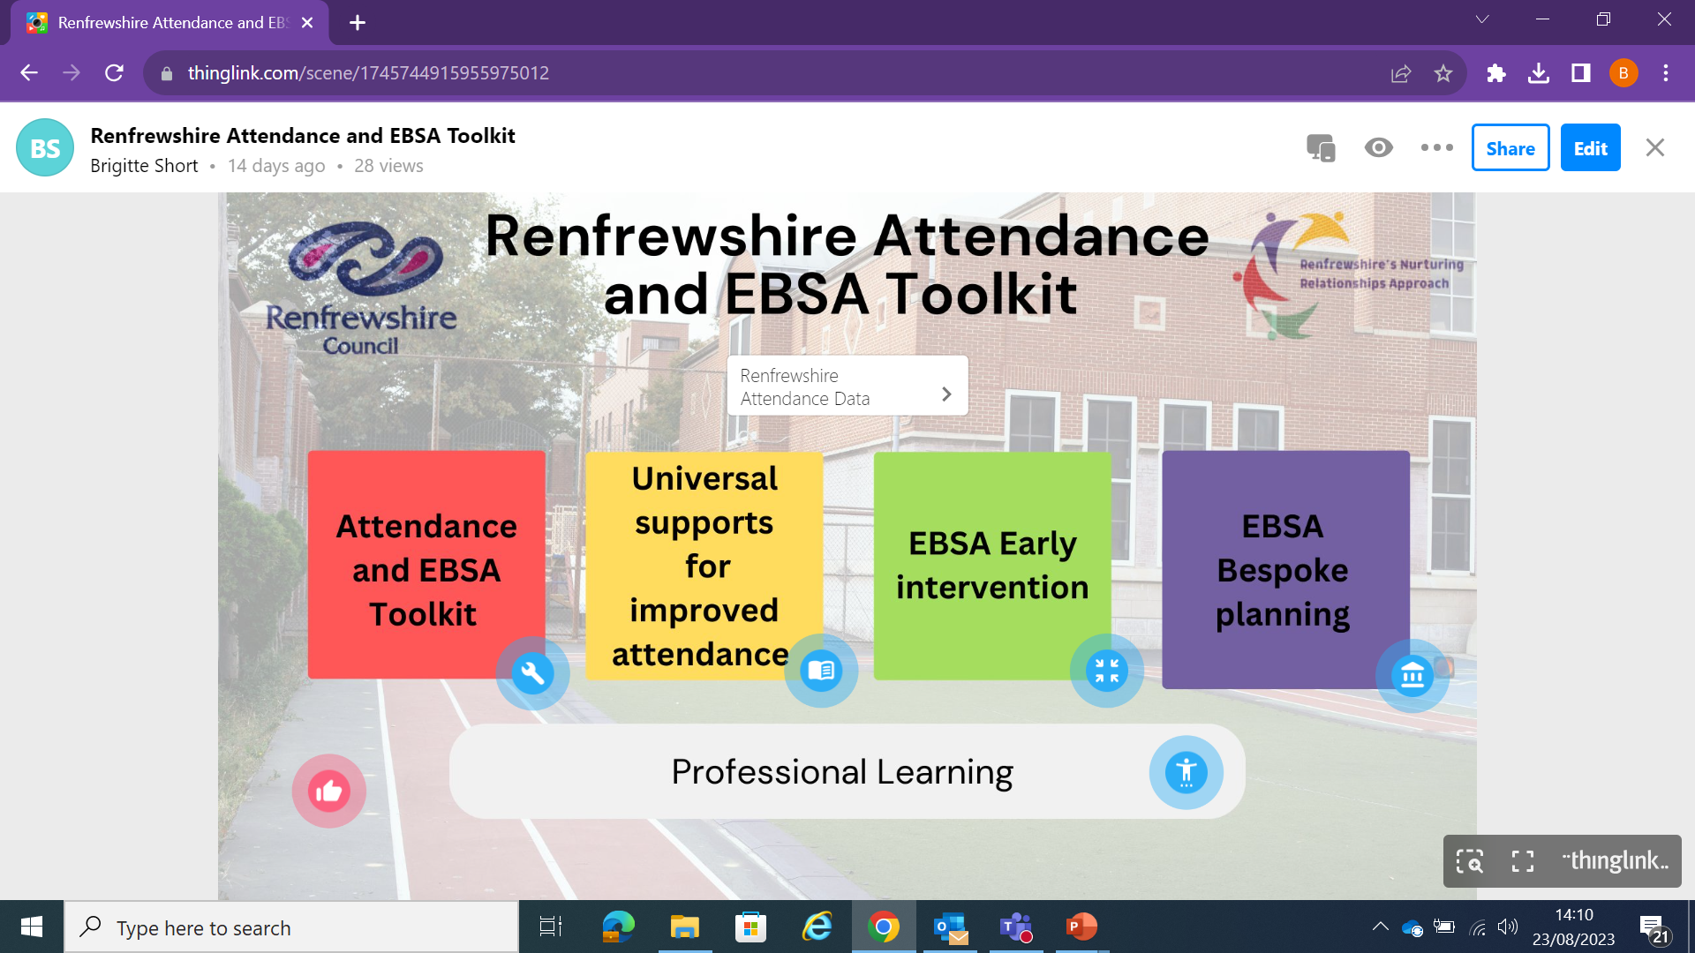
Renfrewshire's Attendance and EBSA Toolkit
ThingLink

Slide 22
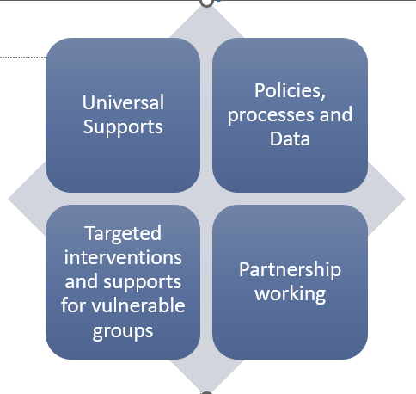
Support in North Ayrshire
Notes:
All LAs have included Attendance as a stretch aim. We have 4 key areas we are working on in NA – with 5 workstreams taking place to support attendance.
Improving school attendance: key principles
Here are some of they key principles set out in today’s report on school attendance :
1. Simply being in school is not enough
“Engagement is as important as attendance,” the report states. “Children and young people may physically be in school but can be disengaged from learning.”
2. Any absence can be harmful
“All absence can affect progress,” the report advises. However, it stresses that there are particular concerns when a pupil’s attendance falls below 90 per cent: “The higher the absence, the greater the impact on attainment.”
3. Low attendance is more likely in some groups
Certain groups are more vulnerable to low attendance, including:
Those affected by poverty
Secondary-aged students
Pupils from Gypsy and Traveller communities
Pupils with additional support needs, including: care-experienced
children and young people, young carers, pupils who have experienced exclusion, and anxious pupils.
4. Involving families is critical
Schools should work closely with families to ensure “effective communication and support” that will “remove barriers that impact on attendance”. The report authors found several examples of the positive impact of home-link workers or third-sector organisations.
5. Seek prevention, not just cures
“Early warning systems should initiate intervention,” the report states. Effective tracking and monitoring systems will “ensure early intervention is triggered”.
The report adds: “This is essential to avoid lengthier absences, which often require more complex interventions.”
6. Support is out there for schools
There are several resources to help schools improve pupil attendance. A number of these are listed on page 5 of the report.
7. Support for pupils must be more consistent
As part of the Scottish Attainment Challenge, all local authorities have included attendance as a “stretch aim” over the next three years, while 25 of Scotland’s 32 authorities have a “strategic plan” for improving attendance. Some 15 of the 18 schools sampled for the report included improving attendance in their improvement plans.
However, today’s report states: “There appears to be significant variations across Scotland in how data is used to identify children and young people who require support and the thresholds that trigger support.”

Slide 23
North Ayrshire Attendance Support
Universal supports for attendance in NA:
Developing alternative approaches to the curriculum
Nurturing approaches
The compassionate and connected curriculum
Building on Positive Relationships approach
Parental Engagement
Be Amasin’ (anxiety resources)
Targeted supports for attendance in NA:
Lets Introduce Anxiety Management (LIAM)
Project Restore
Extended Outreach and Tuition Services
Family Centred Wellbeing Service and Rosemount Project
Area Inclusion Workers
Supporting School Attendance in North Ayrshire (glowscotland.org.uk)
Notes:
Many of these supports are accessed via the school but some require a request for assistance such as family centred wellbeing service. Extended outreach and tuition need to be applied for through the Outreach support group and are usually at the extreme end of the continuum of supports.
An outline of these supports can be found on the supporting school attendance website for greater detail (link)

Slide 24
Discussion
Reflecting on the national and local picture – what do you think the key issues are?
What do you think your role might be in supporting attendance in North Ayrshire?

Slide 25
Exploring barriers to school attendance
Assessment and Early Intervention
North Ayrshire Council
Notes:
One of the key ways we can promote attendance is through exploring the barriers in more detail and being prepared to put into place supports at the early stages

Slide 26
What is EBSNA?
Emotionally Based School Avoidance (EBSA) or Emotionally based School Non- Attendance (EBSNA) is a broad umbrella term used to describe a group of children and young people who have severe difficulty in attending school due to emotional factors, often resulting in prolonged absences from school
North Ayrshire Council
Notes:
This can be a catch all term for all types of non-attendance and you may have heard it used interchangeably with non-attendance generally – however, it has a specific definition that distinguishes it from other types of non-attendance – in that it is seen as severe difficulty in attending school due to emotional factors, this can be anxiety, fear, phobic type issues or even difficulties separating from parents/carers.
The best approach where possible is to try and prevent it from reaching this point….we will look at this in more detail.

Slide 27
EBSNA versus other forms of non-attendance
Criteria to distinguish EBSNA from other forms of non-attendance:
Significant difficulties in attending school, often resulting in absences from school
Emotional distress when faced with the prospect of attending school
Staying at home with the knowledge of parent/carers and school staff
Absence of anti-social behaviours or community use/issues
North Ayrshire Council
Notes:
This distinguishes it from what we previously called truancy which is often about missing school to engage in anti-social behaviours in the community – it may be that there are other factors that are more appealing to the young person – this is not the same as EBSNA

Slide 28
Effective attendance intervention- What does the research say?
Factors which are associated with positive outcomes include:
• Intervening early and quickly
Returning to school at the earliest opportunity
Capturing the voice of the young person
Match support to need
Close home school liaison
Strength and protective factors
From EBSNA Horizons Training
North Ayrshire Council
Notes:
We have invested in undertaking training from Horizons who have used the most up to date research to guide how we support children and young people with emotionally based school non-attendance issues – the most effective approach is to catch this early so that it doesn’t become a significant issue and turn into emotionally based school non-attendance. When children and yps attendance begins to drop there should be discussions about what is not working for them and trying to help get them back to school quickly – also working closely with the parents to ensure they are aware of what is going on but know that school and parents are a team working to resolve the issues. Also identifying the areas that are going well so we can build on them.

Slide 29
Early intervention
Monitor attendance data and other forms of information that can indicate potential concerns at the earliest possible stage.
Reach out to yp and their parents to offer support
Identify factors and address concerns as soon as possible
Staff should have awareness of risk and resilience factors associated with barriers to school attendance
Carry out assessment to establish the full picture
North Ayrshire Council

Slide 30
Starting points for schools…..
Applying a systemic perspective to understand the reasons for non attendance, including risk factors
Training for staff to help them develop a good awareness of some of the possible risk factors that can impact attendance.
Using a range of methods to understand pupil views, particularly relating to their risk/resilience factors and anxiety. Use differentiated resources where required.
Work closely with parents/carers.
North Ayrshire Council

Slide 31
Consulting with children and young people
A central part of your assessment is making sure you have spoken and listened to the child or young person and their views on the current situation and their wellbeing.
This is a key part of Article 12 in the UNCRC which supports children to have their views heard and considered
Research tells us that:
It is important that the child feels listened to, that there are people in the school that care about them, and that they are empowered and involved in planning what support is needed.
Young people will need to perceive they have some control over what is happening to them and to believe their actions are likely to lead to generally positive outcomes (self efficacy)
It is essential to involve the young person and their family in understanding what is going on and in planning ways forward.
North Ayrshire Council
Notes:
Schools are already well versed in consulting with children and young people
This is a key part of Article 12 in the UNCRC which supports children to have their views heard and considered (this is now being incorporated in Scottish Law) – as attendance can be such a complex area – really important that we get cyp views on what it feels like for them and what may be the barriers and potential solutions. Exploring their ideal school and what a good day can look like – can be useful. See NAEPS consulting with children guide Booklet-Tools-and-Resources-to-Explore-CYP-Views.pdf (glowscotland.org.uk)

Slide 32
Working with parents
Take time to build strong, collaborative partnerships
Keep in regular contact
Consider how stressful the situation potentially is for them:
- identify a key person or small team who will be the main contacts
- use an empathetic, curious, open, no blame approach
(Adapted from Bromley Education Matters)
North Ayrshire Council
Notes:
Working with parents and carers is a key part of ensuring good attendance – in Scottish law it is parents responsibility to ensure their child attends but often parents may require support for this. Parents can also have different experiences and attitudes towards school which it can be helpful to explore. It is important to get the balance between setting out clear expectations around attendance with parents but also being empathetic and supportive.
When we surveyed parents in NA about attendance we had 2814 responses (EY 341, primary 1503 and secondary 1309, ASN 38) demonstrating that this is an important area for parents. They expressed a variety of views – some indicating that we had to be firmer/clearer about attendance with others stating that there needed to be more support and flexibility – indicating that there isnt always one size fits all.
Relationships with parents and carers was seen as being something that schools did well in many instances.

Slide 33
Moving beyond a within-child model of school refusal
Previous terminology like school refuser…..
Implies that the child has choice and control over their attendance
Locates blame within the child- the child is the problem
Language perpetuates a misconception that children with barriers to school attendance do not want to attend school.
Language influences how we understanding the child’s needs and how we respond to the child
The term detracts from important environmental factors that could be contributing to and maintaining the situation, as well as environmental factors that could support a child back to school
North Ayrshire Council

Slide 34
Risk and resilience factors
Ecological level | Risk factors | Protective (resilience) factors
Education and community | Bullying Key transitions (e.g., P7-S1, change of school) Academic demands Journey to school Exams Peer relationships | Positive relationships with staff Friendships Subject interest Flexibility of approaches within school Creating opportunities for success Partnership working
Family | Parental separation/divorce Parental mental health Loss and bereavement High levels of family stress Poverty Young carer | Good family support network/extended family members Developing parental understanding and building their skills
Child/Young person | Fear of failure/low self- esteem Age (4-5, 11-12 & 14-15 years) Separation anxiety Traumatic experiences Autistic Learning/communication differences | Motivated to achieve a future goal/career Keen to learn Positive experiences Feeling listened to and understood Understanding the relationship between thoughts, feelings and behaviours
North Ayrshire Council
Notes:
Research tells us that there are a number of risk factors that will make attendance issues more likely – this is reinforcing previous slides on factors that impact on non-attendance according to research. If we are aware that a cyp is udergoign these stressors or life events, it may be helpful to carefully monitor. However, it is important to recognise that there are many resilience factors that make these risks less likely to have an impact and support should focus on building these

Slide 35
Understanding and Identifying the Drivers of EBSNA
Kearney and Silverman (1990) came up with a model of ‘’school refusal’ at the time that introduced four functions of EBSNA
Avoid situations that evoke negative affect
Escape from aversive social situations
Reduce Separation anxiety
Rewarding experiences at home.
These factors generally negatively reinforce or positively reinforce the EBSNA- therefore can be influential in maintaining it. These functions are usually interlinked and may operate simultaneously.
The assessment tool – ‘School Refusal Questionnaire’ can support assessment around this.
North Ayrshire Council
Notes:
According to this model, the avoidance of uncomfortable feelings or situations described in the first two points could be viewed as negatively reinforcing the EBSA, whereas in the second two points, the EBSA could be seen as being positively reinforced by factors outside of school (Kearney & Spear, 2012).
Targeted Intervention and Data Gathering – Forth Valley & West Lothian Regional Improvement Collaborative (glowscotland.org.uk)

Slide 36
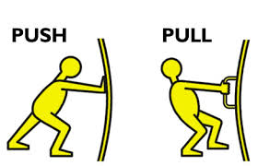
When stress exceeds support…..
Emotionally based school non-attendance occurs when
‘stress exceeds support, when risks are greater than resilience and when ‘pull’ factors that promote school non-attendance overcome the ‘push’ factors that encourage attendance’ (Thambirajah et all, 2008)
Push factors- factors that push a young person towards attending school
Pull factors – factors that pull a young person away from attending school.
North Ayrshire Council

Slide 37
One of the key drivers of EBSNA can be anxiety. Understanding how to support anxiety early on can help prevent escalation.
Notes:
For more information on supporting anxiety – see NA ‘Be Amasin’’ guidance and training – see link below.
https://blogs.glowscotland.org.uk/na/mhwbnac/mhwb-supports-resources/anxiety/new-resources-2022/

Slide 38
Ideas for intervention
Harness existing strengths and interests
Behavioural experiments to build confidence and resilience
Gradually increase duration or complexity of demand to build a sense of mastery
Rebalance high stress levels through regular relaxation, sensory breaks, calm starts.
Discuss and plan for situations that they find difficult – role play
Develop the CYPs understanding of their experience of anxiety and school.
Complete the ‘Ladder of Strength and Courage’ activity to empower them to see small manageable steps
Develop strategies to manage worries such as deep breathing techniques, mindfulness, and CBT
Explore social anxieties and develop insight into social interaction that they find
difficult.
Targeted support to develop key social communication and assertiveness skills.

Slide 39
Ideas for intervention
A ‘safe space’ to escape to when feeling overwhelmed
Access to catch up tutoring and pre-teaching (online or face to face) to build confidence
Complete a friendship audit to review friendship opportunities (e.g. Sociograms)
Support to identify positive aspects of school (e.g. favoured lessons/teachers)
Targeted support to reduce areas of particularly high anxiety
Support the CYP to prepare a script that they can use with other children about school return
RAG(Red, Amber, Green) the school environment to review hotspots and areas requiring support
Practical support to develop friendships e.g. Circle of Friends, Buddy systems, lunchtime clubs
Make a commitment to connection and belonging e.g. spend additional time welcoming back, video calls prior to transition, special jobs
Provision of a secondary attachment figure

Slide 40
Ideas for intervention
Give the child time to prepare for a return to school; getting back into sleep routines, trying on school uniform, etc.
Make use of ‘transitional objects’ that represent their parents/carers
Home-school projects which span across environments s
Establish calm routines with parent/Carer ahead of home –to-schooltransition
Try to increase the appeal of school e.g. utilise the child’s interests
A balanced ‘school day’ at home, education and wellbeing activities
Consider small amounts of contact with parent/carter throughout the day e.g. allowing phone calls home
Prioritise the child’s mental health and wellbeing needs, with a focus on rebuilding resilience
Provide a safe relationship in school and gradually increase trust and tolerance for time away from parents/carer
A strong focus on relational repair and reconnection

Slide 41
Discussion
What have you already been doing to support with the attendance in your school?
Given what you have heard – what else do you think might be useful going forward?
North Ayrshire Council

Slide 42
Some Conclusions
Attendance is a complex area that requires understanding of the causes underlying it and a variety of approaches to support it
There is already lots of good work going on within NA but sometimes we need to be creative in how we use our approaches to support the different aspects of attendance
It is important to listen to the voices of children and young people and their families to understand the solutions
A balance between having high expectations alongside having support is key
We need to interrogate our data to help us more clearly understand where the issues lie and use this to shape our solutions
North Ayrshire Council

