Slide 1
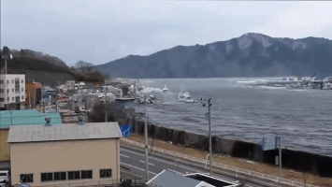
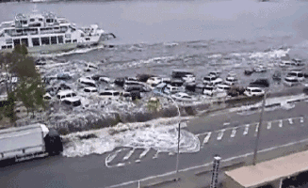
tsunamis
By Kerr and jack

Slide 2
What are tsunamis
tsunamis are ocean waves produced by under water landslides and also earthquakes lots of these tsunamis do lots of damage to buildings people and animals

Slide 3
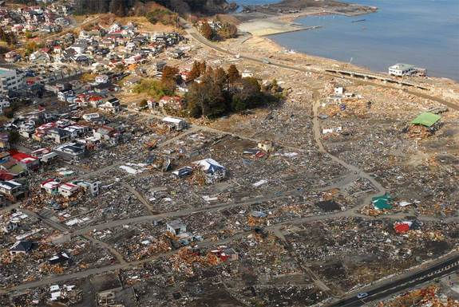
Japan Earthquake & Tsunami of 2011
On March,11th,2011a magnitude-9 earthquake shook north-eastern Japan unleashing a powerful tsunami that destroyed towns and anything in its way

Slide 4
What happens during a tsunami
Once the water is moved by an earthquake or other event, large waves like ripples spread out from the point where the water first moved

Slide 5
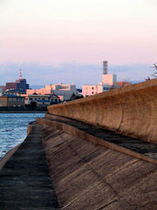
What measures can be taken to prevent a tsunami
Once a tsunami has been formed, there is no way to stop it; but with an effective warning system in place, people can be evacuated but in japan there tsunami walls but we don’t think it could do much

