Slide 1
Wildfires
By Isla and Vanessa

Slide 2
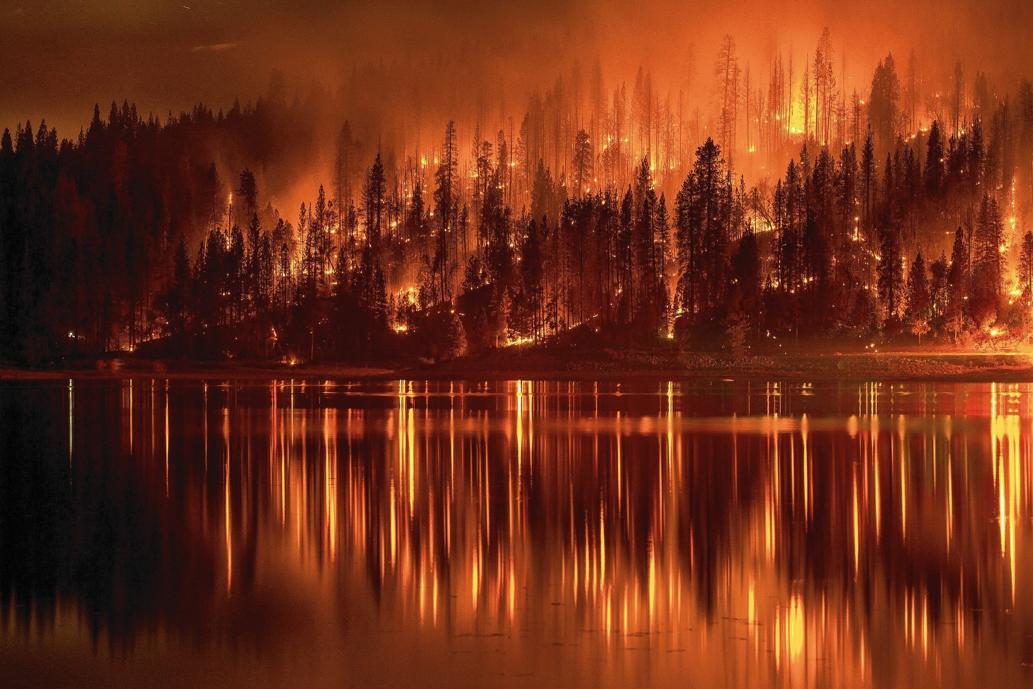
What is a Wildfire?
A wildfire is a large, destructive fire that spreads quickly over woodland or bush.

Slide 3
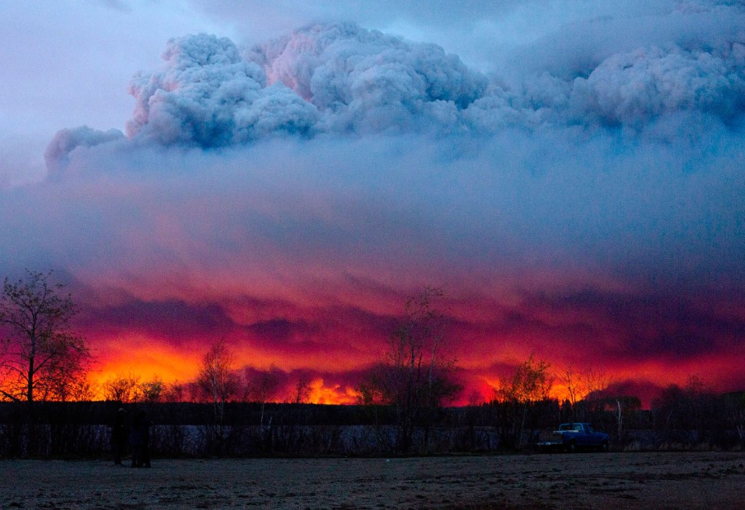
The Problems of Wildfires
The aftermath of wildfires, that it does indeed endanger animals and their habitat.
This destroys the vegetation for these animals to live.
In forests, wildfires can move as fast as 10.8 kilometres per hour.(6.7 mph)
In Grassland, they can move as fast as 22 kilometres per hour. (14mph)
A wildfire can reach to a maximum temperature of 800 degrees Celsius (1,470 degrees Fahrenheit)

Slide 4
What do Wildfires involve ?
Wildfires can destroy people’s homes, and their whole life could change – for the worse.
These wildfires are very hazardous, could injure people or even kill them.
The toxins in the flames can damage people’s internal organs. This can/could permanently scar them for the rest of their life.

