Slide 1
Heat wave
By Lewis graham

Slide 2
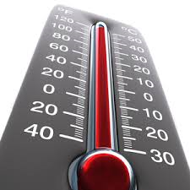
What is a heat wave?
A heat wave is when the temperature rises dramatically in a short amount of time such as one/two days.
As heat rises in earths atmosphere so does the chance of getting heat waves.

Slide 3
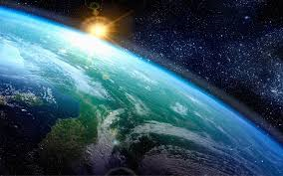
How are heat waves caused?
Heatwaves are caused by a system of higher atmospheric pressure. air from upper levels of the atmosphere descends and rotates out.

Slide 4
How often do heat waves occur?
Heatwaves are most common in summer when high pressure develops across an area.

