Slide 1
Flooding

Slide 2
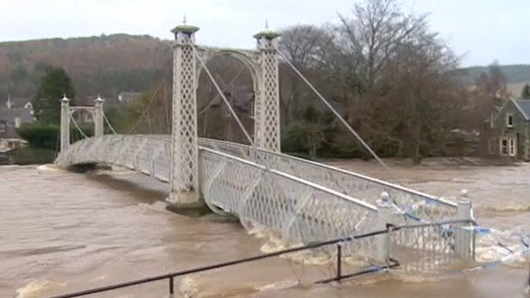
Flooding
Flooding is where waterways and lakes flood and overflow onto roads and into towns and villages this can all occur very quickly without warning
http://www.chroniclelive.co.uk/news/north-east-news/flood-warning-river-tyne-northumberland-10652863

