Slide 1
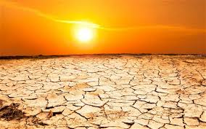
Drought
By Graham, Devon & Aaron

Slide 2
What is a drought?
A drought is a period of below-average precipitation in a given region.
Drought is an extended period of unusually dry weather when there is not enough rain.

Slide 3
How would you describe a drought?
Time of droughts can have significant environmental, agricultural, health, economic and social consequences. The effect varies according to vulnerability. For example, subsistence farmers are more likely to migrate during drought because they do not have alternative food sources.

Slide 4
What does a droughts involve?
The lack of precipitation can cause a variety of problems for local communities, including damage to crops and a shortage of drinking water.

Slide 5
Describe what causes a drought?
Lack of rain.
Global warming.
Lack of trees(deforestation) will cause drought as they have a great impact on the water cycle.(human factors).

Slide 6
Example of a drought
The 2000s drought in Australia, also known as the Millennium drought, is said by some to be the worst recorded since settlement. The year 2006 was the driest on record for many parts of the country. It started in 1995 and ended in 2009.

Slide 7
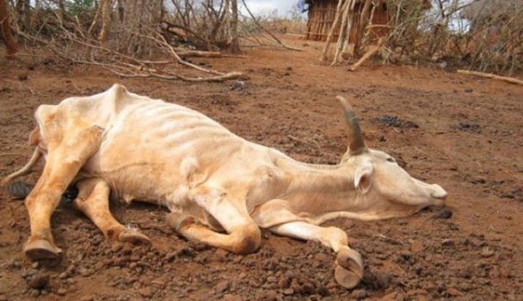
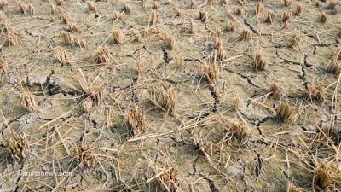
Describe how it effects wildlife
herbivores will die because of little vegetation and rain and drinking water,
therefore killing the animals. carnivores may be ok as the dead animals will provide food for scavengers

