Slide 1
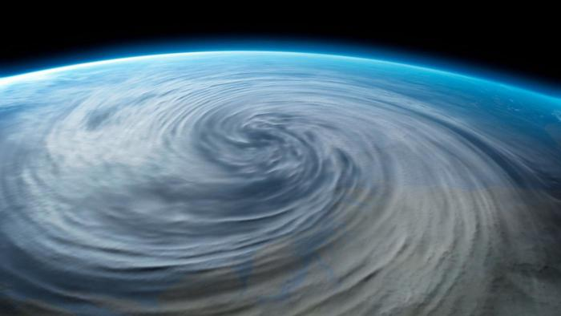
Cyclones
By
Robbie Kirk
Niamh Scott
Murron MacMillan

Slide 2
What Is A Cyclone
Cyclone refers to any spinning storm that rotates around a low-pressure center. The low-pressure center is also referred to as the 'eye' of the storm, which is well known for being eerily calm compared with the areas under the spinning 'arms' of the storm. You could say that the eye is watching what's going on down below, so it needs a clear path, but the arms are where all the action happens because this is where the storm is throwing out all of its rain and wind.
The approximately 80 tropical cyclones that occur throughout the globe each year cause billions of dollars in damage and kill about 10,000 people. However, in addition to the cost, there may be some economic benefits to be derived from tropical cyclones.

Slide 3
What do cyclones involve
Wind damage, not simply a function of the maximum sustained surface wind
Rainfall, associated with tropical cyclones is both beneficial and harmful. Although the rains contribute to the water needs of the areas traversed by the cyclone
Wind blowing across a stretch of open water creates waves on the surface of the water. The wave heights depend on a number of factors including the wind velocity, the length of time the wind has been blowing.

Slide 4
How its caused
- It is caused by a combination of strong winds driving water onshore and the lower atmospheric pressure in a tropical cyclone. In the southern hemisphere the onshore winds occur to the left of the tropical cyclone's path.

Slide 5
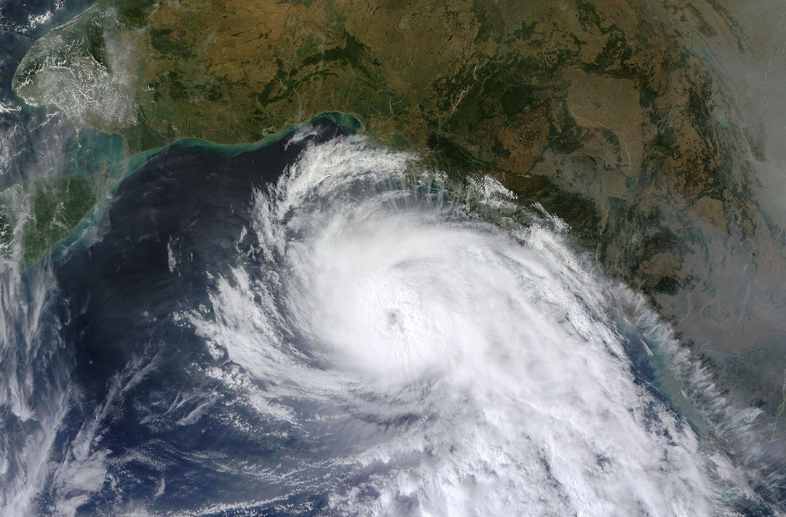
Cyclone has occured
in Tamil Nadu, 2013. a cyclone (madi) hit, with the lowest pressure (mbar) of 986. The 2013 North Indian Ocean cyclone season was an event in the annual cycle of tropical cyclone formation, in which tropical cyclones formed in the North Indian Ocean and Arabian Sea. The season had no official bounds, but cyclones typically formed between May and December, with the peak from October to November. These dates conventionally delimit the period of each year when most tropical cyclones form in the northern Indian Ocean.

