Slide 1
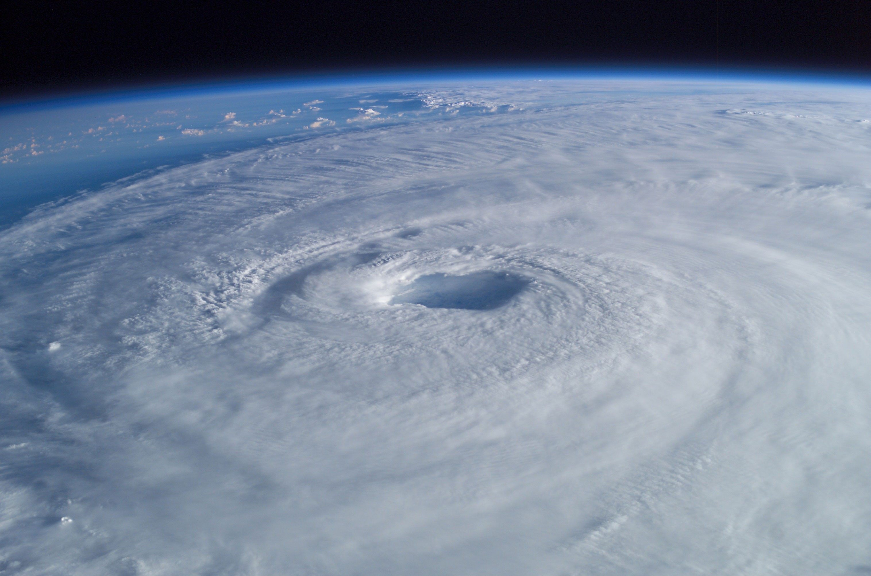
Cyclones
By Matthew Davidson

Slide 2
What are cyclones?
This is important when we're talking about ocean storms because the location of the storm determines what we call it. If the storm occurs in the Atlantic Ocean and Northeast Pacific, it's called a hurricane. If the exact same type of storm occurs in the Northwest Pacific, this is a typhoon. And if we find those same storms in the South Pacific and Indian Ocean, these are called tropical cyclones.

Slide 3
Where are they located
Tropical cyclones also occur in various parts of the Pacific Ocean, and can affect coastal regions of Mexico, south-east Asia, north-east Australia and the south Pacific islands.

Slide 4
What causes a cyclone?
The sources of a cyclones is the lukewarm oceans in the tropical regions. To initiate a tropical cyclone the sea surface temperature generally needs to be above 26.5C. However, existing cyclones often persist and move to other waters.

Slide 5
Facts about cyclones
A cyclone is an area of winds blowing in a circular motion , usually Centred on an area low pressure. They circle clockwise In the southern hemisphere, and anti-clockwise in the northern hemisphere.
Cyclones often have different names, depending on where they occur. In the north Atlantic ocean they are called hurricanes, and they are often are called typhoons.

Slide 6
Damages
When a cyclone hits it causes PST hazards. PST is an acronym standing for Primary, Secondary and Tertiary. A primary hazard involves destructive winds, debris and storm surge. Secondary hazard is flooding, fires and of course fresh water flooding. Finally Tertiary hazards involves food prices that go majorly up and other long term hazards like water poisoning.

Slide 7
The worst cyclone
Great Bhola Cyclone, Bangladesh was one of the worst the worst cyclone based on number of deaths. This cyclone was in the year of 1970 NOV 12 in the bay of Bengal. This cyclone was catastrophic for the area. 300,000 – 500,000 deaths were recorded which was the most death by cause of a cyclone.

Slide 8
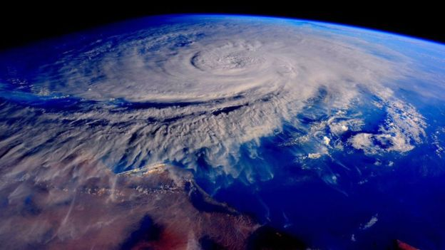
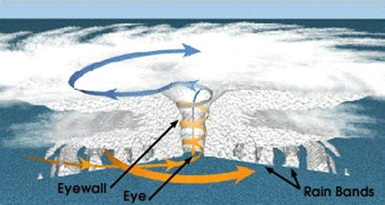
Pictures

