Slide 1
S3 INNOVATION
Sending signals

Slide 2
Starter – in your groups…
Apart from speaking give three examples of ways that information can be sent from one place to another
For each example, estimate how quickly the message can be sent
Suggest some advantages and disadvantages of each method

Slide 3
Lesson TITLE: sending signals
Learning Intention:
To learn about different ways in which signals can be sent and received
Activity: cable, wave and light communication demonstrations
Success Criteria:
All – will be able to give examples of how signals can be sent in different systems Most – will be able to explain what happens to information and energy at different stages in each example Some – will be able to give and explain some advantages and disadvantages of each example

Slide 4
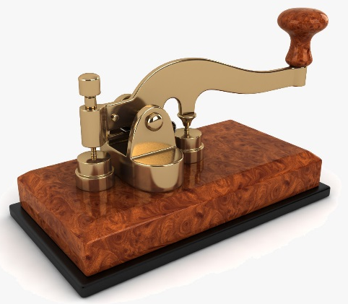
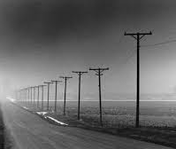
Sending signals in cables
The first long distance communication system was the TELEGRAPH
It used wires to carry electrical signals that were ‘ON’ or ‘OFF’
These were transmitted along wires using a special switch called a telegraph key

Slide 5
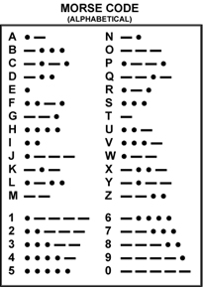
Sending signals in cables
Using the key to switch on and off quickly (dot) or slowly (dash) messages could be sent using MORSE CODE
Different letters are represented by different patterns of dots and dashes
E.g. SCIENCE =
•••, -•-•, ••, •, -•, -•-•, •

Slide 6
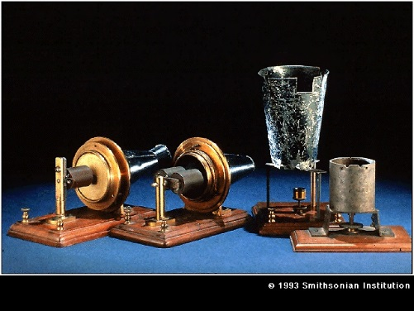
Sending signals in cables
In 1875 Alexander Graham Bell invented the telephone.
The mouthpiece contains a microphone, which converts SOUND into ELECTRICAL energy
The earpiece contains a loudspeaker which converts ELECTRICAL energy to SOUND

Slide 7
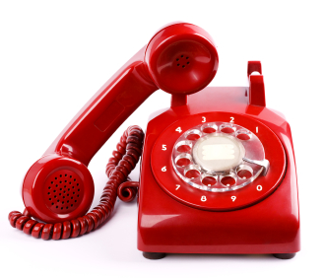
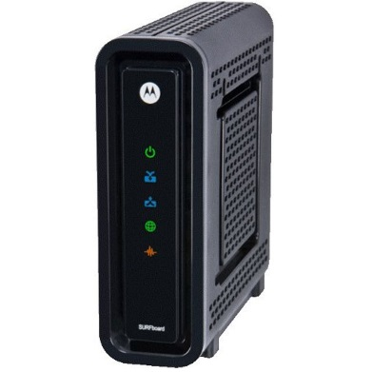
Sending signals in cables
Telephone cables can be used to carry many types of electrical signals – speech, text, images and data can all be sent by these methods
Signals in cables travel almost instantaneously – there is no delay in the message being received

Slide 8
Sending signals in cables
ADVANTAGES OF CABLES –
Simple and reliable technology
Easy to install and repair
DISADVANTAGES OF CABLES –
Copper is an expensive material
Signals can be affected by ‘interference’
Signals can be ‘tapped into’ – not always secure

Slide 9
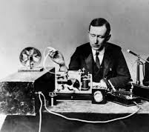
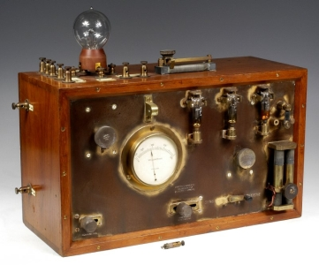
Sending signals by waves
In the early 1900s Guglielmo Marconi first used pulses of radio waves to transmit Morse code over a distance
Radio waves are part of the electromagnetic spectrum and travel at the speed of light (300,000,000 m/s)

Slide 10
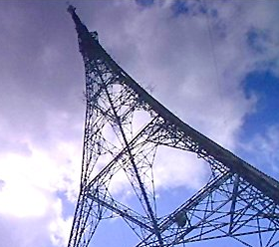
Sending signals by waves
Radio signals are produced by converting electrical signals in a TRANMITTER AERIAL
The waves travel in all directions from the transmitter and can be picked up by a RECEIVER AERIAL, where they are converted back into an electrical signal

Slide 11
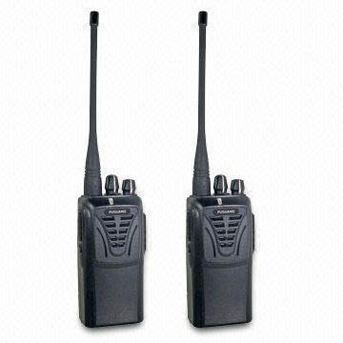
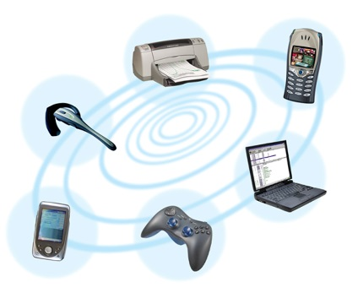
Sending signals by waves
Most radio signals are used for one-way communication – broadcasting
Walkie-talkies contain a transmitter and a receiver, so they can be used for two-way communication
TV, Bluetooth, and Wi-Fi all use radio waves to send and receive signals

Slide 12
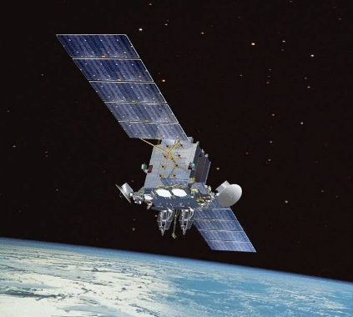
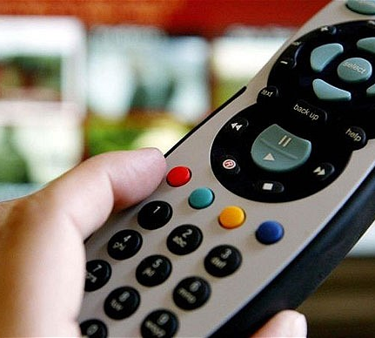
Sending signals by waves
Other types of electromagnetic waves can be used to send signals –
Mobile phones and satellite communication systems use MICROWAVES to carry signals
Most remote controls use INFRA-RED waves

Slide 13
Sending signals by waves
ADVANTAGES OF WAVES –
Signals can reach a very large audience (broadcast)
Can be used to carry many types of signals (radio, TV, etc)
DISADVANTAGES OF WAVES –
Range of signals can be limited (FM radio ~ 30 km)
Signals can be affected by weather, geography, interference

Slide 14
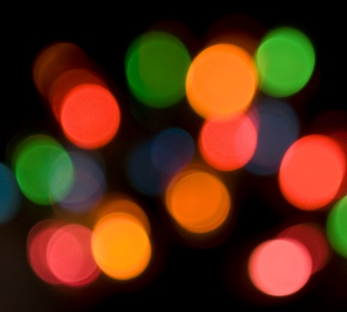
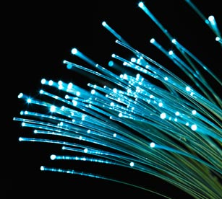
Sending signals by LIGHT
LIGHT is another type of electromagnetic wave and can be used to send signals
Often the light signals are carried in special cables made from glass – FIBRE OPTICS

Slide 15
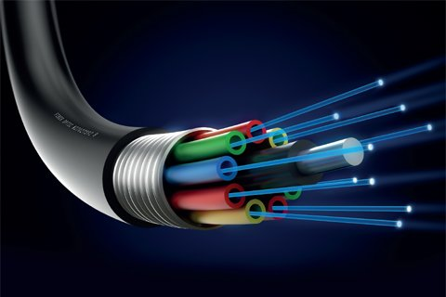
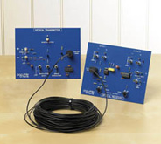
Sending signals by LIGHT
To send a signal along an fibre optic cable, it must be converted (usually from an electrical signal) into LIGHT energy
At the receiving end of the fibre, the light energy is converted back into an electrical signal

Slide 16
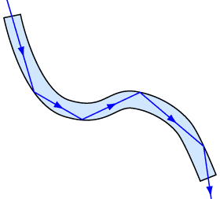
Sending signals by LIGHT
Light travels along a fibre optic cable by INTERNAL REFLECTION
Light travels slightly slower in glass, at around 200,000,000 m/s
A single fibre can carry many individual signals, using different colours of light

Slide 17
Sending signals by light
ADVANTAGES OF LIGHT –
Glass for making the fibre optic cable is very cheap
Very secure – can’t be ‘tapped into’
DISADVANTAGES OF WAVES –
Easily broken
Difficult & expensive to repair

