Slide 1
S3 INNOVATION
Sound & Audio ENGINEERING

Slide 2
Starter – in the next 2 minutes, find out…
In which decade was the first audio recording made?
Who made it?
What was is?
What technology was used to make the recording?
What technology could we use today?

Slide 3
In which decade was the first audio recording made?
1877
Who made it?
Thomas Edison (USA)
What was is?
‘Mary had a little lamb’
What technology was used to make the recording?
A phonograph – vibrations recorded onto a wax cylinder
What technology could we use today?

Slide 4
Lesson TITLE: Sound engineering
Learning Intention:
To use a software package to record and modify an audio signal
Activity: Using ‘Audacity’ PC audio software
Success Criteria:
All – will make a recording of their own voice Most – will be able to apply a simple effect of the audio file Some – will be able to apply more complex effects to the file

Slide 5
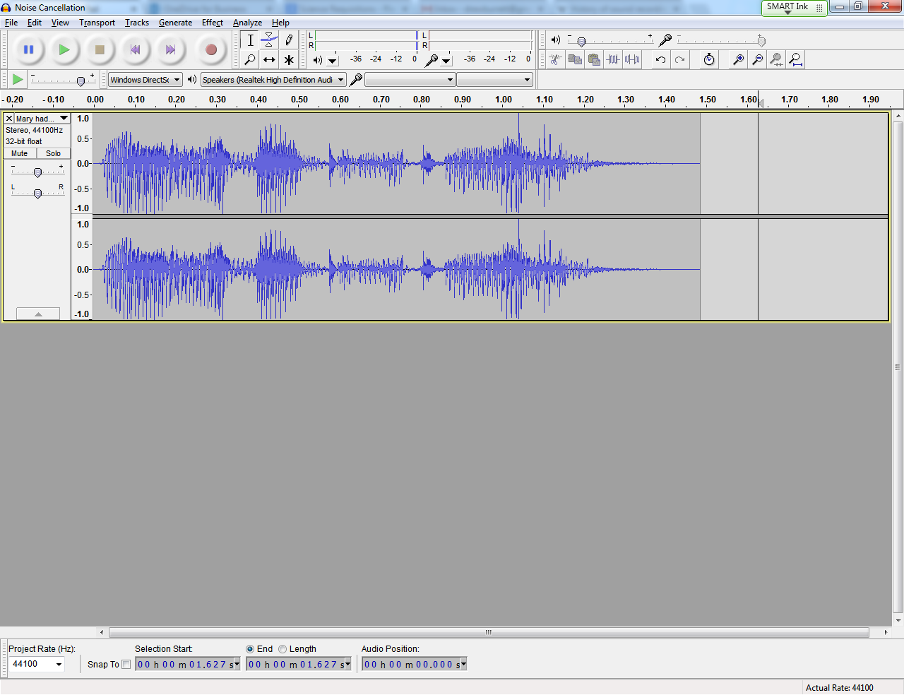
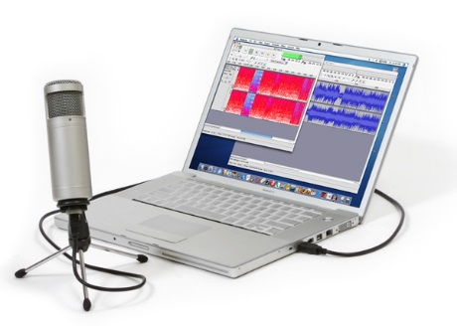
Recording sound - audacity
Using ‘Audacity’ audio software you can record a sound onto a PC via a microphone
When the sound has been recorded you can apply various effects

Slide 6
Recording sound - audacity
Working with a partner, record a short piece of speech and save this original sound.
Using the built in effects in Audacity, find out what changes happen when you –
Amplify
change pitch
change speed
Add echo

