Slide 1
S3 INNOVATION
Properties of Sound

Slide 2
Starter – recall & revise
In your groups, write down as many facts about sound as you are able to remember
Circle the ones you are CERTAIN about
Underline any that you don’t all agree upon

Slide 3
Lesson TITLE: properties of SOUND
Learning Intention:
To revise the properties of sound waves
Activity: View and analyse sound waves using an oscilloscope
Success Criteria:
All – Will be able to record the shapes of the sound waves observed Most – Will be able to link the properties of the wave trace with the properties of the sound heard Some – Will be able to predict and draw the shapes of sound waves depending on their properties

Slide 4
SOUND - revision
Sound is a form of energy
All sources of sound vibrate, producing waves which travel away from the source
Sound waves are carried by particles in the materials they pass through
Sound can travel through solids, liquids and gases, but not through a vacuum

Slide 5
SOUND - revision
Sounds have important properties –
Loudness (VOLUME) – loud sounds carry more energy
Pitch (FREQUENCY) – low pitch sounds have low frequency
Sound waves can be viewed using an OSCILLOSCOPE
The waves displayed on an oscilloscope change with –
Loudness (VOLUME) – height of the waves (amplitude)
Pitch (FREQUENCY) – spacing of the waves (period)

Slide 6
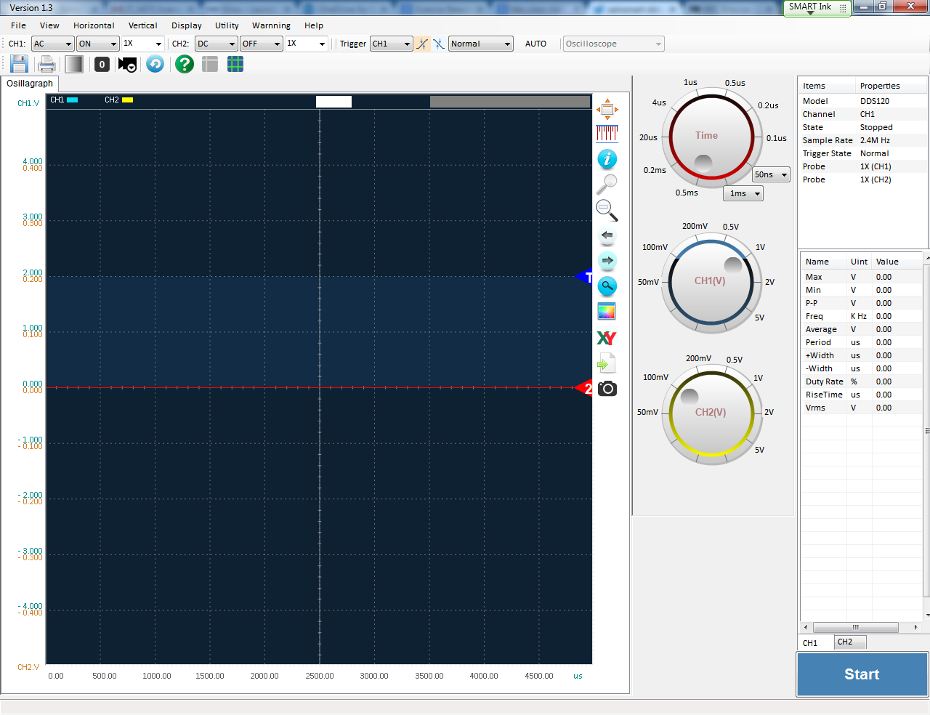
‘Seeing’ sound
The apparatus below can be used to view sound waves.
loudspeaker
signal generator
PC oscilloscope
PC

Slide 7
‘Seeing’ sound
The wave displayed on the oscilloscope has two important features –
Amplitude – height of the wave above & below the centre line – relates to the volume
Period – spacing between one wave and the next – relates to frequency
amplitude
period

Slide 8
‘Seeing’ sound
Changing the volume of a sound will change the amplitude –
LOUD sounds have a larger amplitude
QUIET sounds have a smaller amplitude

Slide 9
‘Seeing’ sound
Changing the frequency of a sound will change the period –
LOW sounds have a longer period (fewer waves on screen)
HIGH sounds have a shorter period (more waves on screen)

Slide 10
VIDEO LINKS
The relationship between vibrations and sound (1.38)
How does sound travel through a solid? (2.20)
How frequency and amplitude affect pitch and loudness respectively (1.17)

