Slide 1
S3 INNOVATION
Electronics

Slide 2
Lesson TITLE: Electronics
Learning Intention:
To use my knowledge of electronics and logic gates to invent and promote a product.
Activity: The Dragon’s Den
Success Criteria:
All – Use logic gates to invent a product Produce an advert for the product Some – Might be able to persuade your teacher to invest.

Slide 3
The Dragon’s Den

Slide 4
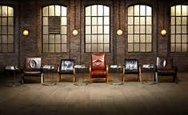
You must...
Create a product using at least one LOGIC gate.
You can use the INPUT/OUTPUT cards for inspiration.
You will design a poster to promote the product, and present to the class.

Slide 5
Things to try and include
Name/Branding
USP
Originality
Pricing
LOGIC (Truth table) and Block Diagram
Who your product is aimed at

