Slide 1
S3 INNOVATION
Electronics

Slide 2
Lesson TITLE: Electronics
Learning Intention:
Logic Gates
Activity: Using NOT and AND gates
Success Criteria:
All – Be able to describe how these logic gates work Most – Design a scenario where they could be used Some – Draw truth tables for these logic gates

Slide 4
Logic
In electronics many devices are DIGITAL.
This means they are either ON or OFF.
If it is ON, it is given the number 1, if it is OFF it is given the number 0.
0 = OFF 1 = ON

Slide 5
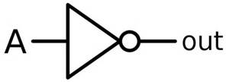
NOT gates
A NOT gate has only one input and one output. The output is always the opposite of its input.
Input | Output
0 1 | 1 0
A NOT gate is also called an inverter. NOT gates are often used in combination with other logic gates.

Slide 6
Example
Collect a circuit board, connect wires as shown.
What could this circuit be used for?

Slide 7
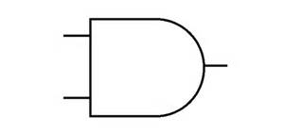
AND gate
An AND gate requires two inputs, but only has one output.
Both inputs must be ON for the output to be ON.
Input 1 | Input 2 | Output
0 | 0 | 0
0 | 1 | 0
1 | 0 | 0
1 | 1 | 1

Slide 8
Example
Collect a circuit board, connect wires as shown.
What could this circuit be used for?

Slide 9
Circuit Designer
Job 1 – Draw a block diagram, then make a circuit which turns a light on when it gets dark.
Job 2 – Draw a block diagram, then make a circuit which turns on when it is light, however can be turned off with a switch.

