Slide 1
Primary 7 Residential
March 20th-March 24th

Slide 2
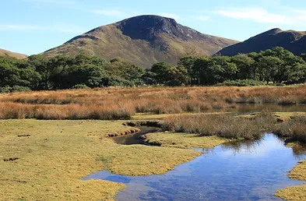
Where?
Lochranza Outdoor Centre
Group will be met at the ferry terminal and bused over to Lochranza by the Lochranza Centre team

Slide 3
Accommodation
Gender groupings
Mixture of 2/4/8 rooms
Children will be asked to nominate 2 people they wouldn’t mind sharing with
Majority of rooms are en-suite- a few rooms have a shared shower block

Slide 4
Food
Cooked breakfast
Packed lunch
Three course dinner
Choice of meals including vegetarian
Bring your own snacks
Well stocked gift shop

Slide 5
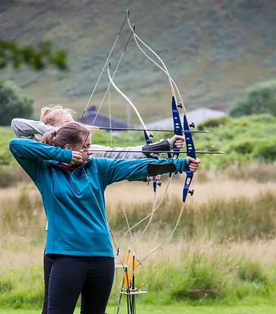
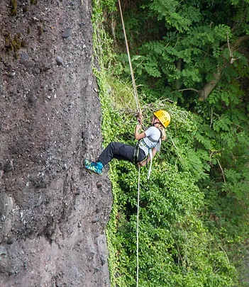
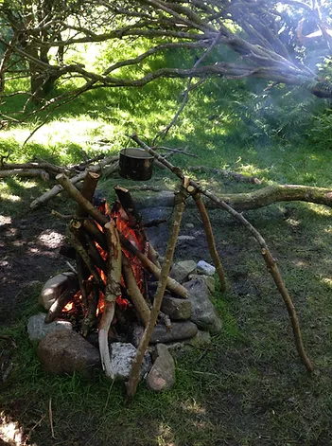
Activities
Ranging from beach walks to gorge walking

Slide 6
What to pack…not the kitchen sink!!
Old trainers + wellies
Waterproof jacket with a hood
Waterproof trousers- only if you have them
A rucksack for during the day to keep your packed lunch/snacks/water bottles
Several pairs of socks- not fancy- thick and durable
Outdoor trousers- not jeans- leggings/tracksuit bottoms
Thick jumpers/fleece
Hat + gloves
Waterbottle
Towel
Change of clothes for nightime
Pjs
Dry shoes- change of footwear for nightime
Underwear!
Washbag- soap/shampoo/toothbrush
Bin bag for wet and dirty items

Slide 7
What not to pack…

Slide 8
What happens if…

Slide 9
Children should arrive at school as normal with their luggage
any child with medication : medication should be handed to school staff in ziplock bag with child’s name on all medication
Parents can arrive at 11.30am to wave the children off
Bus leaves school @ 11.45am on Monday 20th March
12.30pm Ferry to Arran
Friday 24th 11.05am ferry home
Back at school by 12.30pm
Children can be picked up @ 12.30pm

Slide 10
Communication
Texts will be sent out via group call AM/PM
Children will update twitter daily with pictures
Should we need to speak with any parent directly school staff will make direct contact
No child should take mobile phone with them – this will be removed

Slide 11
What happens now?
Check we have all permission slips
Children will receive medical paperwork home- only return this if it is required
Children will be asked to nominate at least two people they would not mind sharing with

