Slide 1
Mathematicions
By jj and John paul

Slide 2
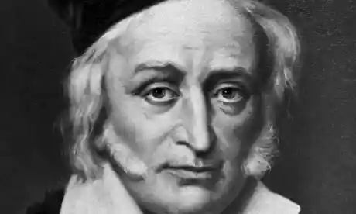
1. Where they where born
1. Alan turning was born 23 June 1912 . 2.Fibonacci was born November 23 1170. 3.Pythagoras was born about 570 bce It doesn't tell you what month. 4.Maurites cornelis was born 17 June 1898 . 5.James Maxwell was born 13 June 1831.

Slide 3
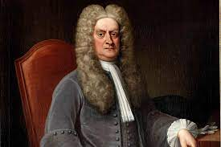
2.Events of there childhood
Jun 23, 1912. Born. Alan Matheson Turing was born on June 23, 1912 in Maida Vale, London.
Aug 19, 1926. Early Signs of Intelligence. ...
Aug 29, 1931. Getting Serious About Technology. ...
Sep 30, 1936. Studied at Princeton University. ...
Dec 6, 1939. Hut 8. ...
Mar 18, 1940. Bombe. ...
Nov 29, 1942. Travels to US. ...
Feb 19, 1946. Presented Paper

Slide 4
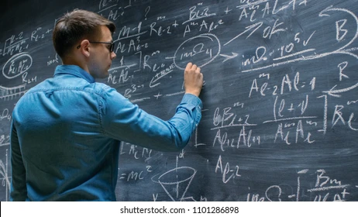
3.What made James Maxwell interested in mathematics
How did Maxwell come up with his equations?
The four modern Maxwell's equations can be found individually throughout his 1861 paper, derived theoretically using a molecular vortex model of Michael Faraday's "lines of force" and in conjunction with the experimental result of Weber and Kohlrausch.

Slide 5
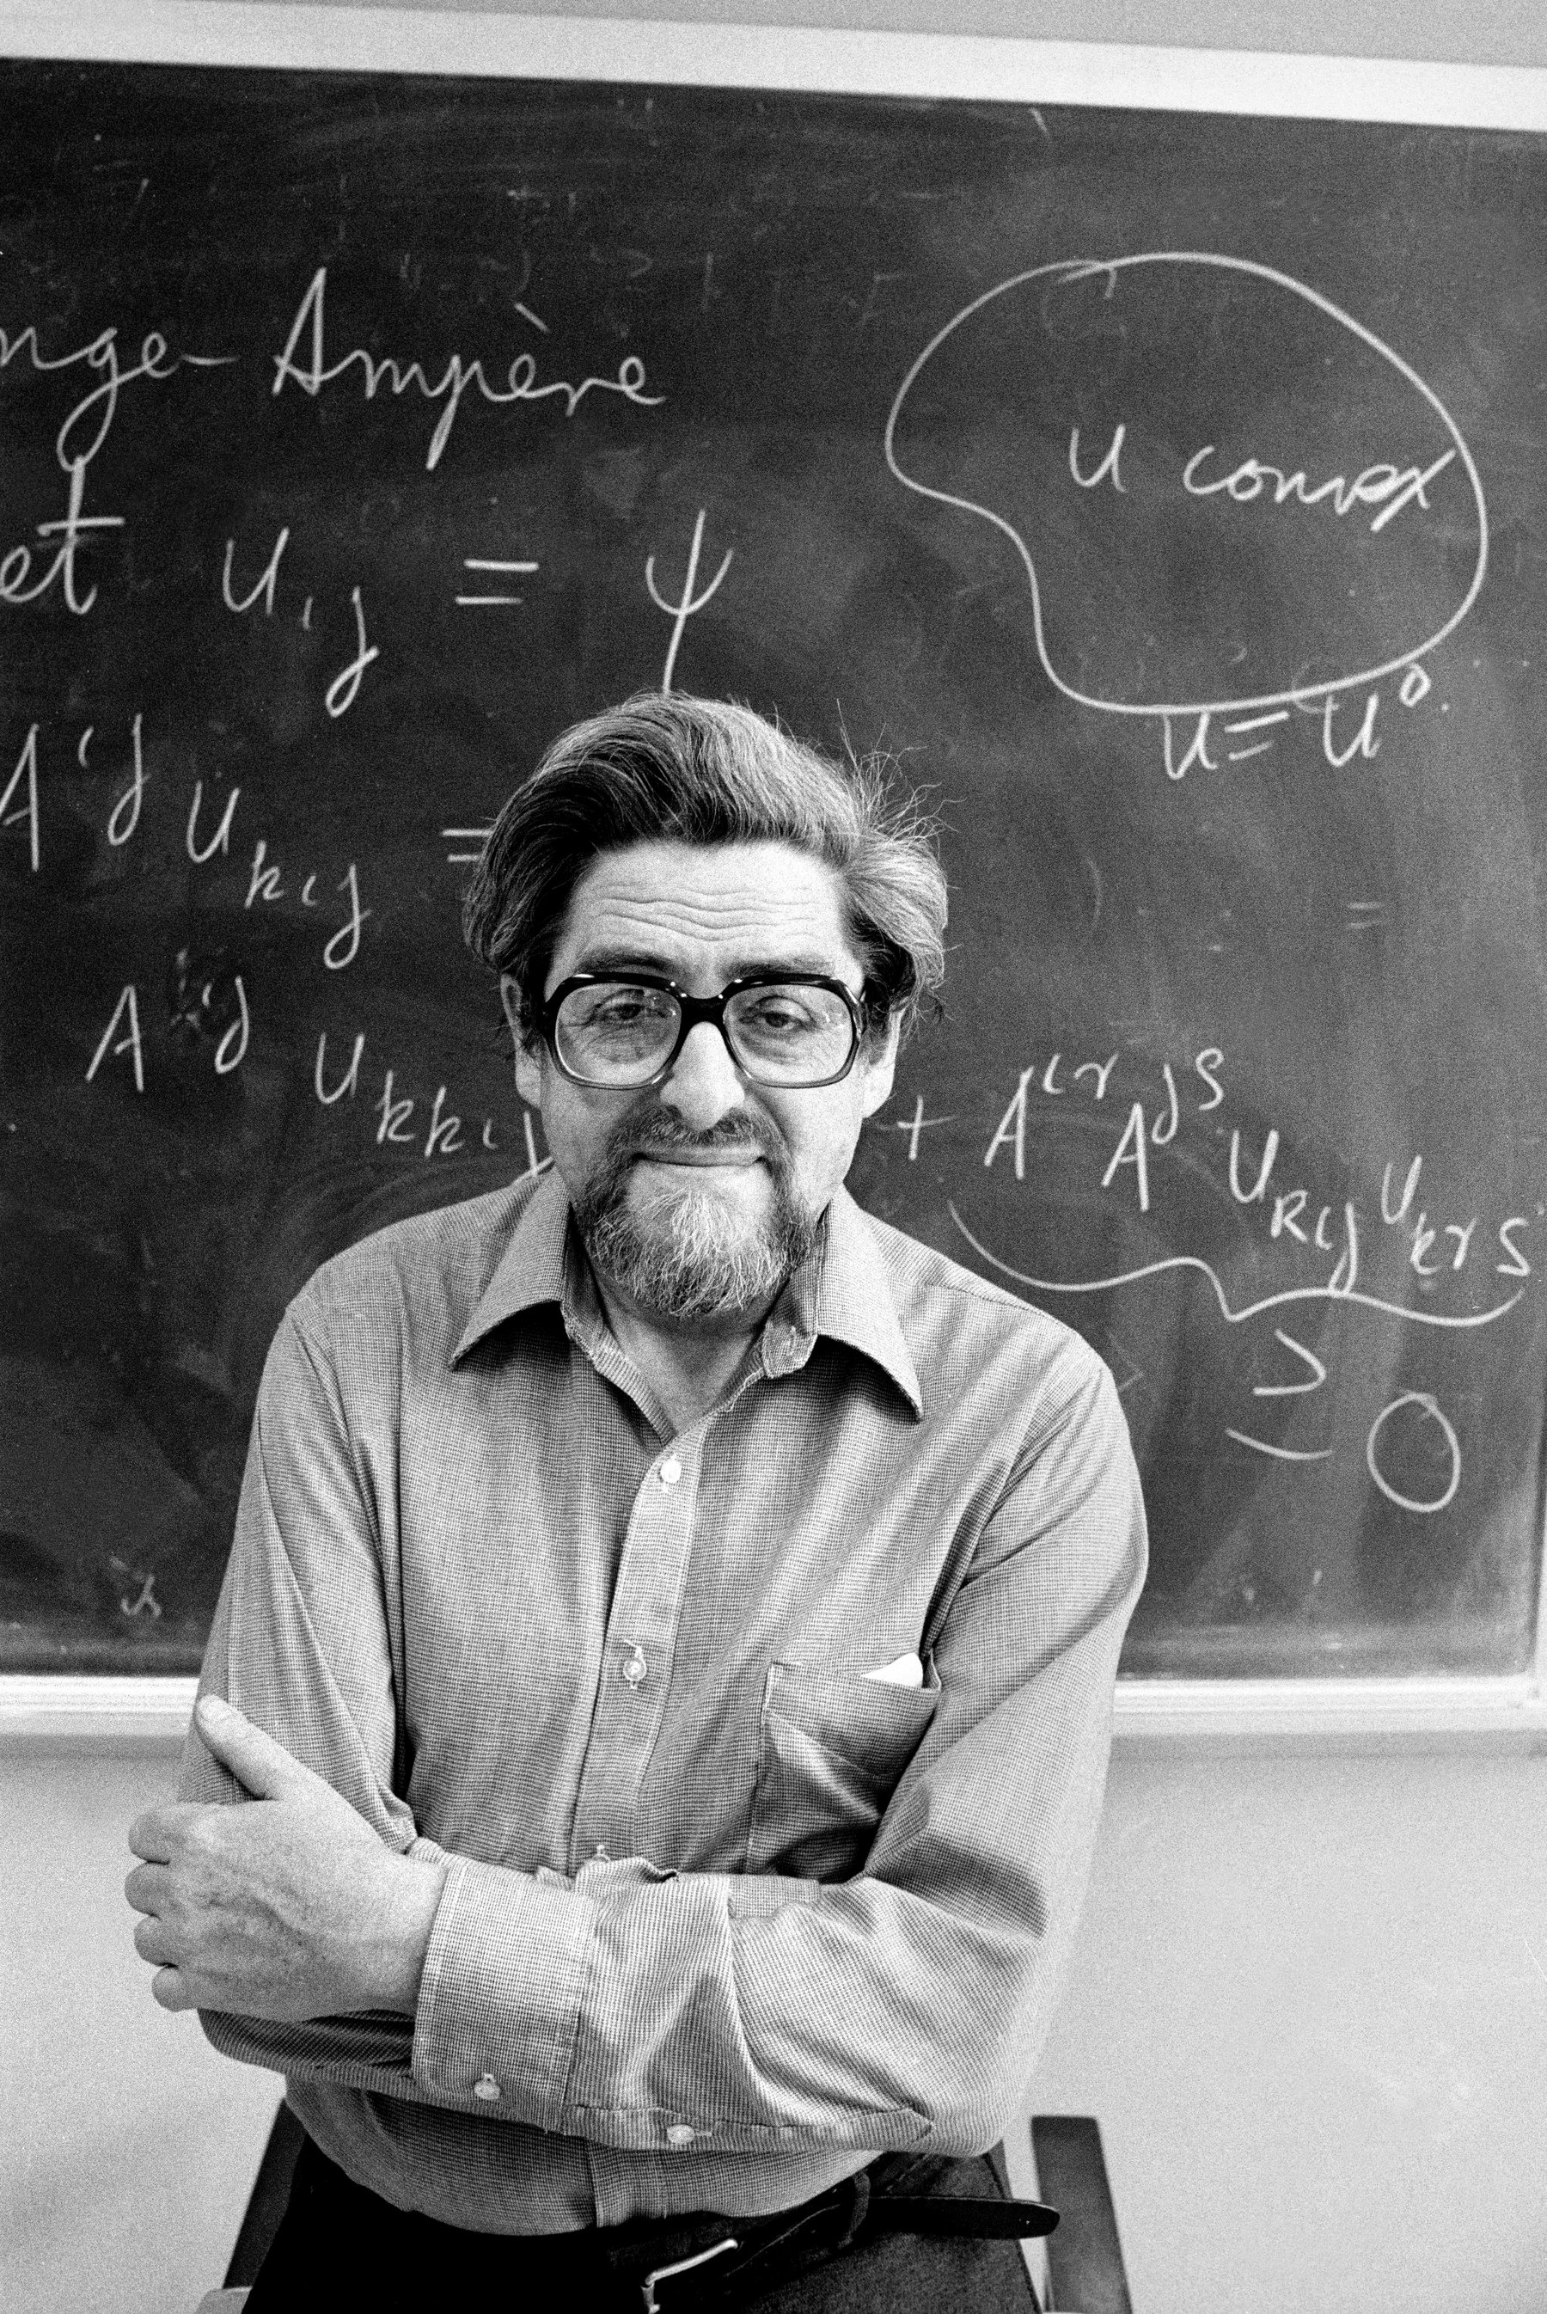
4. How did James Maxwell condibrut to maths
Maxwell was proved correct, and his quantitative connection between light and electromagnetism is considered one of the great accomplishments of 19th-century mathematical physics. Maxwell also introduced the concept of the electromagnetic field in comparison to force lines that Faraday described.

Slide 6
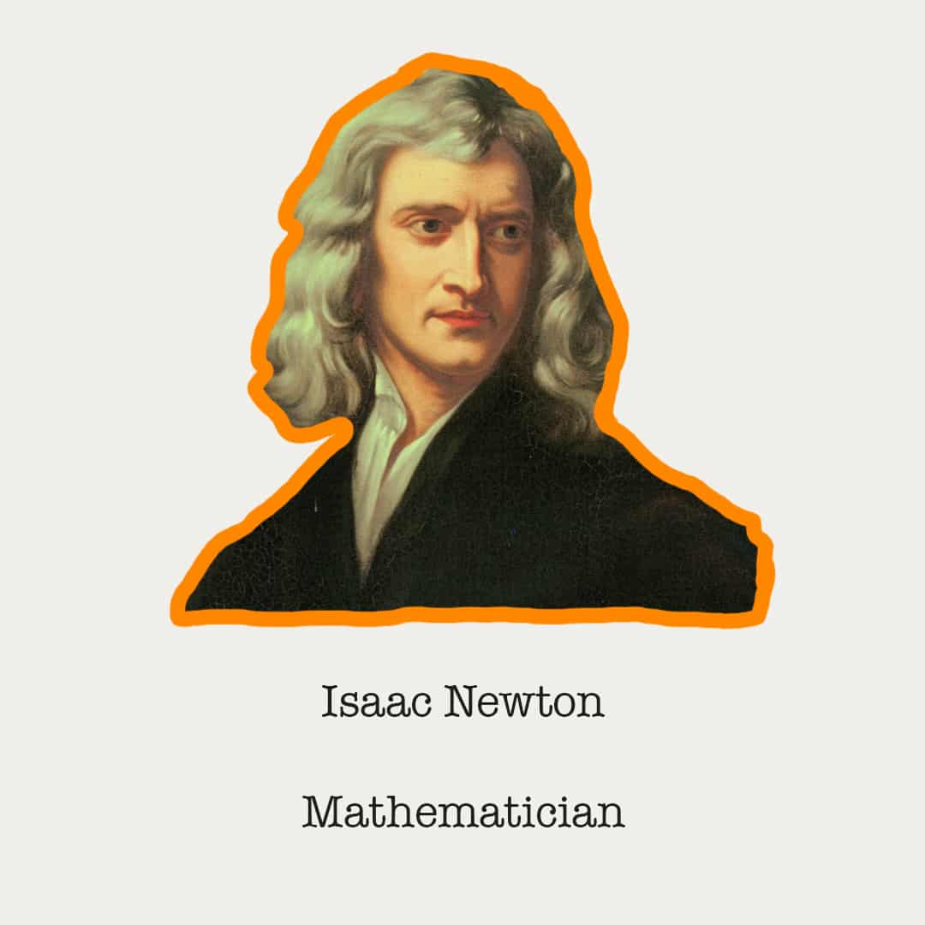
5.How James Maxwell they change world with math
Maxwell made fundamental contributions to the development of thermodynamics. He was also a founder of the kinetic theory of gases. This theory provided the new subject of statistical physics, linking thermodynamics and mechanics, and is still widely used as a model for rarefied gases and plasmas.

Slide 7
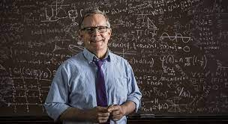
Thank you for listening to jj and John paul

