Slide 1
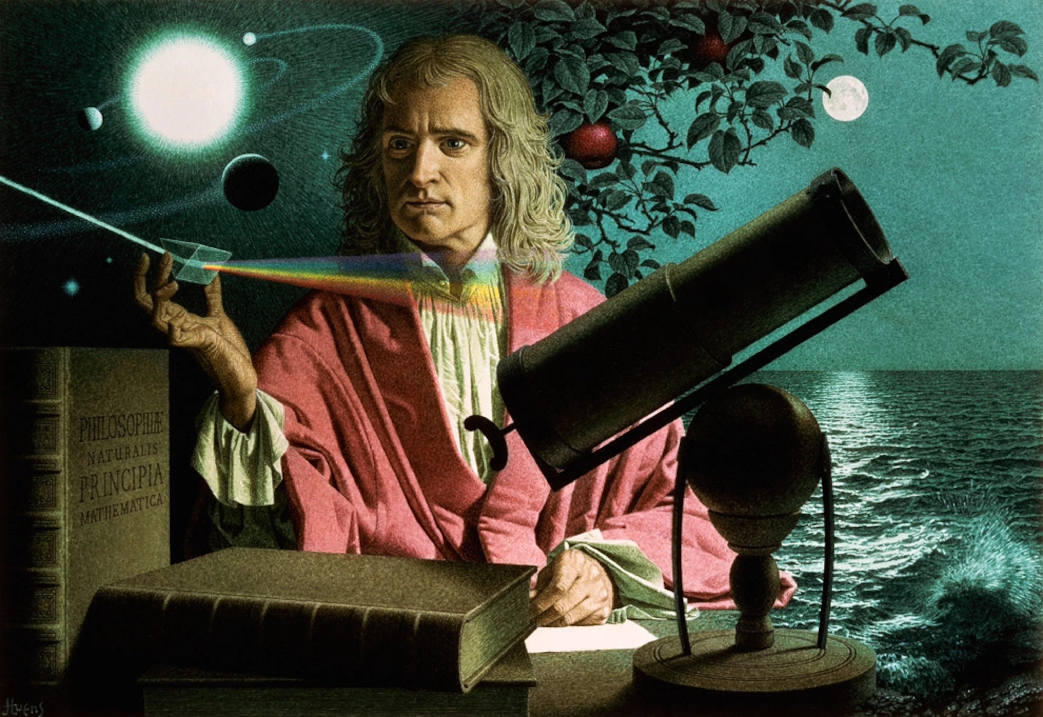
Isaac Newton
Isaac Newton

Slide 2
Isaac Newton's child hood?
Isaac Newton was born to a widowed mother (his father died three months prior) and was not expected to survive, being tiny and weak. Shortly thereafter Newton was sent by his stepfather, the well-to-do minister Barnabas Smith, to live with his grandmother and was separated from his mother until Smith's death in 1653.

Slide 3
Isaac Newton's inventions
Here are some of his inventions
Newton's Orbital Cannon.
Newtonian Cat Doors.
Laying Down the Three Laws of Motion.
Here are some more
Newton: Father of Calculus.
Newton and the Refraction of Light.
Newton and the Reflecting Telescope.
Newton Perfected Coinage.
Newton invented gravity.

Slide 4
Where his inspiration struck
Legend has it that, at this time, Newton experienced his famous inspiration of gravity with the falling apple. According to this common myth, Newton was sitting under an apple tree when a fruit fell and hit him on the head, inspiring him to suddenly come up with the theory of gravity.

Slide 5
Did Isaac newton have siblings
Isaac had 2 sisters and 1 brother
There names were.
Mary smith
Hannah Smith Pilkington
Benjamin Smith
Ps could not find a photo of his siblings so you can stare at his face for another slide

Slide 6
Random facts about Newton
Isaac Newton has two birthdays. ...
Isaac almost gave up on his education. ...
An apple never actually fell on his head. ...
Newton discovered a lot more than gravity. ...
Isaac has his own special 50p. ...
Newton never got married. ...
He died at age 84. ...
His dog once set his laboratory on fire.

Slide 7
THANKS FOR LISTINING TO OUR POWER POINT

