Slide 1
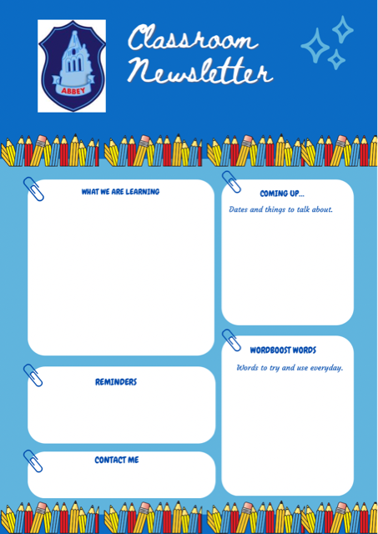
Primary 1M
Literacy:
Learning to hold a pencil correctly for writing and drawing.
Learning the ORT characters.
Listening and attention skills.
Numeracy and Maths:
Number formation.
Counting out and recognising numbers.
Shape
Health and Wellbeing:
Building class relationships and settling into Primary 1.
IDL:
Space and seasons
British wildlife
Maths week Scotland 26th September – 2nd October.
Roald Dahl Day 13th September.
European Languages day 26th September.
Library on a Monday
P.E. on a Monday.
Outdoor Learning day Thursday
Gobble
Howl
Trudge
Delicious
Celebrate
Reply
Investigate
enormous
Mrs Jacqueline Muir
Through the Seesaw App

