Slide 1
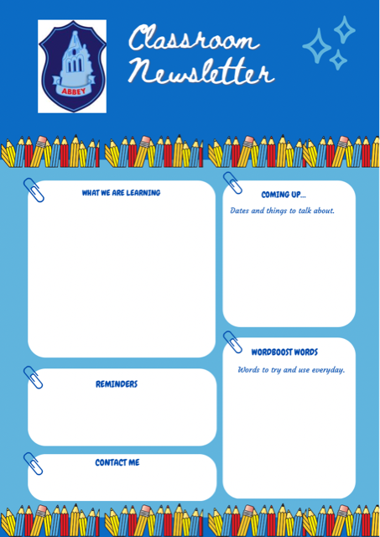
Primary 4M
Numeracy & Maths
= Information Handling
= Number processes
= Sequencing Numbers to 100
= Addition + Subtraction
Literacy
= Reading strategy: Prediction
= Reading with expression
= Ask + answer simple questions.
HWB
= Managing our Emotions
= Athletics/Ball Games
= P4M Kilwinning Library Visit – 22/9/22
= Roald Dahl Story day – 13/9/22
= P4M Twitter takeover -11/10/22
= Maths Week Scotland – 26/9/22 – 2/10/22
Monday – School library (Fortnightly)
Wednesday – Indoor P.E.
Thursday – Indoor P.E. & Outdoor Learning day
Preposterously
Tottered
Discarded
Poky
Tentatively
Contraption
Nouns, adjectives, verbs + adverbs.
Mrs R Maitland
gw09carruthrachel@ea.n-ayrshire.sch.uk

