Slide 1
WHAT’S GOING ON IN OUR WORLD?
Our focus in personal support this week is to concentrate on two very serious, current global events, and the impacts these events have had on people within those countries.
Throughout this week please think about what we as global citizens of the world can do to support those affected, and raise more awareness of these events.

Slide 2
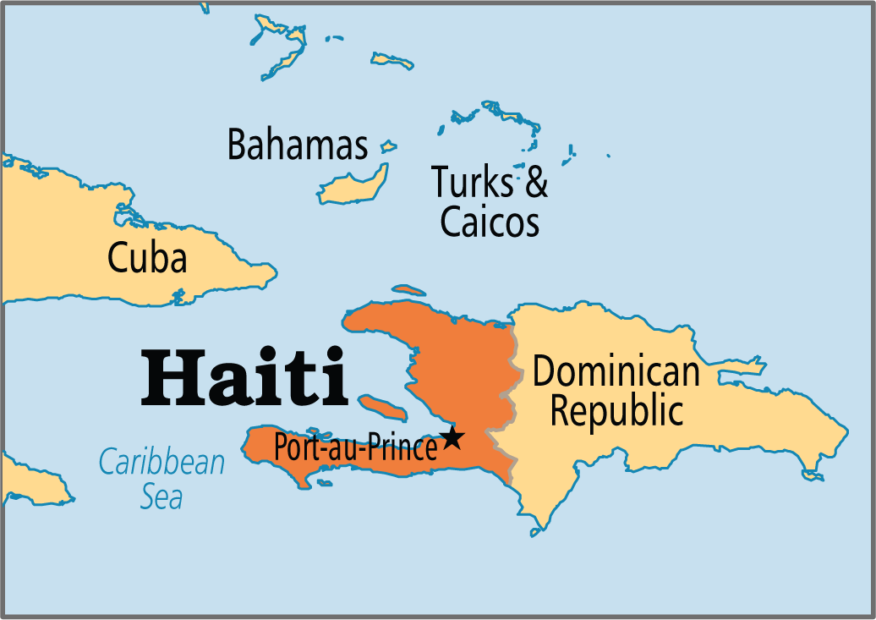
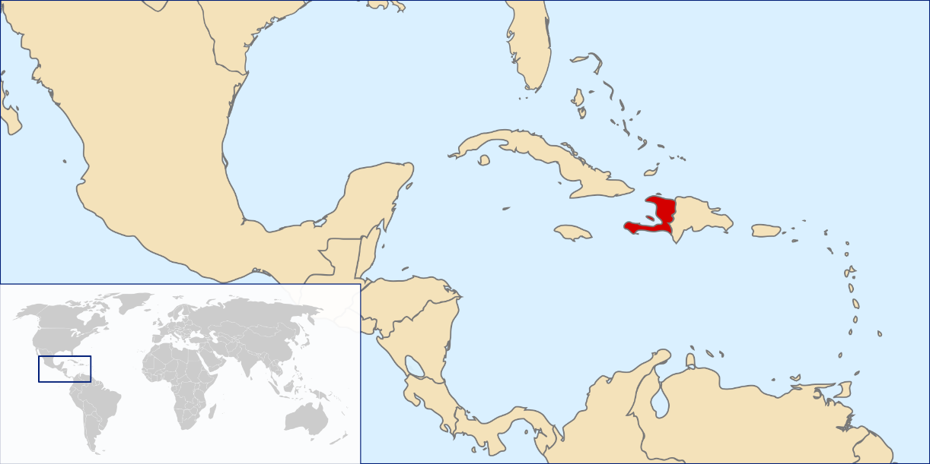
WORLD FOCUS ONE - HAITI
Haiti is a Caribbean country, which shares its border with the Dominican Republic.
It is also said to be the poorest country in the Western Hemisphere.
In 2010 Haiti was hit by a devastating earthquake which killed almost 300,ooo people, and left over millions homeless and living in temporary shelter.
Even 6 years later, one million people were still said to be living in camps.

Slide 3
HURRICANE MATTHEW
On 6th October, Haiti was hit very badly by Hurricane Matthew.
Hurricane Matthew was a category 4 hurricane meaning Haiti, particularly the south, was affected by winds of 145mph, as well as very heavy rain causing terrible floods and landslides.
Matthew was so severe that Haiti has had:
- many towns and villages completely destroyed – Jeremie in particular
- several towns and settlements completely cut off from help as roads have been swept away
- worst of all up to 1000 people are believed to have been killed as a

Slide 4
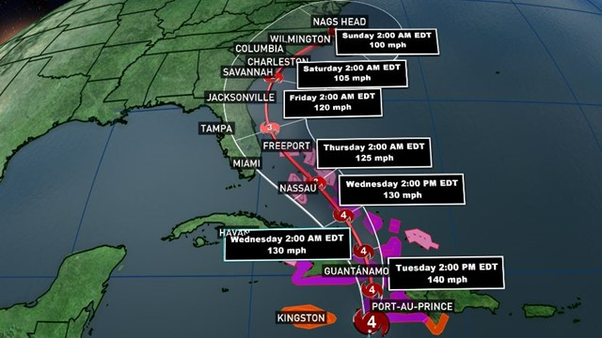
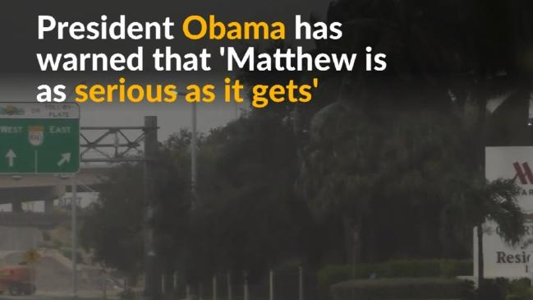
HURRICANE MATTHEW
At the time there was not a lot of information in the global media about the devastation in Haiti.
Hurricane Matthew was due to hit SW USA, therefore a lot of focus was given to the preparations in places like Florida and South Carolina.

Slide 5
HURRICANE MATTHEW
Although parts of the USA were quite badly affected by flooding and wind damage, the impact was nowhere near as bad as the effects on Haiti.
The impact of this hurricane, combined with the length of time it will take to recover will set the country back even further in its development.
Watch the following clips to see for yourself the devastation caused:
https://www.youtube.com/watch?v=kkEPJgp3ePg
https://www.youtube.com/watch?v=2MYBLxFbEQU

Slide 6
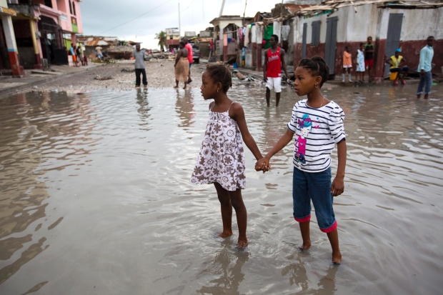
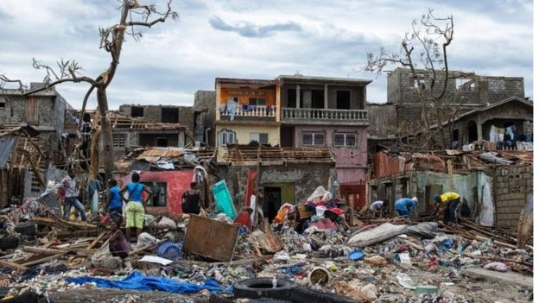
AFTERMATH OF HURRICANE MATTHEW
The destructive effects of Matthew have left 1.4 million people in Haiti in need of emergency aid.
Within six days of the disaster, 175,500 people had set up home in 224 temporary shelters.
However these shelters are said to lack enough food and clean water.

Slide 7
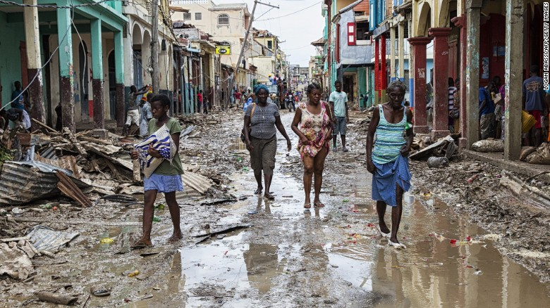
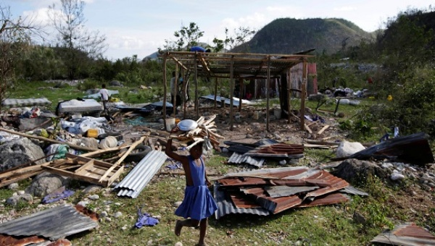
AFTERMATH OF HURRICANE MATTHEW
The nearly destroyed city of Jeremie was inaccessible for four days, with very little clean water and food available.
Blocked roads prevented aid getting through to people, and some of the more isolated parts of the country were cut off for two weeks.
The ongoing cholera outbreak in Haiti has worsened – 34 treatment centres have been washed away.

Slide 8
HELPING HAITI
People in Haiti are in urgent need of safe shelter, food and clean drinking water.
Large amounts of crops have been destroyed, which will affect not just food supplies, but also income. A long term supply of food will therefore be very important.
To protect people from the effects of cholera, people need cholera kits which contain soap, chlorine tablets and hygiene kits.

Slide 9
HOW CAN WE HELP?
Pupils can help by purchasing cake and candy at our Halloween cake and candy stall next Monday at interval. Some of this money will be donated to Oxfam’s Haiti Appeal.
Staff can come along to our coffee morning in the main staffroom this Friday at interval. £2 for a ticket (and a Kandy Bar cake!)
Let’s try to raise a good amount of money to help support those in most need.

