Slide 1
Antibullying Focus Week -Tuesday 15th Nov Period 1
Ambition – Respect - Excellence

Slide 2
Antibullying Focus Week -Tuesday 15th Nov Period 1
Ambition – Respect - Excellence

Slide 3
Antibullying Focus Week -Tuesday 15th Nov Period 2
Ambition – Respect - Excellence

Slide 4
Antibullying Focus Week -Tuesday 15th Nov Period 2
Ambition – Respect - Excellence

Slide 5
Antibullying Focus Week -Tuesday 15th Nov Period 3
Ambition – Respect - Excellence

Slide 6
Antibullying Focus Week -Tuesday 15th Nov Period 3
Ambition – Respect - Excellence

Slide 7
Antibullying Focus Week -Tuesday 15th Nov Period 4
Ambition – Respect - Excellence

Slide 8
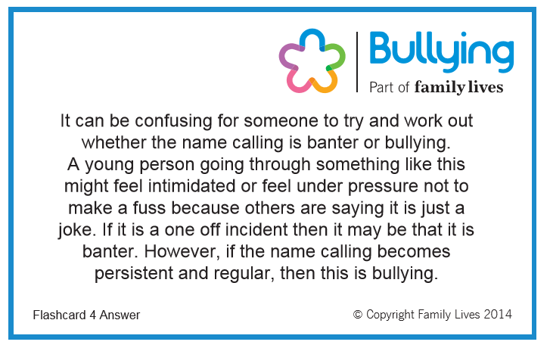
Antibullying Focus Week -Tuesday 15th Nov Period 4
Ambition – Respect - Excellence

Slide 9
Antibullying Focus Week -Tuesday 15th Nov Period 5
Ambition – Respect - Excellence

Slide 10
Antibullying Focus Week -Tuesday 15th Nov Period 5
Ambition – Respect - Excellence

Slide 11
Antibullying Focus Week -Tuesday 15th Nov Period 6
Ambition – Respect - Excellence

Slide 12
Antibullying Focus Week -Tuesday 15th Nov Period 6
Ambition – Respect - Excellence

Slide 13
Antibullying Focus Week -Tuesday 15th Nov Period 7
Ambition – Respect - Excellence

Slide 14
Antibullying Focus Week -Tuesday 15th Nov Period 7
Ambition – Respect - Excellence

Slide 15
Antibullying Focus Week -Wednesday 16th Nov Period 1
Ambition – Respect - Excellence

Slide 16
Antibullying Focus Week -Wednesday 16th Nov Period 1
Ambition – Respect - Excellence

Slide 17
Antibullying Focus Week -Wednesday 16th Nov Period 2
Ambition – Respect - Excellence

Slide 18
Antibullying Focus Week -Wednesday 16th Nov Period 2
Ambition – Respect - Excellence

Slide 19
Antibullying Focus Week -Wednesday 16th Nov Period 3
Ambition – Respect - Excellence

Slide 20
Antibullying Focus Week -Wednesday 16th Nov Period 3
Ambition – Respect - Excellence

Slide 21
Antibullying Focus Week -Wednesday 16th Nov Period 4
Ambition – Respect - Excellence

Slide 22
Antibullying Focus Week -Wednesday 16th Nov Period 4
Ambition – Respect - Excellence

Slide 23
Antibullying Focus Week -Wednesday 16th Nov Period 5
Ambition – Respect - Excellence

Slide 24
Antibullying Focus Week -Wednesday 16th Nov Period 5
Ambition – Respect - Excellence

Slide 25
Antibullying Focus Week -Wednesday 16th Nov Period 6
Ambition – Respect - Excellence

Slide 26
Antibullying Focus Week -Wednesday 16th Nov Period 6
Ambition – Respect - Excellence

Slide 27
Antibullying Focus Week - Thursday 17th Nov Period 1
Ambition – Respect - Excellence

Slide 28
Antibullying Focus Week - Thursday 17th Nov Period 1
Ambition – Respect - Excellence

