Slide 1
Anti-Bullying Week
15th – 18th November 2016
Ambition – Respect - Excellence

Slide 2
Bullying – what would you do?
Day 1
Watch this film, as a class decide on a course of action.
Spot it Stop it

Slide 3
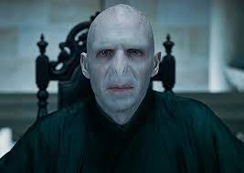
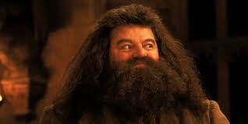
Fear or Respect
Day 2 – Task
Think of a character from a film, book or TV show that the other characters fear.
Write down why you think they are frightened of that character on a post it.
Think of a character from a film, book or TV show that the other characters respect.
Write down why you think they respect that character on a post it.

Slide 4
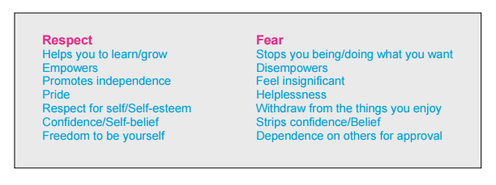
Fear or Respect
Fear and respect can be confused in relationships.
We can do things for people because we fear them.
We can also do things for people because we respect them.
It is important to spot the difference between fear and respect.

Slide 5
Bullying – what would you do?
Day 3
Watch this film again, after everything you have discussed this week, will you make a different choice?
Spot it Stop it

