Slide 1
Refugee Week
20-24th June 2016

Slide 2
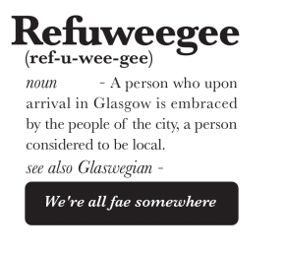
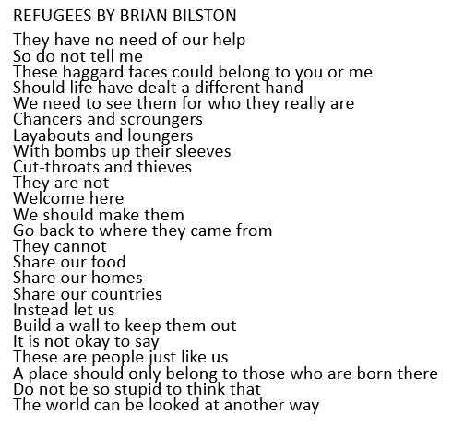
Refuweegee is a program set up in Glasgow to welcome refugees to the city.
Refugees are given a bag with essential items like toothpaste and soap when the arrive.
Each bag contains a letter or note written by a local welcoming them to Scotland.
Kind words are incredibly powerful – what would you write?

