Slide 1
Refugee Week
20-24th June 2016

Slide 2
What is a Refugee?
Are refugees the same as immigrants?
What is the difference?

Slide 3
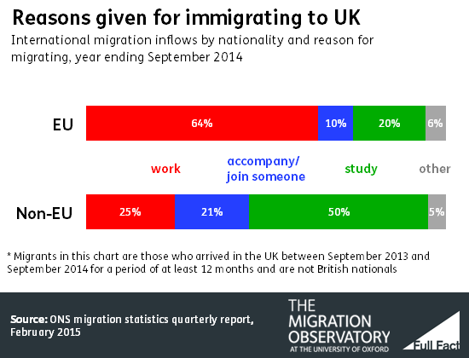
Why do people Migrate?
These figures from 2014 show that the main reasons people migrate to the UK is work and study.

Slide 4
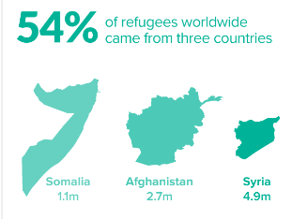
Why do People seek refuge?
Worldwide there are currently
Why do so many refugees come from these 3 countries?

Slide 5
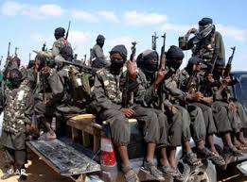
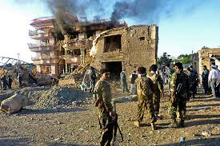
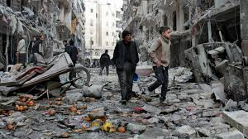
War is the main reason why people leave their homes and become refugees? They need refuge.

Slide 6
