Slide 1
Child Labour
13th-17th June 2016
Children and young people have the right to be protected from economic exploitation, and from work that would harm them - UNCRC article 32

Slide 2
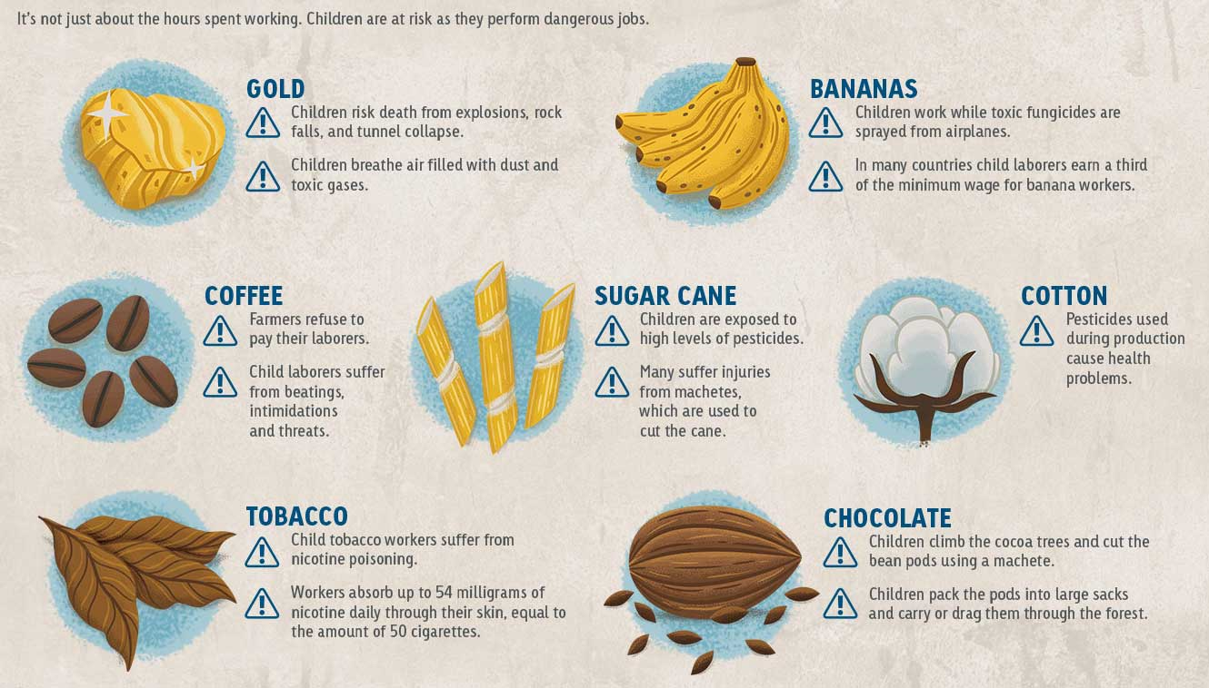
A short film
Click here
Here are some hazards associated with jobs that children are doing in some parts of the world
How can we discourage the use of Child Labour? What are your ideas?

