Slide 1
Child Labour UN Convention of the Rights of the Child (UNCRC)
13th-17th June 2016
Children and young people have the right to be protected from economic exploitation, and from work that would harm them - UNCRC article 32

Slide 2
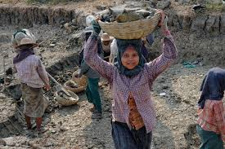
What does that mean?
Why is this important?
Economic exploitation means not being paid a fair amount for your work. It can also mean being made to work more hours than you are supposed to.
Harmful work is
anything hazardous;
anything that gets in the way of your education;
anything bad for your health or your physical, mental, spiritual, moral or social development.
Can you think of any examples?

Slide 3
Child Labour and the UK
Article 32 says the government must do everything they can to make sure you are protected from exploitation and harmful work. This includes:
Having rules for the age at which children are allowed to work;
Having rules about the hours children can work;
Having rules for the types of work children can do;
Punishing people who break these rules.
Do you know what age you have to be to have a job in Scotland?
In Scotland and the rest of the UK you have to be 13 to have a job.
Even then, you are only allowed to have a part-time job.
(models and actors can be younger)
Click here if you want to know more

Slide 4
Child labour and the UK
Children and young people are also protected from work that could harm them.
Includes working in factories and on farms
Anyone who breaks the rules on child labour faces a fine. In 2009, the maximum fine for most offences was £1,000. More serious breaches of the law, like employing a child in a dangerous job, could result in fines of £20,000 or even higher.
Do you think this is an appropriate way of punishing people who exploit children or make them do harmful work? Should we be stricter?

