Slide 1
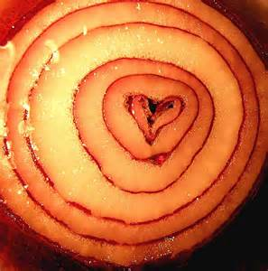
‘Valentine’
Carol Ann Duffy

Slide 2
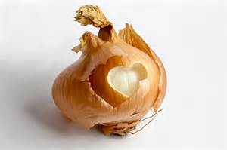
Overview
Duffy rejects traditional symbols of love, such as 'red roses' or 'satin hearts' in favour of 'an onion‘ to criticise conventional ideas and empty gestures of love. By doing this Duffy turns an ordinary object into an unusual symbol of love, and makes it seem a more appropriate symbol than traditional Valentine gifts by promising her lover, and the reader that her love is more original, honest and true.
Through the use of first person, the poet conveys the strength of feeling in the speaker in their desire for a relationship which is based on honesty.

Slide 3
This poem subverts conventional notions of romance and love in the attempt to depict a more honest appraisal of the challenges and risks of relationships.
The metaphor of the onion as “a moon wrapped in brown paper” is similar to the conceits used by the seventeenth century metaphysical poets.
A conceit is an unlikely comparison which aims to engage the reader’s attention and intellectual curiosity through the element of surprise.
In some times they controlled part or all of the structure of the poem. These were often found in sonnets, a form traditionally used for conventional love poems. Duffy has retained the conceit but has rejected the conventional form in favour of something more liberating.

Slide 4
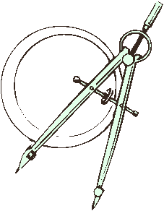
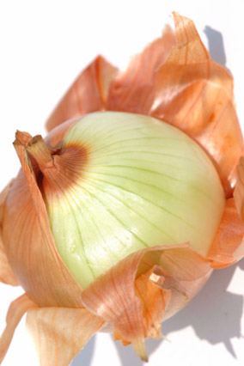
Consider these conceits which all have an aspect of love as the theme.
Two lovers and a compass A cruel boyfriend/ girlfriend and the ocean
Love and an oil change An onion and love
An onion and love

Slide 5
Form
Traditionally love poems are written in the form of the Sonnet. The Sonnet is the standard form and was used famously by Shakespeare. Duffy does not use this form and the form of the poem is irregular: the lines are of varied length and the rhymes come in unusual places to stress a particular word such as 'lethal'.
Duffy’s form
The poem is written in free verse using irregular stanzas to support its content and purpose, which is to reject traditional restrictive conventions such as marriage and other notions of love and to warn lovers that being overly possessive can have undesirable consequences. The words are often stark and monosyllabic to allow her to present her ideas clearly and unambiguously.

Slide 6
Narrative
Duffy creates a sense of an intimate conversation by using the words 'I' and 'you' as if her persona is talking personally to the reader.
By what other ways does Duffy make the poem sound like it is spoken to someone present?
She uses the present tense so that the incident she is describing appears to be unfolding as we read.
She uses minor sentences starting in the middle as if she is in a conversation with someone else – perhaps answering a question.
She uses the words “Here” and “Take it” as if passing something over to someone else present.

Slide 7
Discussion Questions
What is the significance of the conventional Valentine gifts in the poem? Why do you think Duffy rejects them?
In stanza 2, the poet uses the imagery of the moon. In detail, explain the effect of this comparison by considering the various connotations of the moon.
There are several instances of simple and minor sentences. What effect do you think Duffy is trying to achieve by using these?
How does Duffy suggest the emotional power of a lover in stanza three? In particular, consider the choice of the words “blind” and “grief”.
The poem hinges on the line almost at the poem’s centre: “I am trying to be truthful”. What truths does Duffy wish to communicate? Consider the use of the word “trying”.

Slide 8
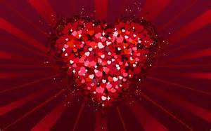
‘Valentine’
The poem’s title initially suggests that it will deal with the conventional notions of love. However, the traditional idea is subverted in the opening line: Not a red rose or a satin heart. and in line 12: Not a cute card or a kissogram.
By inserting a negative at the opening of these lines, the speaker is effectively dismissing traditional symbols of love and instead utilises the symbol of an onion to give her perceptions of the reality of love and relationships.

Slide 9
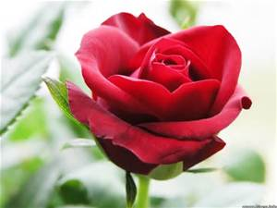
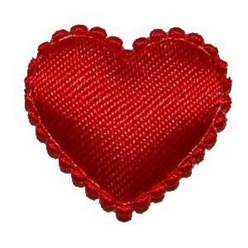
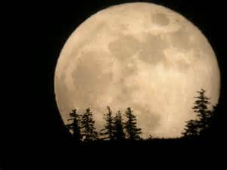
The speaker gives this gift to their lover and then feels the need to justify it and what it and she are offering.
Minor sentence as if we have joined the middle of a conversation between 2 lovers – intimate, are we imposing?
The “brown paper” refers both to the texture and colour of the outer layer of the onion as well as reminding us that real romantic gifts do not need to be embellished or concealed within expensive wrapping.
= a more romantic gift as she has put so much thought and care into offering something unique which represents love more honestly/ realistically than traditional notions.
Not a red rose or a satin heart. I give you an onion. It is a moon wrapped in brown paper. It promises light like the careful undressing of love.
Suggests contrast: reality of love vs. the conventional portrayal of love = the magical/mystical (moon) and the banality/ practicality of relationships (onion)
Light symbolises hope/openness/honesty that this relationship will have a bright future as it is real/aware of realities of r.ships and their difficulties/issues as well as their positives.
Simile = reference to the sexual aspect of their relationship, and also the growth of their emotional bond which the peeling away of clothes and layers of pretence/fallacy will reveal. The word careful suggests tenderness, affection, warmth and sensitivity between the lovers as they gradually allow external barriers to come down and expose their true selves to each other.

Slide 10
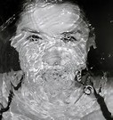
Harsh disclosure = further supported by this emphatic statement: attempting to justify all that has been said so far, and stresses again her need for honesty.
Through this frankness, the speaker is attempting to stress the significance of truthfulness.
Before this line, the speaker had described their love in mainly gentle terms to show the sincerity of their feelings, yet what follows is a change in tone to one which appears to be more brutal and threatening. She is telling her lover that the truth and she will cause pain but she is trying to be open and prepare lover for all they will experience.
Sounds desperate/pleading/ commanding? Maybe lover has shunned gift so she is again offering it to them. The use of the imperative commands (cf. ‘Take it’) further establishes the forceful character of the speaker. Focuses on the truth/the pain of love/relationships/honesty.
Absolutely certainty – ‘it will’ cause pain/tears – no shunning/hiding away from the reality. Almost gives her lover the choice – that if you accept this gift; you accept all that I am and all I will give you (including the hard times – ‘grief.’
‘blind’ – overwhelming/all consuming misery.
Here. It will blind you with tears like a lover. It will make your reflection a wobbling photo of grief. I am trying to be truthful.
‘trying’ maybe suggests she has struggled with honesty in the past and finds it difficult to speak the truth. Perhaps this has proven an issue in previous relationships and suggests how much she wants this one to succeed so is ‘trying’ something new which she admits to finding difficult.
‘wobbling’ = distortion. Pain so intense that it almost has a physical effect to warp/bend her reflection. Reflection = reflects exactly what it sees so represents that it will shake/distort lover’s very being with its power. Unsettling/worrying/frightening for prospective lover? ‘photo’ – suggests it is long lasting/cannot be forgotten.
New stanza creates a pause – almost like she has paused to read partner’s reaction and has seen their look of shock/distress and again needs to justify why she is presenting her views in this apparently negative manner.

Slide 11
Discussion Questions
Stanza six repeats the idea of the gift but changes its description to suggest the conflicting emotions experienced by lovers. Explain what, the poet is trying to convey about the nature of love.
How are Duffy’s ideas about the nature of love developed in stanza seven, in particular through the extended metaphor of the onion?
The line, “if you like” makes the important point that this is a choice. What pleasures and risks must the recipient of this gift consider before accepting it?
The final stanza contains a warning. What is the warning? Consider the contribution of word choice and sentence structure to its impact.

Slide 12
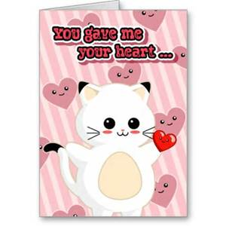
Rejection again of clichés of romance/love
Not a cute card or a kissogram. I give you an onion. Its fierce kiss will stay on your lips, possessive and faithful as we are, for as long as we are.
In the repetition of ‘I give you an onion’ (lines 2 + 13) the speaker emphasises the importance of this gift being accepted by their lover. Accepting the gift = accepting her and her love in its entirety.
Full stop slows down the rhythm. Speaker pauses to see how lover will react.
‘Fierce’ = + and – connotations. Possession/passion which again reiterates the contrasts in love/relationship between its preconceptions and realities (cf. moon/brown paper in stanza 2)
‘stay on your lips’ – long lasting or branding lover as their possession? Continued allusion to the senses through the taste of the onion which, just like some aspects of r.ships, is powerful, unpleasant and difficult to erase.
Pairs ‘possessive’ and ‘faithful’ together – almost paradoxical in nature to emphasise the 2 sides of their relationship/love will be present – jealousy/distrust/insecurity and connection/bond.
Use of the plural suggests both the speaker and the lover are possessive. Also suggests that she sees them as a nit which she is part of now and hopefully will be still in the future.
‘as long’ – almost a warning that infidelity = separation/end to relationship.
Suggests speaker’s fears or realism that relationship could end?

Slide 13
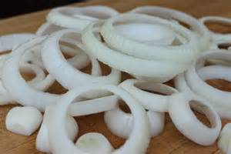
2nd proffering of gift followed by truthful statement of the implications once accepted. Full stop signifies tense wait to see if gift and speaker are wanted/accepted.
Take it. Its platinum loops shrink to a wedding-ring, if you like. Lethal. Its scent will cling to your fingers, cling to your knife.
‘shrink’ implies diminution. Suggests wedding ring is just an object – it doesn’t convey all that love is.
In a bad relationship, the ring may also become an unbearable constraint ‘shrink’.)
Imagery could suggest wedding ring = loss of individuality which is a part of marriage and requires adjustment from both.
Connotations of death/passion – suggests love offered will be intoxicating/overwhelming/intense.
Speaker’s view on marriage? Lethal?
Lethal to individuality?
Links to idea of intoxication. The scent from this relationship has positive connotations of the pleasant smell of perfume, echoing back to the fierce kiss, and reiterating the fact that the memory of a deep relationship may last, even long after it has ended (‘cling’.)
‘Cling’ also has connotations of a lingering embrace but is this desired? Entrapped by scent?
However, this is ultimately a choice – ‘if you like’. Also suggests that marriage is an option if the lover wishes for that in the future – speaker leaves the decision to them and does not push or harass them.

Slide 14
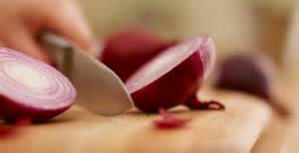
Person who holds the knife is in control/has the power over object being cut (physically or emotionally). Does this line suggest speaker’s recognition that the lover has all the control now? Knife suggests the threat/danger of this to the speaker. Will cause them pain if lover does not accept them especially after opening up to them.
Suggests where a love is difficult to forget, it may lead you into dangerous situations where the final outcome could be brutal and violent as suggested by the knife.
A knife can also slice through an onion just as honest language cuts through the facades/fallacies and reveals the truth.

Slide 15
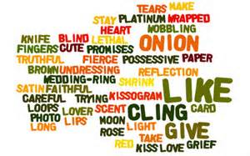
Themes
Complexity of relationships
Importance of truth/honesty
Importance of rejecting conventions
Conveys damaged or irreconcilable relationships? Or, suggests the reality?
Duffy ends on a warning note that love can be lethal (+ and – connotations), forcing the reader to confront the notion that a real love based on honesty and truthfulness can be painful and destructive at times as well as fulfilling and enriching.
Could also suggest that conventional relationships can often be restrictive to the individual (‘shrink’), while a love which is free from such constraints is worth pursuing.
Agree/Disagree? Discuss and be prepared to justify your stance on Duffy’s presentation of a relationship.

