Slide 1
Trojan Sofa
By Bernard MacLaverty

Slide 2
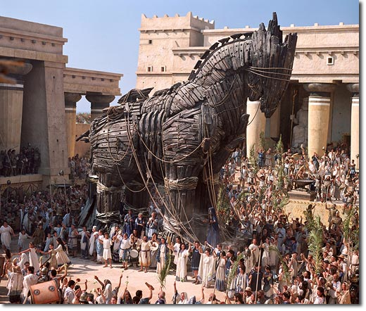
Themes
Trojan Sofa- Concealment and betrayal.
Setting of Ireland during conflicts used to evoke how innocence can be corrupted by conflict.
Prejudice.

Slide 3
Messages
Conflict can taint the innocence around it
Prejudice can be spread through lack of understanding.
Conflict = Bad

Slide 4
Niall
Childhood has been lost, forced into adult world prematurely.
Cannot form his own views and opinions, even his intelligence doesn’t let him break free.
Unaware that he is being indoctrinated by his fathers prejudices’.
Evokes dangers of not thinking for ourselves.
Irony that on escaping the house he runs to his father.

Slide 5
Father
Guiding his son into the wrong type of life by forcing his strong views onto son, misguiding and confusing him.
Father is robbing for himself and to make the protestants look like fools.
Appeals to son’s patriotism and approval.
Fails to recognize the complexity and over arching consequences of war.

Slide 6
Quote Bank
“And it’s one up for old Ireland.”
“Boo-hoo, lend me a hanky”
“Not be turning around in the foreseeable future.”
“I must say it is for Ireland”
“ ‘Ireland the Brave’ says Uncle Eamon from the sidelines”
“It’s a scream that scares the shit outa me”

Slide 7
“The last thing to go is the wee label”
“One side against the other”
The wrong done to this country was so great that we can do anything in retaliation.
“They squabble about the rules and fall out about everything.”

